Slide 1
M U R R A Y ' S E N G L I S H
Guess the Letter!
Look 👀 · Read 🔤 · Type 💬
DAY 1
murraycohen.com
Notes:
REBUILT: was open guessing (too hard for some letters). Now: picture + word-with-missing-letter + TWO letter choices, typed in chat. The cloze means they READ the rest of the word — decoding practice hiding inside a game.

Slide 2
DAY 1
GAME
How to play
👀 Look at the picture
🔤 Read the word — one letter is missing!
💬 Type 1 or 2 in the chat
Notes:
Demo with the first one (giraffe) together. Answer together the first 2-3 times until the routine clicks.

Slide 3

DAY 1
GAME
💬 TYPE 1 or 2 IN THE CHAT
__iraffe
1 g
2 q
Notes:
Answer: g (giraffe). Don't say the word! They read the cloze. After votes land in chat, ask one student: why g? Then advance.

Slide 4
DAY 1
GAME
✅ Super!
giraffe
Notes:
Muted choral: "g! giraffe!" twice. Then next letter.

Slide 5

DAY 1
GAME
💬 TYPE 1 or 2 IN THE CHAT
__pple
1 a
2 v
Notes:
Answer: a (apple). Don't say the word! They read the cloze. After votes land in chat, ask one student: why a? Then advance.

Slide 6
DAY 1
GAME
✅ Yes!
apple
Notes:
Muted choral: "a! apple!" twice. Then next letter.

Slide 7

DAY 1
GAME
💬 TYPE 1 or 2 IN THE CHAT
__ake
1 o
2 c
Notes:
Answer: c (cake). Don't say the word! They read the cloze. After votes land in chat, ask one student: why c? Then advance.

Slide 8
DAY 1
GAME
✅ You got it!
cake
Notes:
Muted choral: "c! cake!" twice. Then next letter.

Slide 9

DAY 1
GAME
💬 TYPE 1 or 2 IN THE CHAT
__an
1 f
2 e
Notes:
Answer: f (fan). Don't say the word! They read the cloze. After votes land in chat, ask one student: why f? Then advance.

Slide 10
DAY 1
GAME
✅ Super!
fan
Notes:
Muted choral: "f! fan!" twice. Then next letter.

Slide 11

DAY 1
GAME
💬 TYPE 1 or 2 IN THE CHAT
__gg
1 f
2 e
Notes:
Answer: e (egg). Don't say the word! They read the cloze. After votes land in chat, ask one student: why e? Then advance.

Slide 12
DAY 1
GAME
✅ You got it!
egg
Notes:
Muted choral: "e! egg!" twice. Then next letter.

Slide 13

DAY 1
GAME
💬 TYPE 1 or 2 IN THE CHAT
__all
1 r
2 b
Notes:
Answer: b (ball). Don't say the word! They read the cloze. After votes land in chat, ask one student: why b? Then advance.

Slide 14
DAY 1
GAME
✅ You got it!
ball
Notes:
Muted choral: "b! ball!" twice. Then next letter.

Slide 15

DAY 1
GAME
💬 TYPE 1 or 2 IN THE CHAT
__at
1 n
2 h
Notes:
Answer: h (hat). Don't say the word! They read the cloze. After votes land in chat, ask one student: why h? Then advance.

Slide 16
DAY 1
GAME
✅ Yes!
hat
Notes:
Muted choral: "h! hat!" twice. Then next letter.

Slide 17

DAY 1
GAME
💬 TYPE 1 or 2 IN THE CHAT
__gloo
1 i
2 l
Notes:
Answer: i (igloo). Don't say the word! They read the cloze. After votes land in chat, ask one student: why i? Then advance.

Slide 18
DAY 1
GAME
✅ You got it!
igloo
Notes:
Muted choral: "i! igloo!" twice. Then next letter.

Slide 19

DAY 1
GAME
💬 TYPE 1 or 2 IN THE CHAT
__am
1 i
2 j
Notes:
Answer: j (jam). Don't say the word! They read the cloze. After votes land in chat, ask one student: why j? Then advance.

Slide 20
DAY 1
GAME
✅ Yes!
jam
Notes:
Muted choral: "j! jam!" twice. Then next letter.

Slide 21

DAY 1
GAME
💬 TYPE 1 or 2 IN THE CHAT
__oon
1 w
2 m
Notes:
Answer: m (moon). Don't say the word! They read the cloze. After votes land in chat, ask one student: why m? Then advance.

Slide 22
DAY 1
GAME
✅ Great ears!
moon
Notes:
Muted choral: "m! moon!" twice. Then next letter.

Slide 23

DAY 1
GAME
💬 TYPE 1 or 2 IN THE CHAT
__ite
1 x
2 k
Notes:
Answer: k (kite). Don't say the word! They read the cloze. After votes land in chat, ask one student: why k? Then advance.

Slide 24
DAY 1
GAME
✅ Super!
kite
Notes:
Muted choral: "k! kite!" twice. Then next letter.

Slide 25

DAY 1
GAME
💬 TYPE 1 or 2 IN THE CHAT
__eaf
1 l
2 t
Notes:
Answer: l (leaf). Don't say the word! They read the cloze. After votes land in chat, ask one student: why l? Then advance.

Slide 26
DAY 1
GAME
✅ You got it!
leaf
Notes:
Muted choral: "l! leaf!" twice. Then next letter.

Slide 27

DAY 1
GAME
💬 TYPE 1 or 2 IN THE CHAT
__range
1 q
2 o
Notes:
Answer: o (orange). Don't say the word! They read the cloze. After votes land in chat, ask one student: why o? Then advance.

Slide 28
DAY 1
GAME
✅ You got it!
orange
Notes:
Muted choral: "o! orange!" twice. Then next letter.

Slide 29

DAY 1
GAME
💬 TYPE 1 or 2 IN THE CHAT
__ig
1 r
2 p
Notes:
Answer: p (pig). Don't say the word! They read the cloze. After votes land in chat, ask one student: why p? Then advance.

Slide 30
DAY 1
GAME
✅ You got it!
pig
Notes:
Muted choral: "p! pig!" twice. Then next letter.

Slide 31
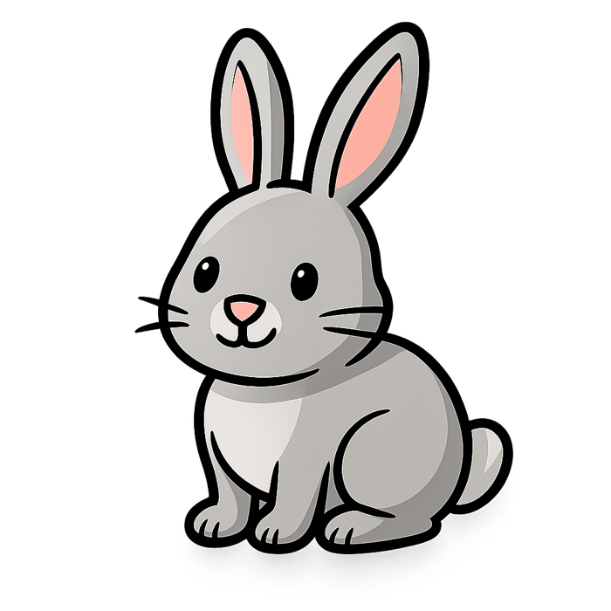
DAY 1
GAME
💬 TYPE 1 or 2 IN THE CHAT
__abbit
1 p
2 r
Notes:
Answer: r (rabbit). Don't say the word! They read the cloze. After votes land in chat, ask one student: why r? Then advance.

Slide 32
DAY 1
GAME
✅ Super!
rabbit
Notes:
Muted choral: "r! rabbit!" twice. Then next letter.

Slide 33

DAY 1
GAME
💬 TYPE 1 or 2 IN THE CHAT
__est
1 n
2 h
Notes:
Answer: n (nest). Don't say the word! They read the cloze. After votes land in chat, ask one student: why n? Then advance.

Slide 34
DAY 1
GAME
✅ Great ears!
nest
Notes:
Muted choral: "n! nest!" twice. Then next letter.

Slide 35
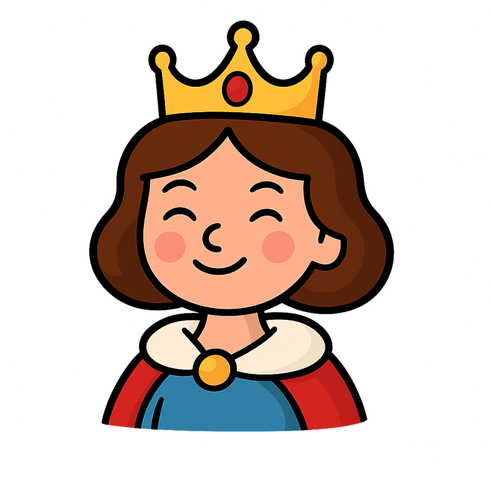
DAY 1
GAME
💬 TYPE 1 or 2 IN THE CHAT
__ueen
1 o
2 q
Notes:
Answer: q (queen). Don't say the word! They read the cloze. After votes land in chat, ask one student: why q? Then advance.

Slide 36
DAY 1
GAME
✅ Great ears!
queen
Notes:
Muted choral: "q! queen!" twice. Then next letter.

Slide 37

DAY 1
GAME
💬 TYPE 1 or 2 IN THE CHAT
__un
1 s
2 b
Notes:
Answer: s (sun). Don't say the word! They read the cloze. After votes land in chat, ask one student: why s? Then advance.

Slide 38
DAY 1
GAME
✅ Great ears!
sun
Notes:
Muted choral: "s! sun!" twice. Then next letter.

Slide 39

DAY 1
GAME
💬 TYPE 1 or 2 IN THE CHAT
__urtle
1 t
2 l
Notes:
Answer: t (turtle). Don't say the word! They read the cloze. After votes land in chat, ask one student: why t? Then advance.

Slide 40
DAY 1
GAME
✅ Great ears!
turtle
Notes:
Muted choral: "t! turtle!" twice. Then next letter.

Slide 41

DAY 1
GAME
💬 TYPE 1 or 2 IN THE CHAT
__mbrella
1 n
2 u
Notes:
Answer: u (umbrella). Don't say the word! They read the cloze. After votes land in chat, ask one student: why u? Then advance.

Slide 42
DAY 1
GAME
✅ You got it!
umbrella
Notes:
Muted choral: "u! umbrella!" twice. Then next letter.

Slide 43

DAY 1
GAME
💬 TYPE 1 or 2 IN THE CHAT
__an
1 y
2 v
Notes:
Answer: v (van). Don't say the word! They read the cloze. After votes land in chat, ask one student: why v? Then advance.

Slide 44
DAY 1
GAME
✅ Super!
van
Notes:
Muted choral: "v! van!" twice. Then next letter.

Slide 45

DAY 1
GAME
💬 TYPE 1 or 2 IN THE CHAT
__o-yo
1 y
2 v
Notes:
Answer: y (yo-yo). Don't say the word! They read the cloze. After votes land in chat, ask one student: why y? Then advance.

Slide 46
DAY 1
GAME
✅ Great ears!
yo-yo
Notes:
Muted choral: "y! yo-yo!" twice. Then next letter.

Slide 47

DAY 1
GAME
💬 TYPE 1 or 2 IN THE CHAT
__atermelon
1 m
2 w
Notes:
Answer: w (watermelon). Don't say the word! They read the cloze. After votes land in chat, ask one student: why w? Then advance.

Slide 48
DAY 1
GAME
✅ You got it!
watermelon
Notes:
Muted choral: "w! watermelon!" twice. Then next letter.

Slide 49

DAY 1
GAME
💬 TYPE 1 or 2 IN THE CHAT
__-ray
1 x
2 k
Notes:
Answer: x (x-ray). Don't say the word! They read the cloze. After votes land in chat, ask one student: why x? Then advance.

Slide 50
DAY 1
GAME
✅ Yes!
x-ray
Notes:
Muted choral: "x! x-ray!" twice. Then next letter.

Slide 51
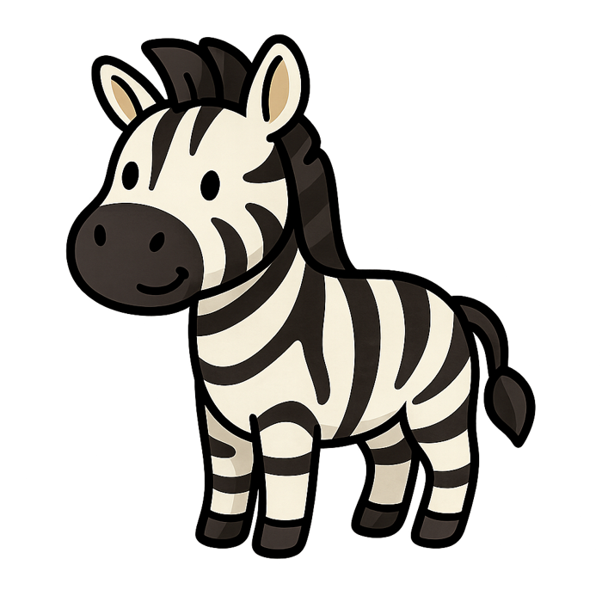
DAY 1
GAME
💬 TYPE 1 or 2 IN THE CHAT
__ebra
1 n
2 z
Notes:
Answer: z (zebra). Don't say the word! They read the cloze. After votes land in chat, ask one student: why z? Then advance.

Slide 52
DAY 1
GAME
✅ Yes!
zebra
Notes:
Muted choral: "z! zebra!" twice. Then next letter.

Slide 53

DAY 1
GAME
💬 TYPE 1 or 2 IN THE CHAT
__og
1 d
2 p
Notes:
Answer: d (dog). Don't say the word! They read the cloze. After votes land in chat, ask one student: why d? Then advance.

Slide 54
DAY 1
GAME
✅ Great ears!
dog
Notes:
Muted choral: "d! dog!" twice. Then next letter.

Slide 55
🏆 26 letters — you did it!

