Slide 1

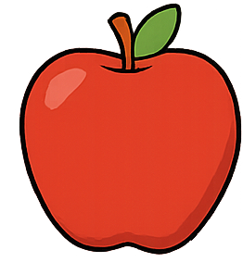
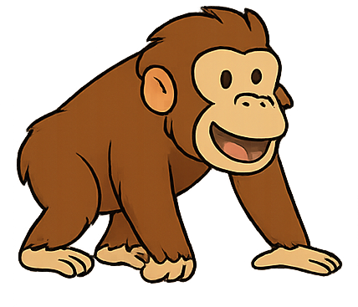
A
Every English Vowel
Has 2 Sounds
apple
ape

Slide 2
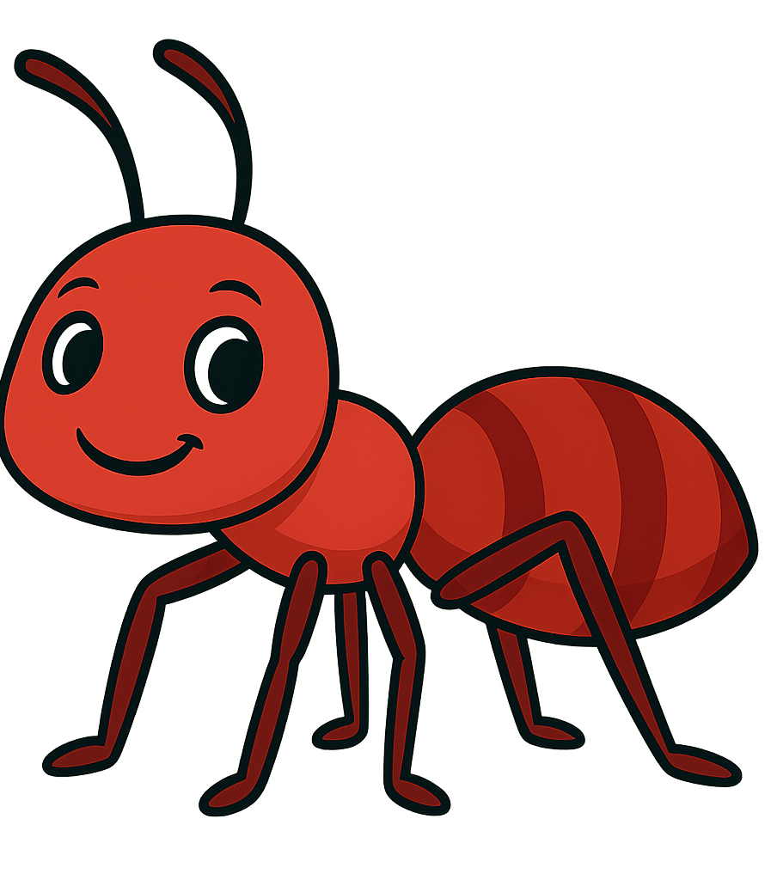

A
Every English Vowel
Has 2 Sounds
ant
acorn

Slide 3


A
Every English Vowel
Has 2 Sounds
axe
apron

Slide 4

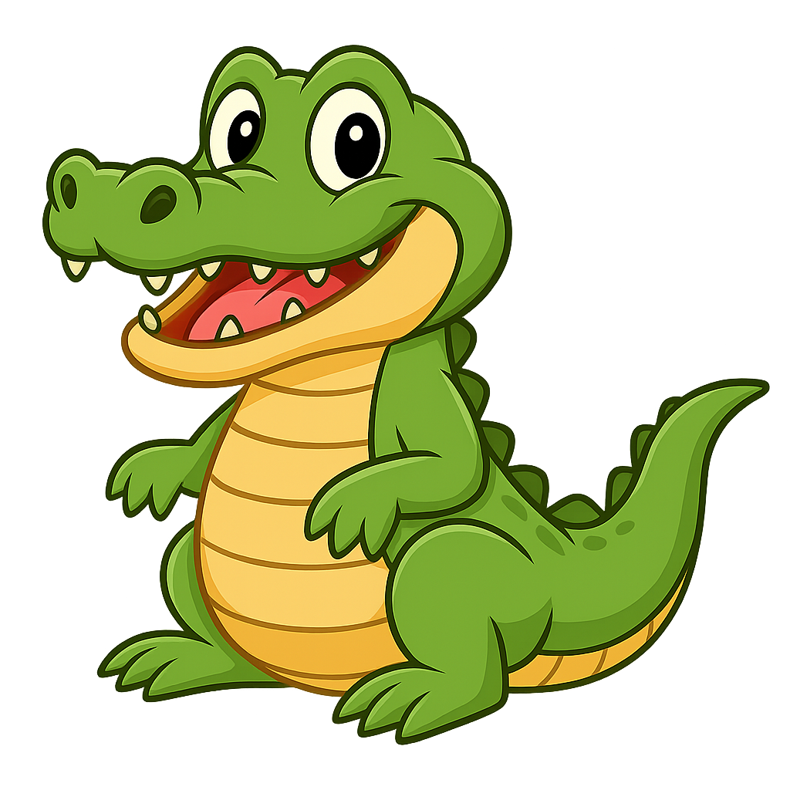
A
Every English Vowel
Has 2 Sounds
alligator
angel

Slide 5
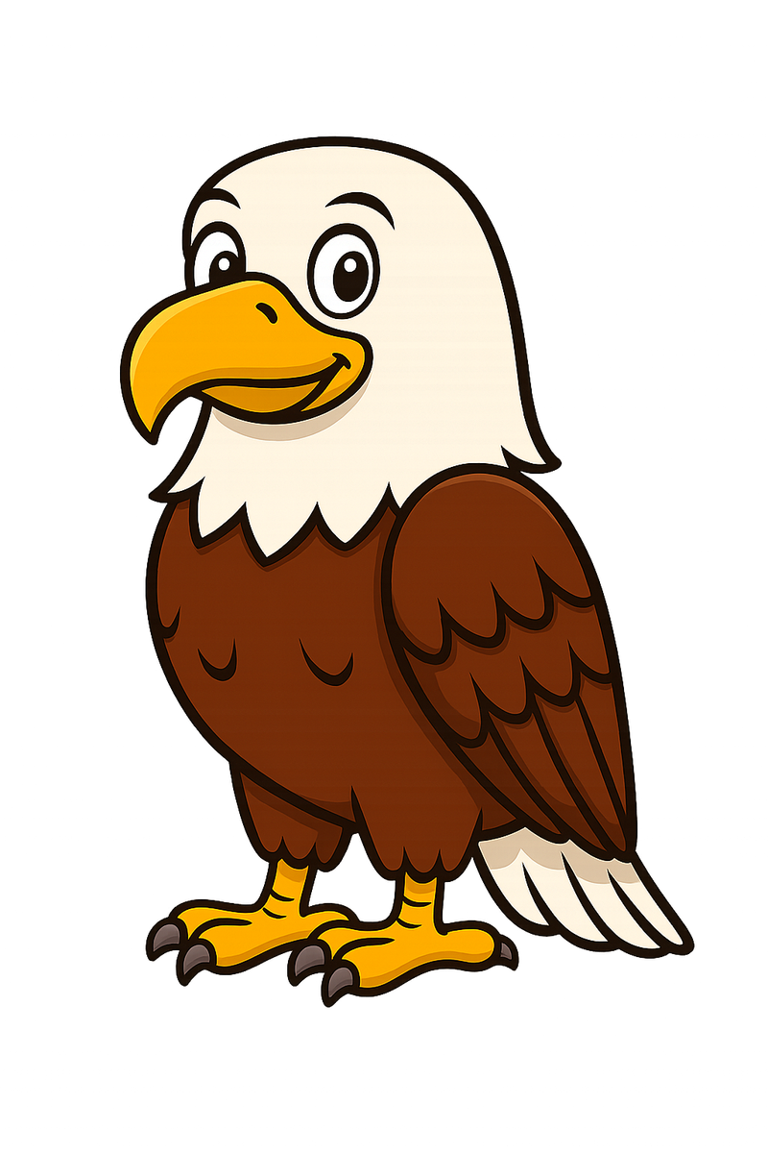
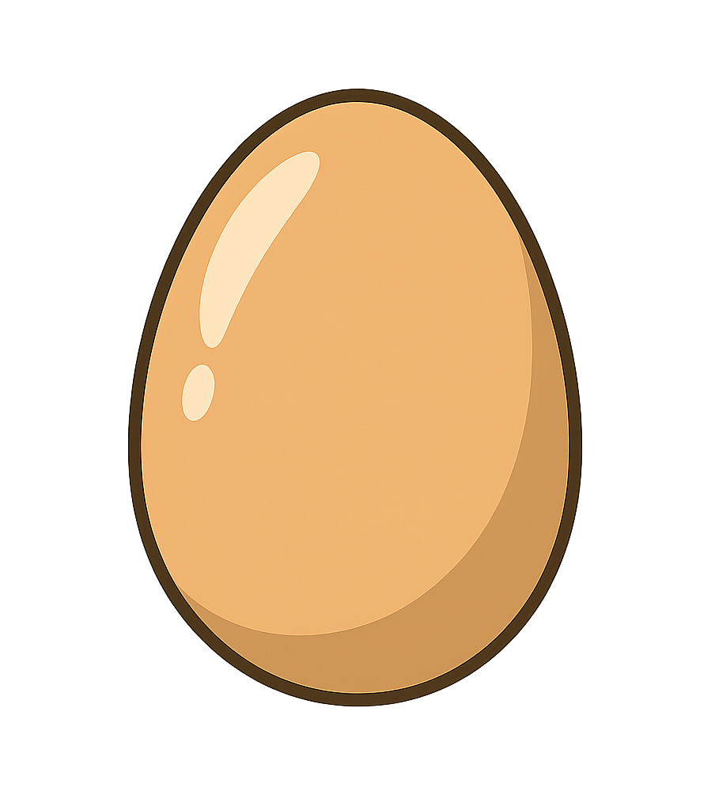
E
Every English Vowel
Has 2 Sounds
egg
eagle

Slide 6
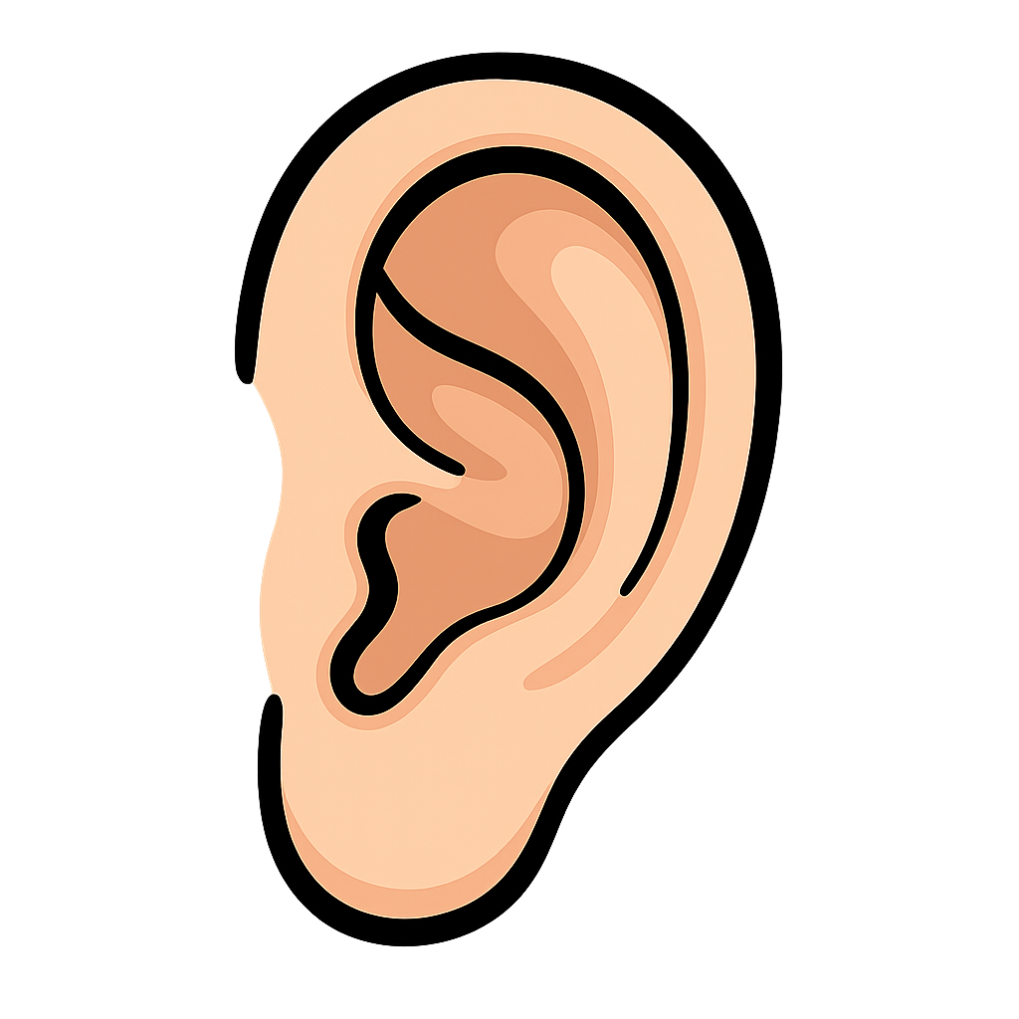

E
Every English Vowel
Has 2 Sounds
elbow
ear

Slide 7

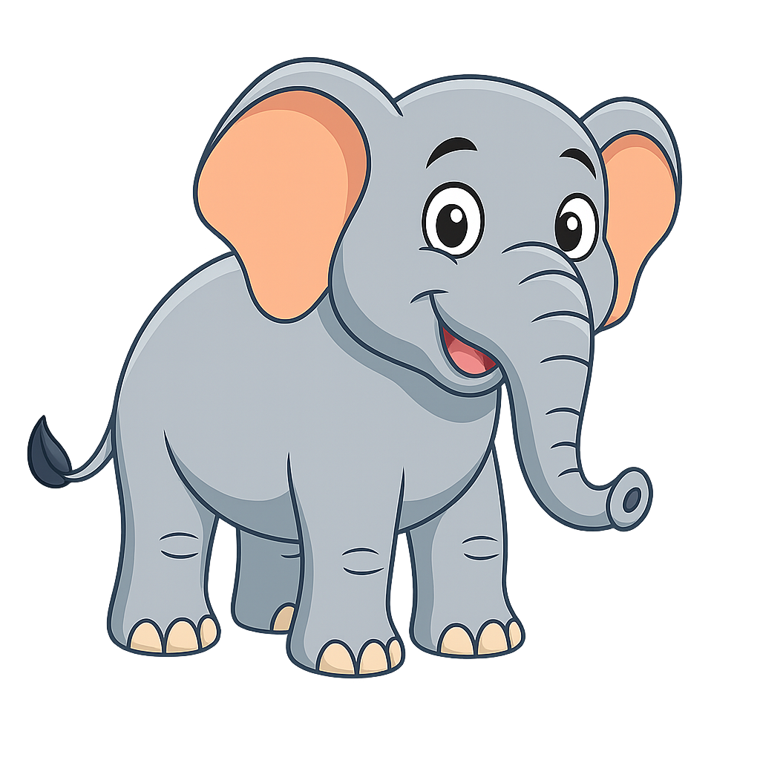
E
Every English Vowel
Has 2 Sounds
elephant
evening

Slide 8


I
Every English Vowel
Has 2 Sounds
igloo
island

Slide 9
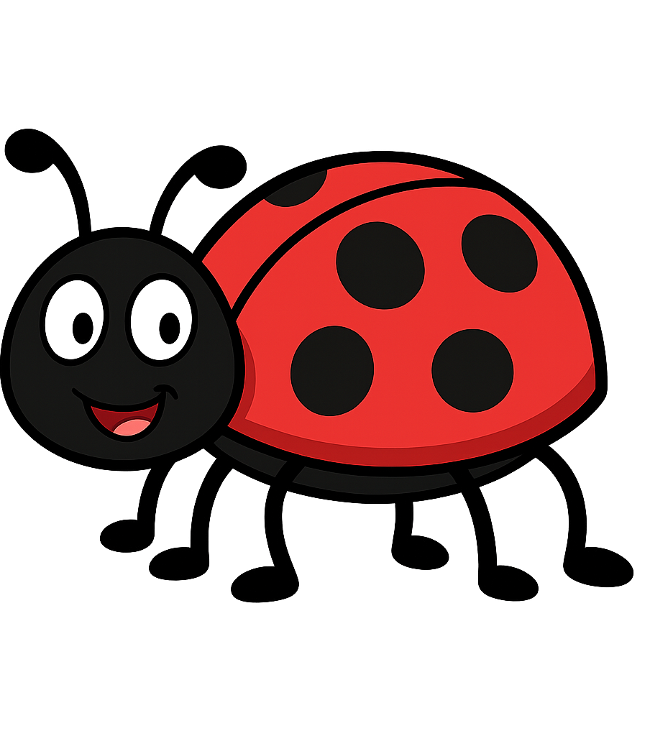
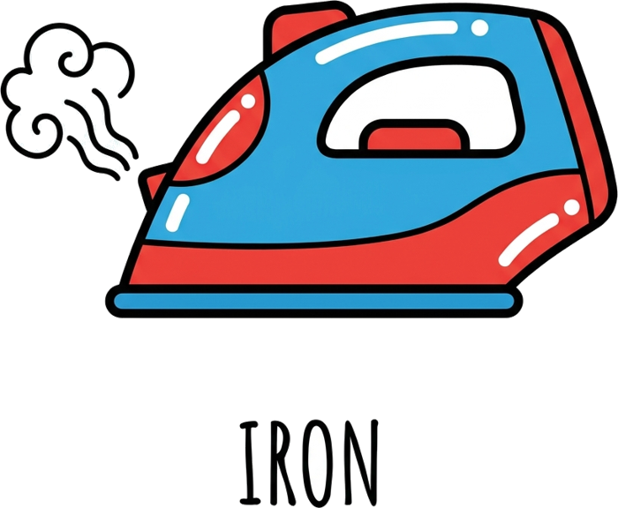
I
Every English Vowel
Has 2 Sounds
insect
iron

Slide 10
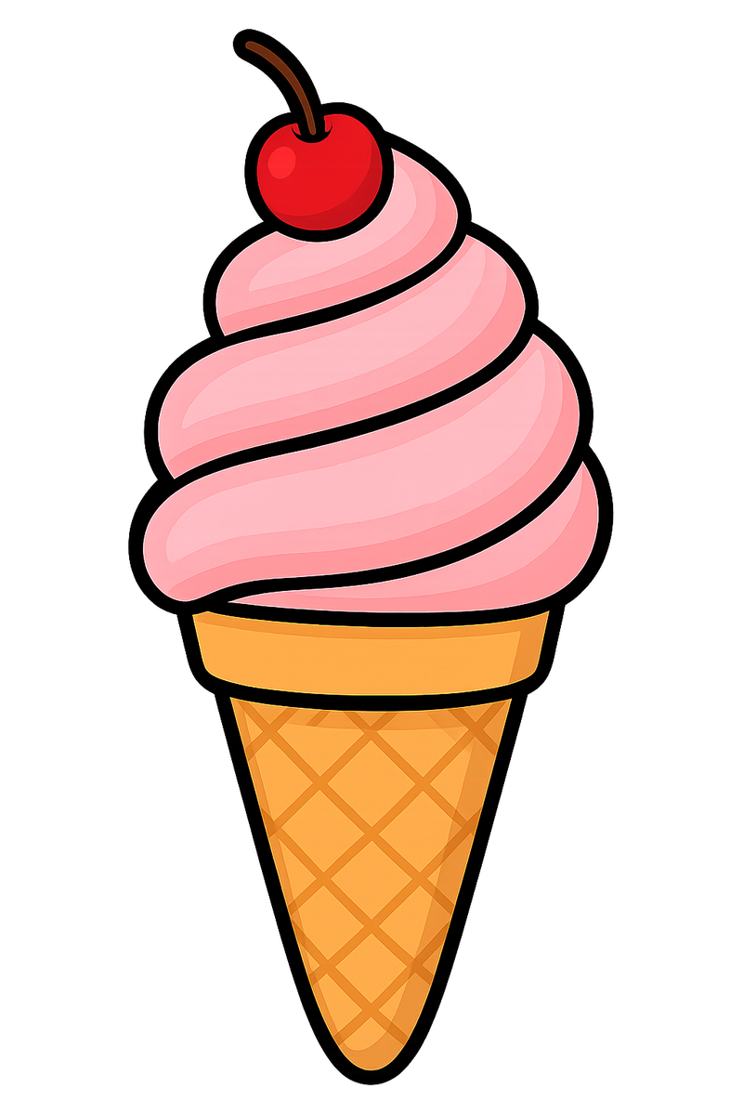

I
Every English Vowel
Has 2 Sounds
Illness
Ice cream

Slide 11
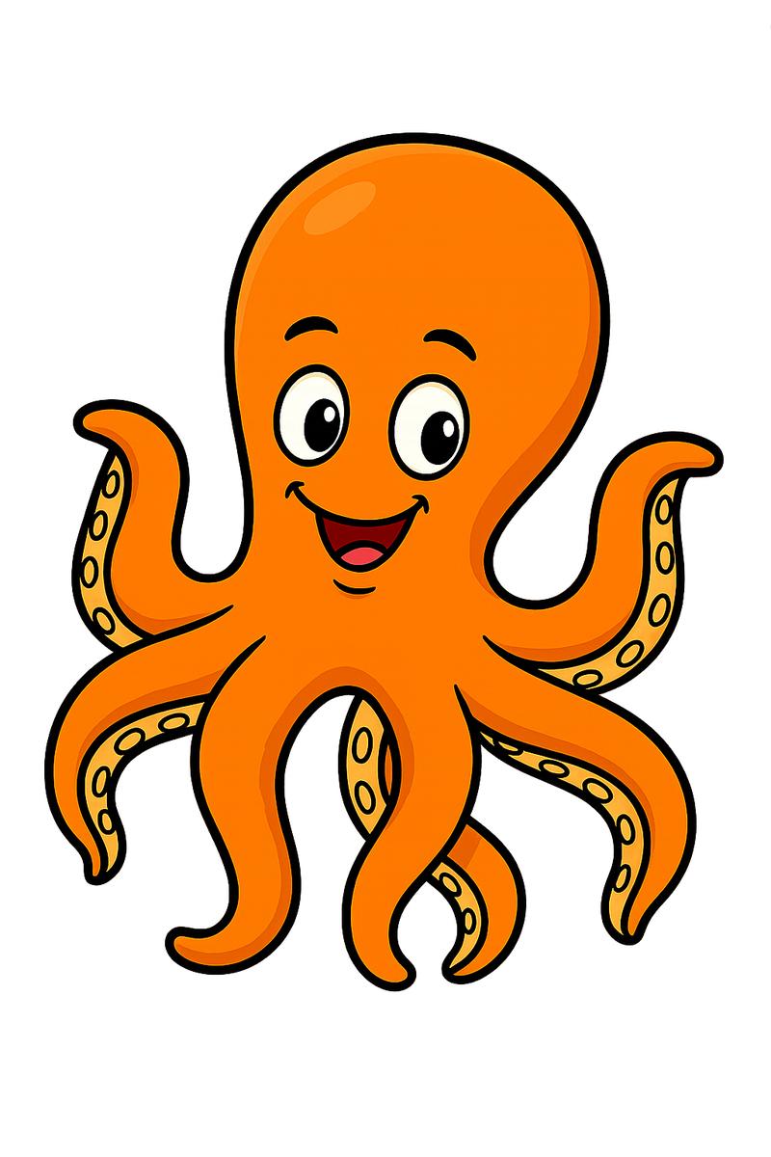

O
Every English Vowel
Has 2 Sounds
octopus
oatmeal

Slide 12
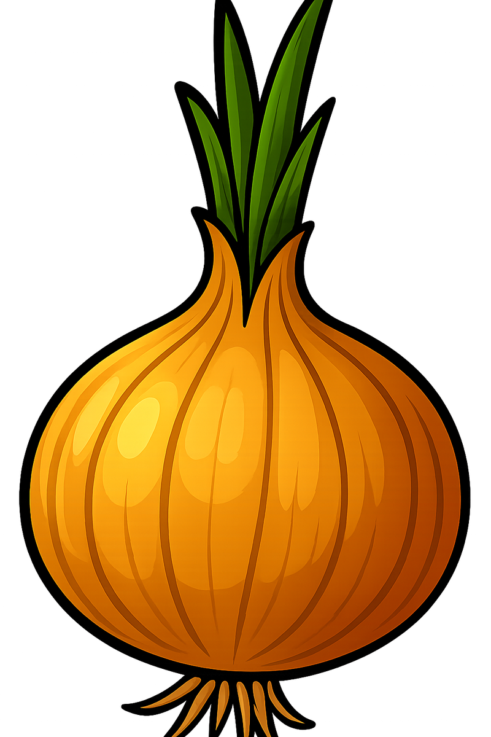

O
Every English Vowel
Has 2 Sounds
onion
open

Slide 13


O
Every English Vowel
Has 2 Sounds
olive
oak

Slide 14

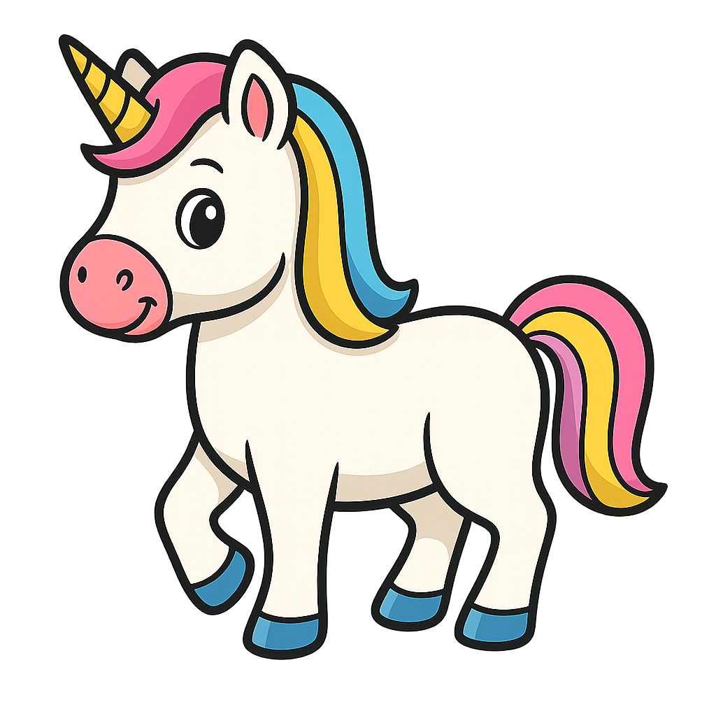
U
Every English Vowel
Has 2 Sounds
umbrella
unicorn

Slide 15
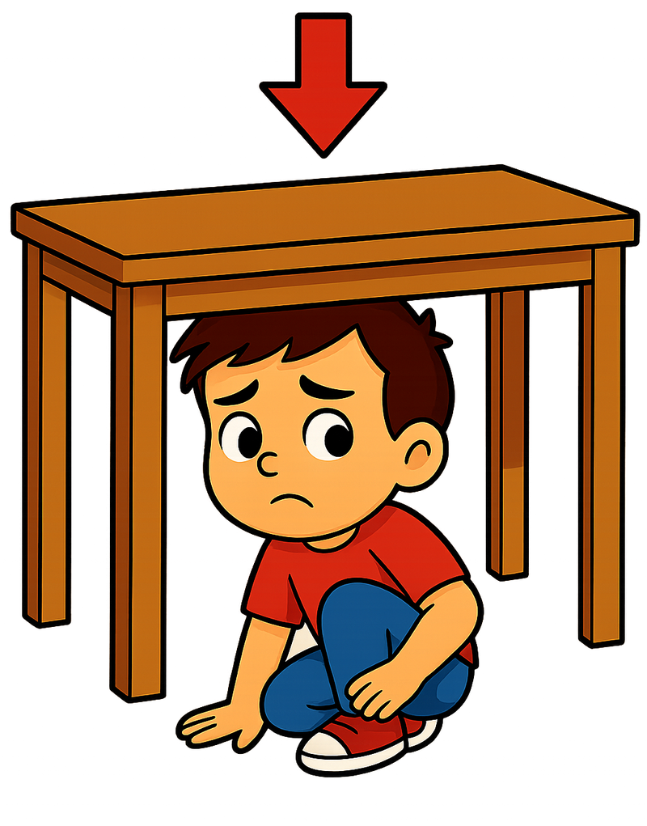
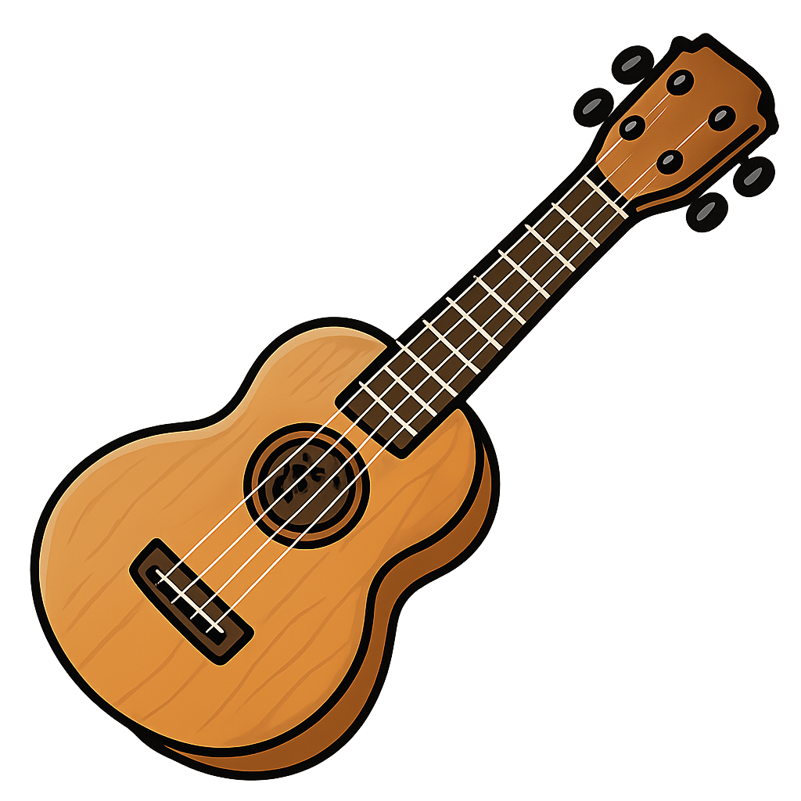
U
Every English Vowel
Has 2 Sounds
under
ukelele

Slide 16

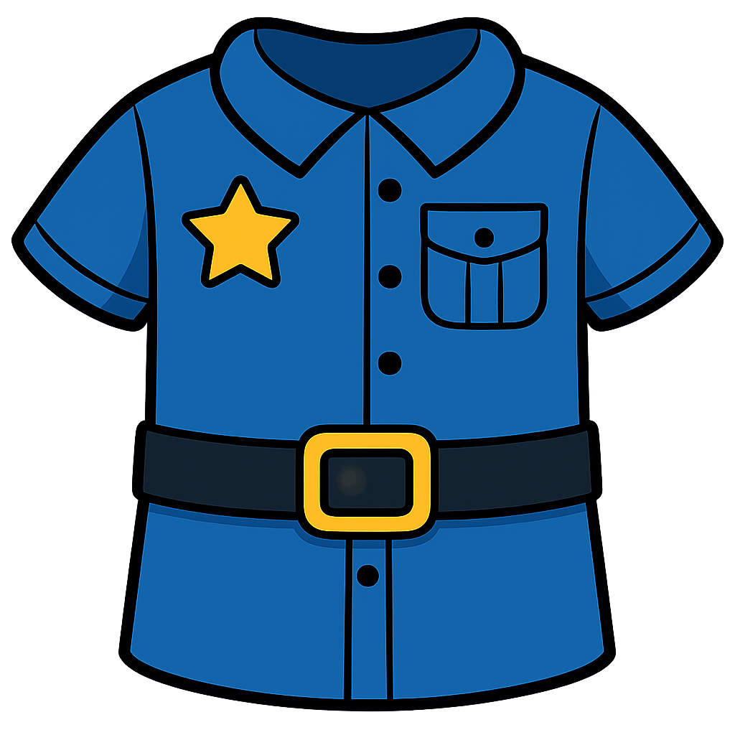
U
Every English Vowel
Has 2 Sounds
up
uniform

