Slide 1
🖼️ Image Guessing Game
How to play:
  Look at the picture.
  Each word begins with a vowel
  I will say the word
  Guess the first vowel sound (Short or Long?)

Slide 2
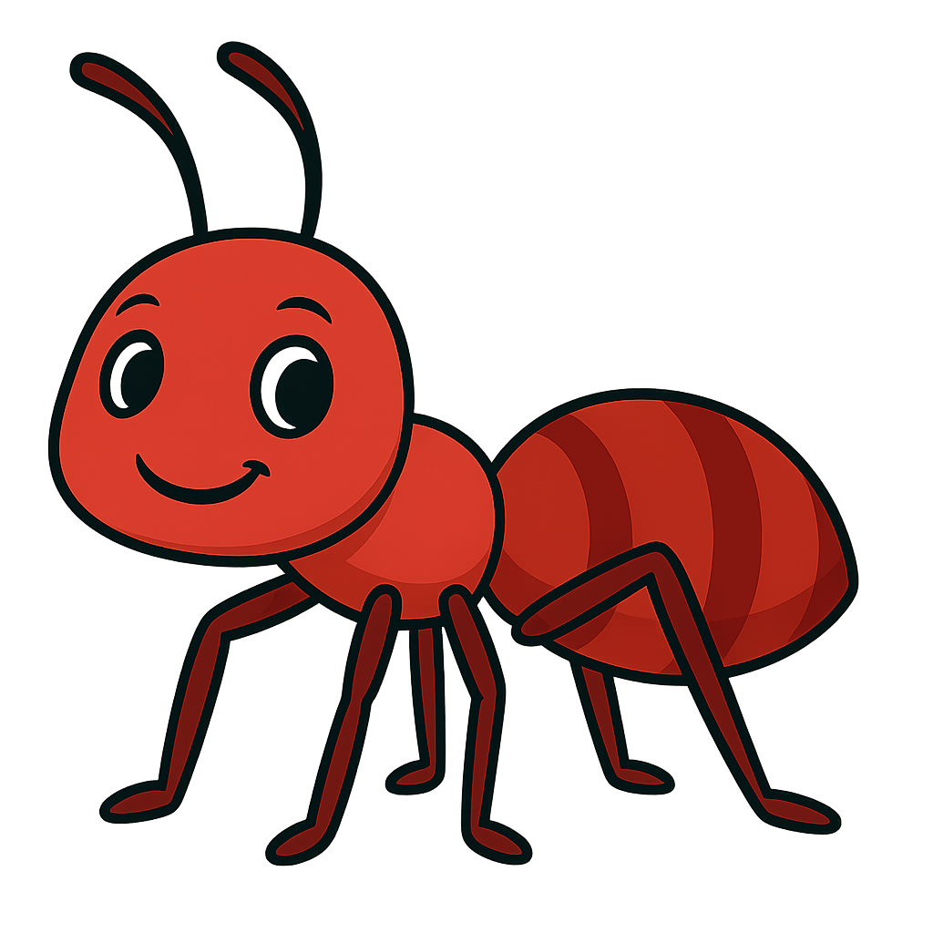

Slide 3
ant

Slide 4
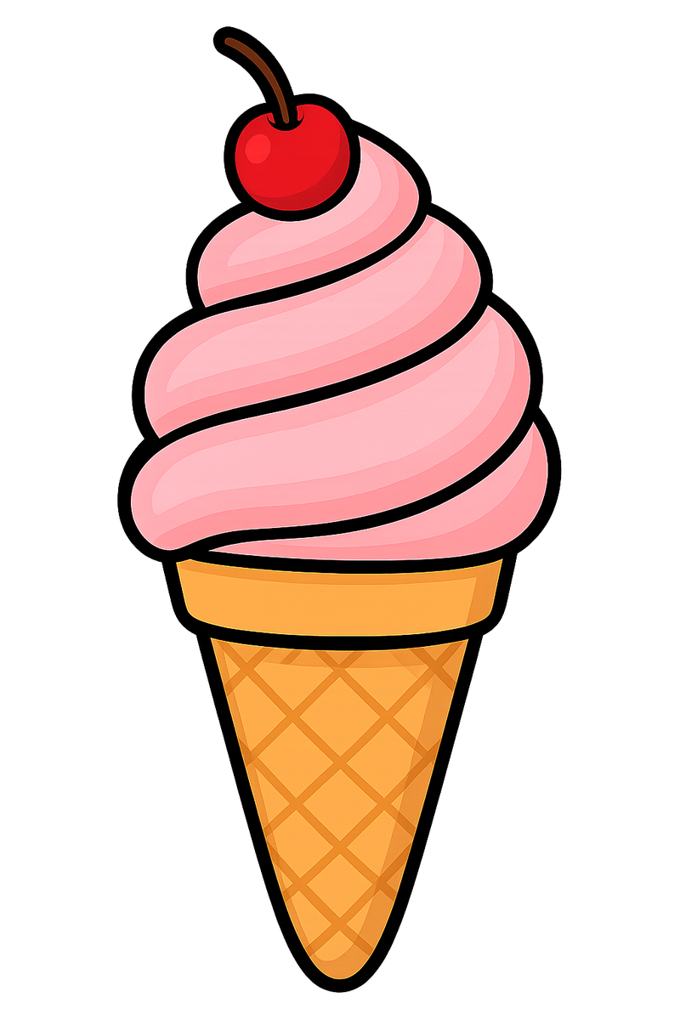

Slide 5
Ice cream

Slide 6
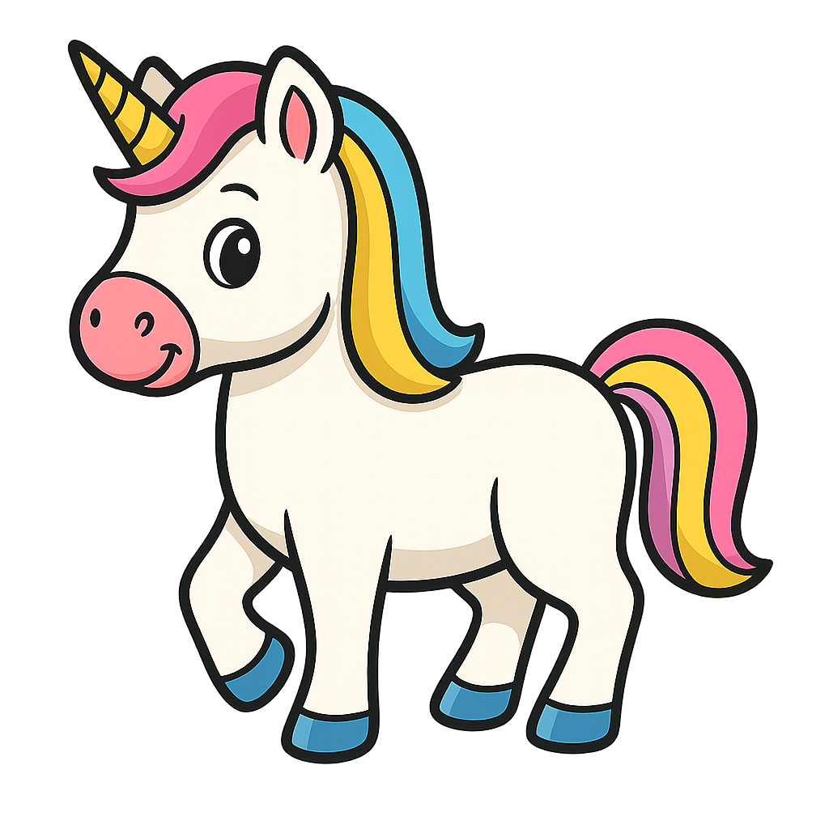

Slide 7
Unicorn

Slide 8


Slide 9
  umbrella

Slide 10
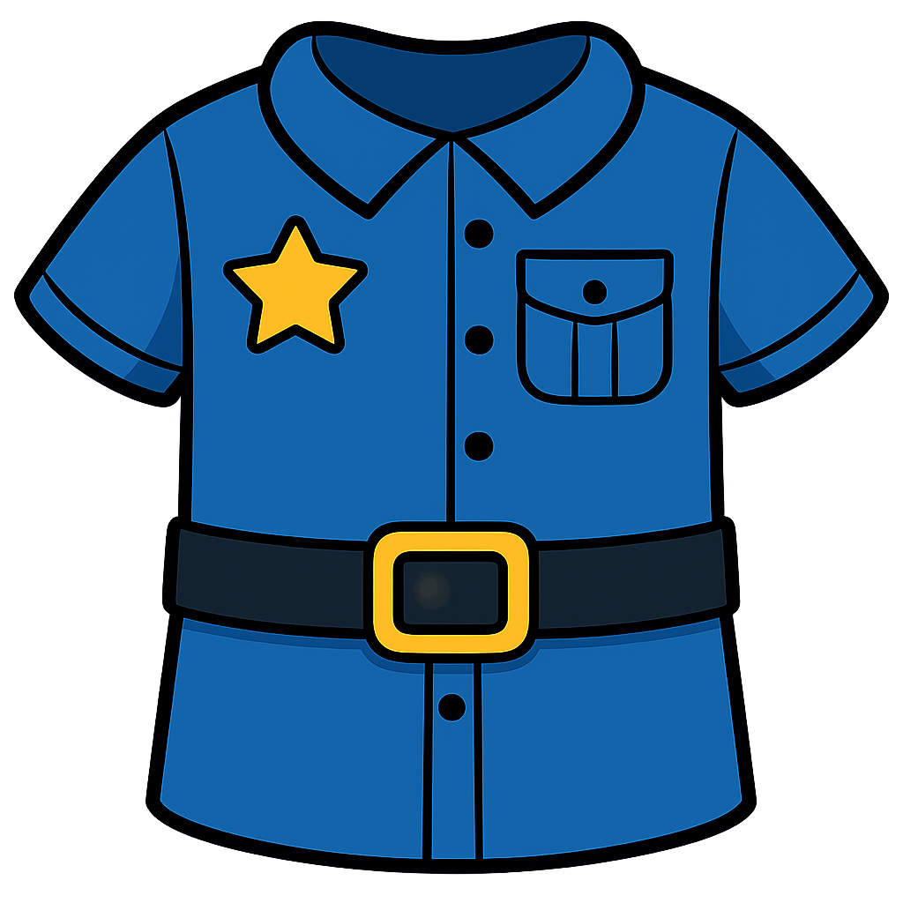

Slide 11
uniform

Slide 12
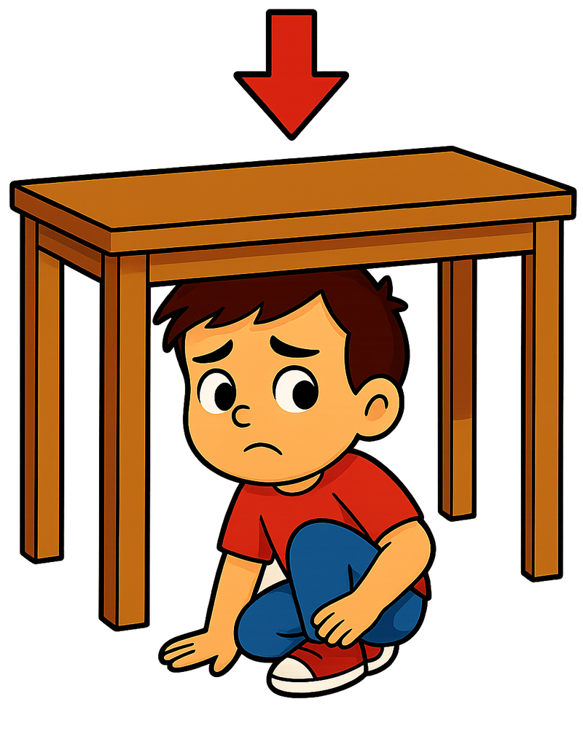

Slide 13
Under

Slide 14


Slide 15


Slide 16
Evening

Slide 17
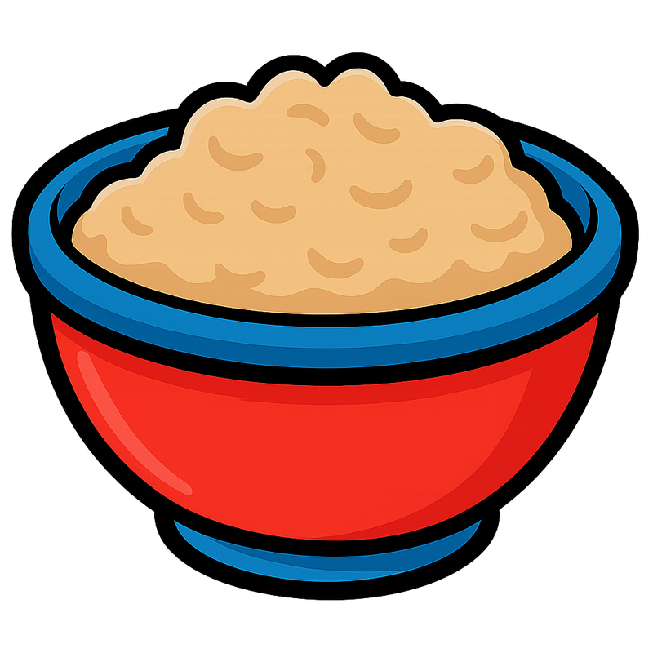

Slide 18
Oatmeal

Slide 19
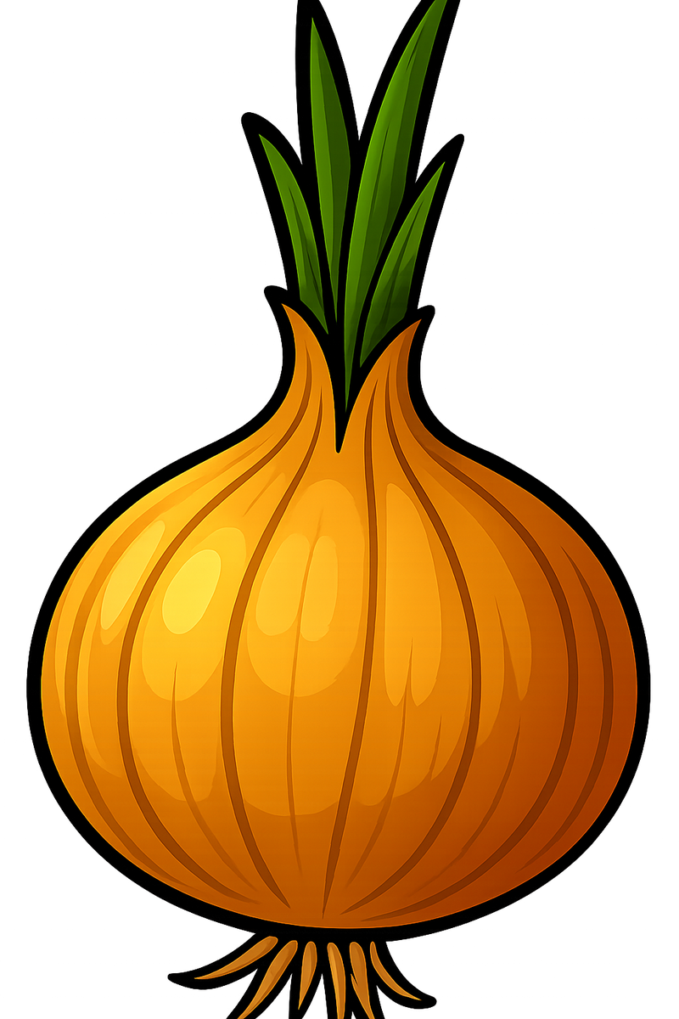

Slide 20
Onion

Slide 21
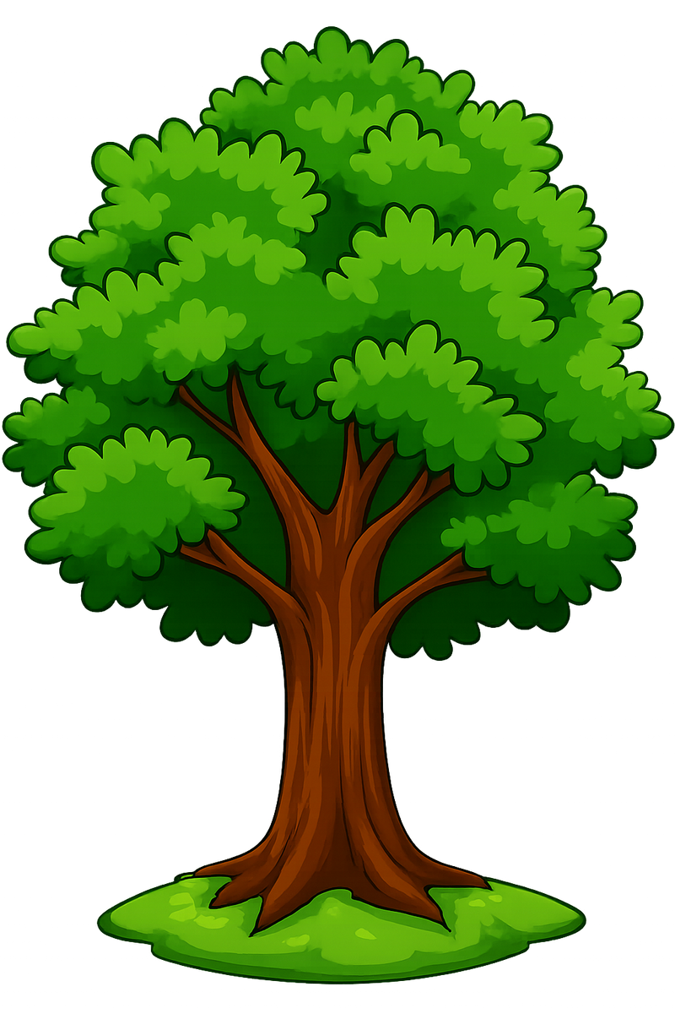

Slide 22
Oak tree

Slide 23
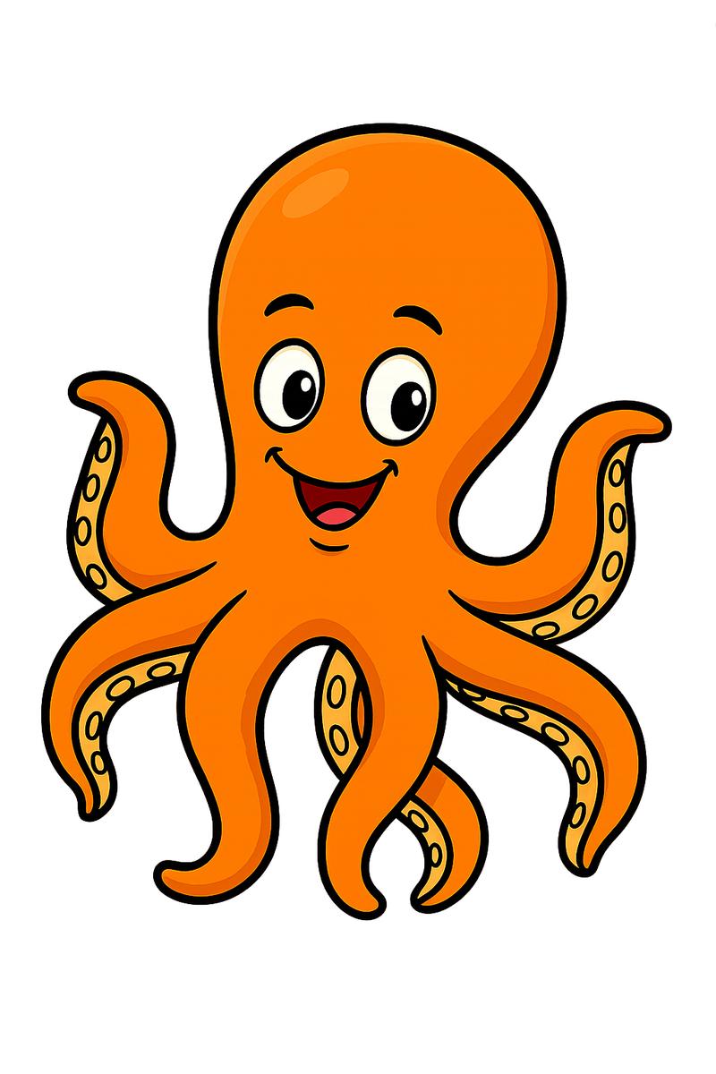

Slide 24
octopus

Slide 25


Slide 26
Island

Slide 27


Slide 28
Illness

Slide 29


Slide 30
iron

Slide 31
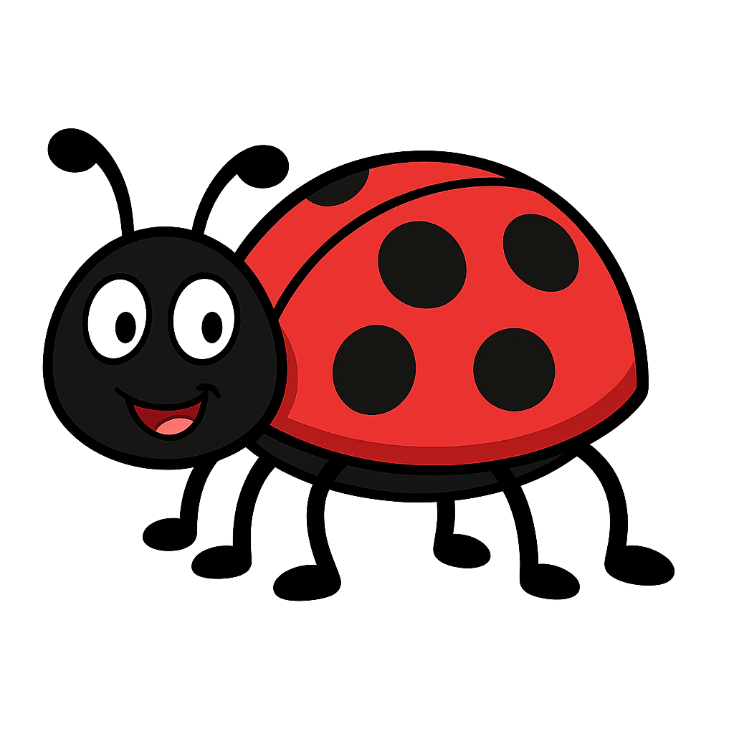

Slide 32
insect

Slide 33

ice

Slide 34


Slide 35
igloo

Slide 36
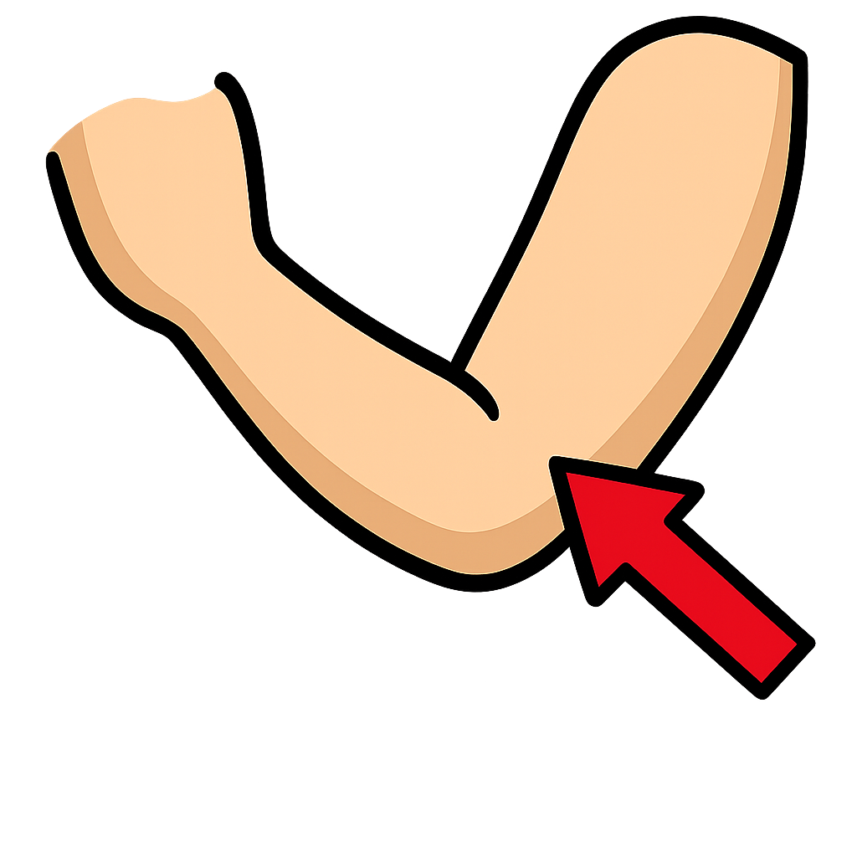

Slide 37
elbow

Slide 38


Slide 39
olive

Slide 40


Slide 41
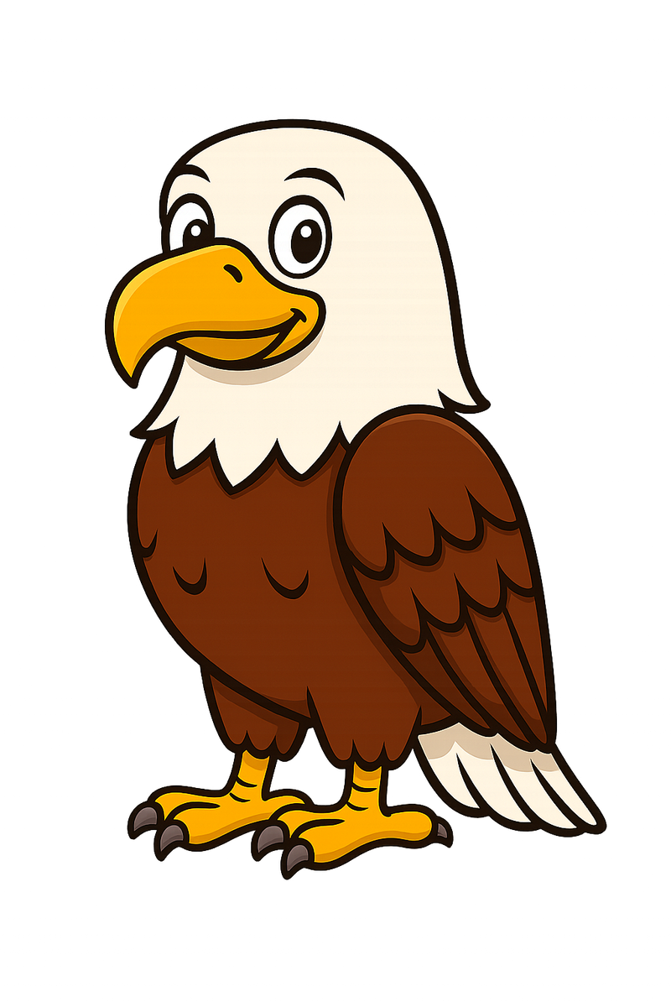

Slide 42
eagle

Slide 43
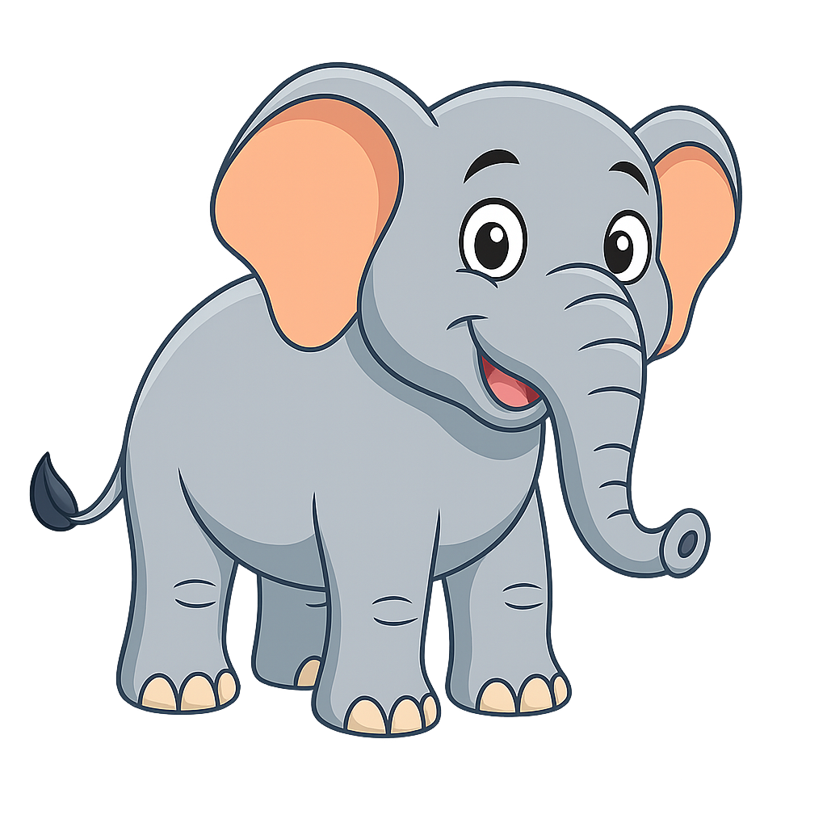

Slide 44
elephant

Slide 45
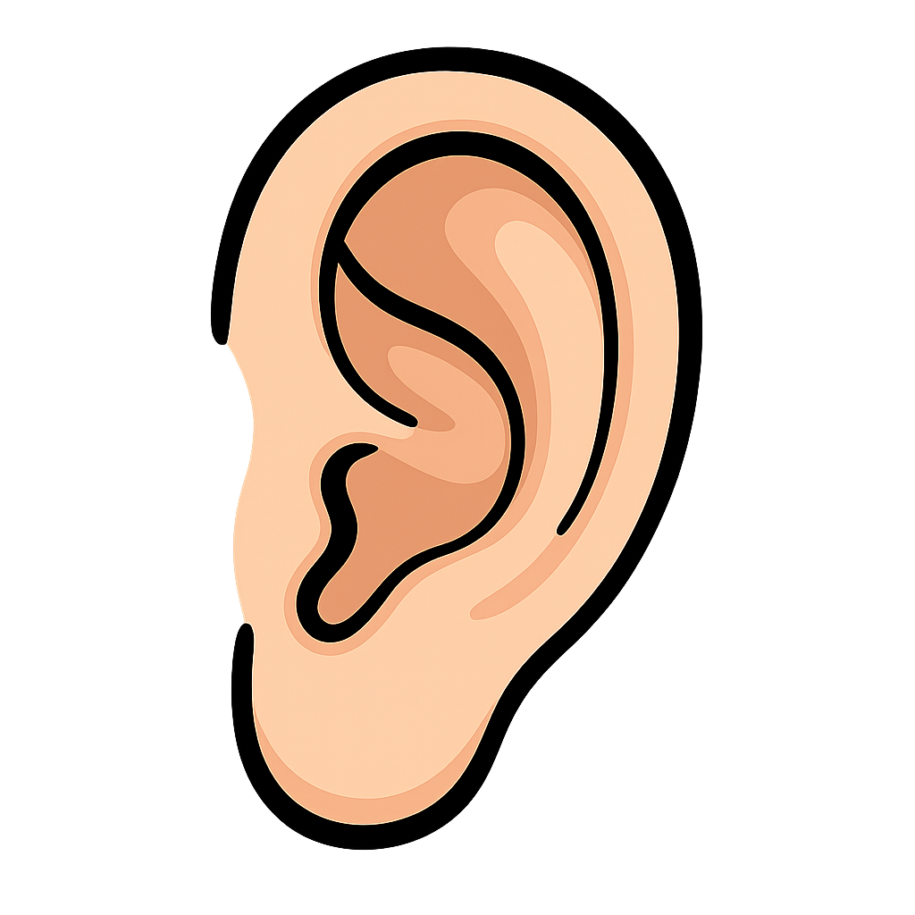

Slide 46
ear

Slide 47
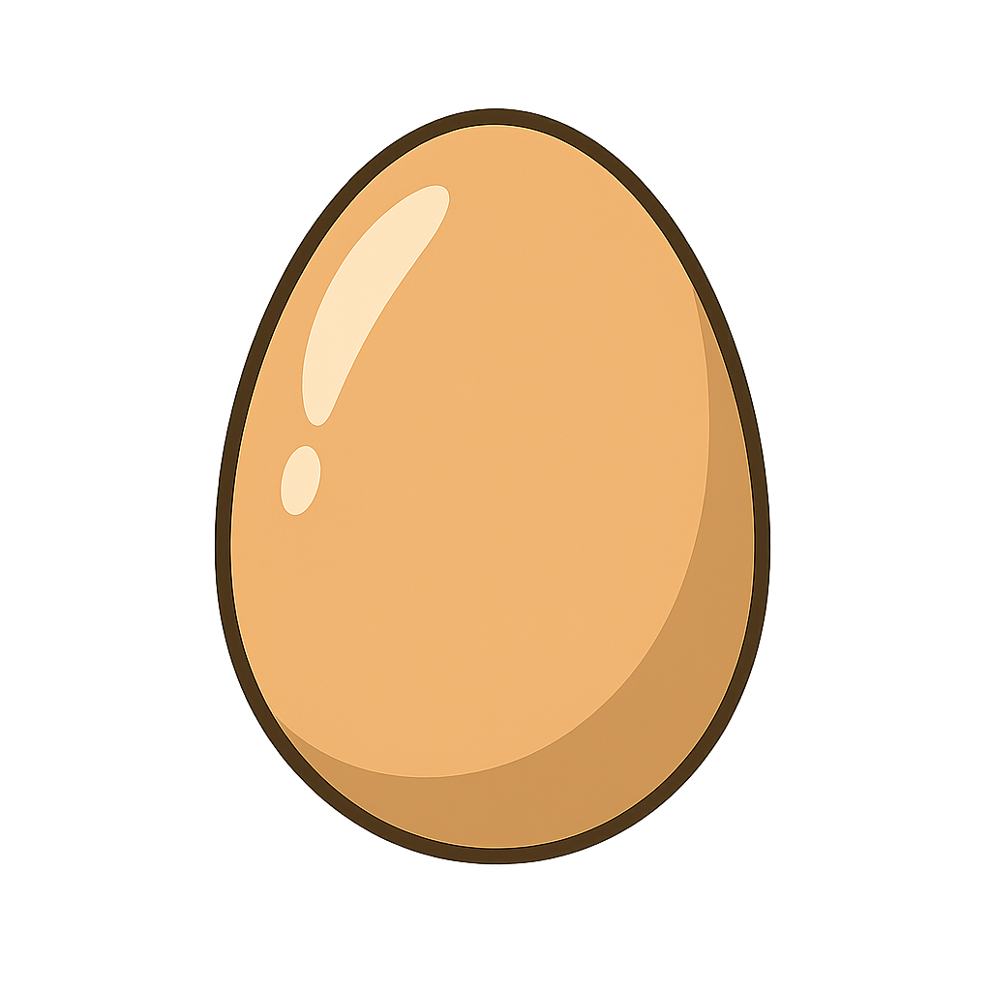

Slide 48
egg

Slide 49
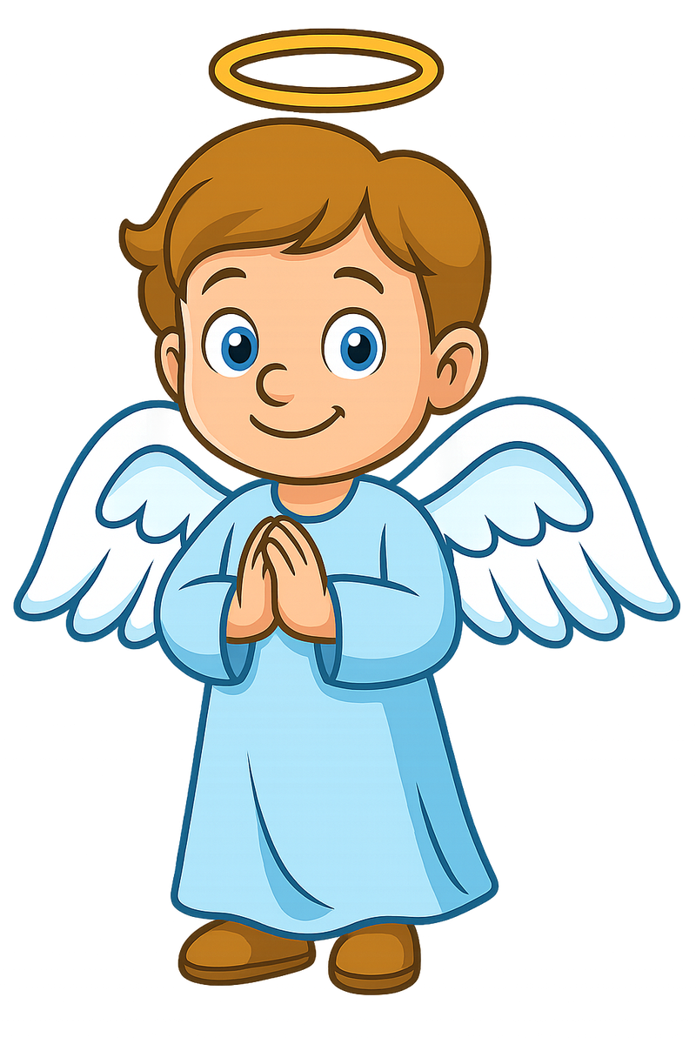

Slide 50
angel

Slide 51
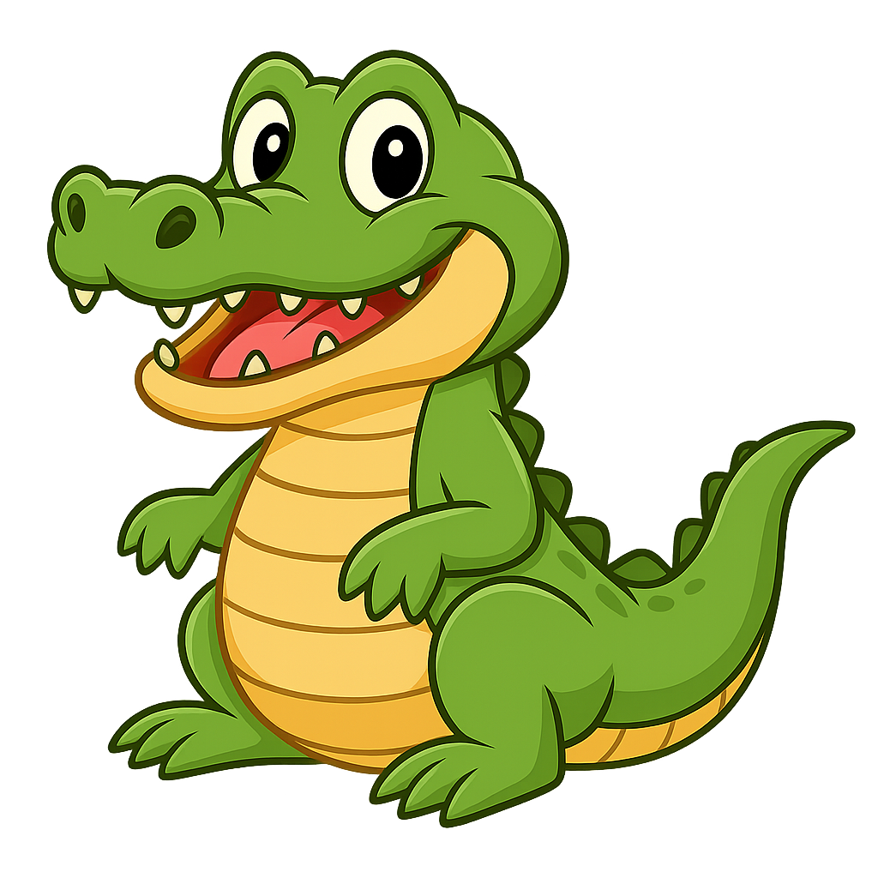

Slide 52
alligator

Slide 53


Slide 54
Apron

Slide 55
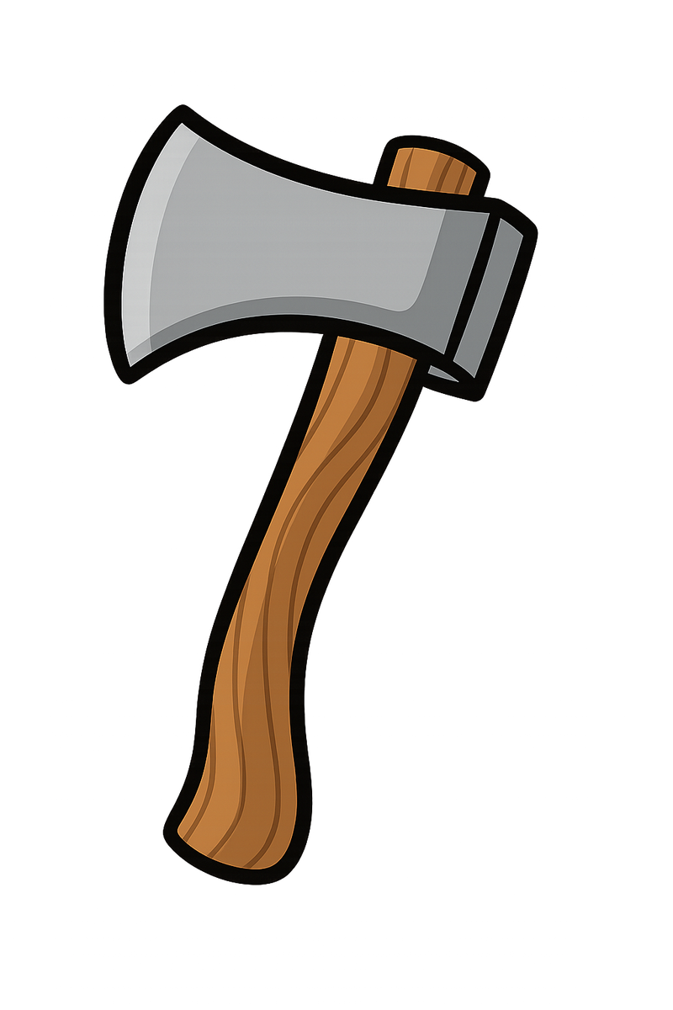

Slide 56
axe

Slide 57


Slide 58
acorn

