Slide 1
🎤 Repeat & Echo Game
1. Look at the picture
2. Teacher says the word (e.g., 'cake')
3. Students repeat
4. Add gesture (e.g., hand stretch for long vowels)
5. Speed up the rhythm!

Slide 2


Slide 3
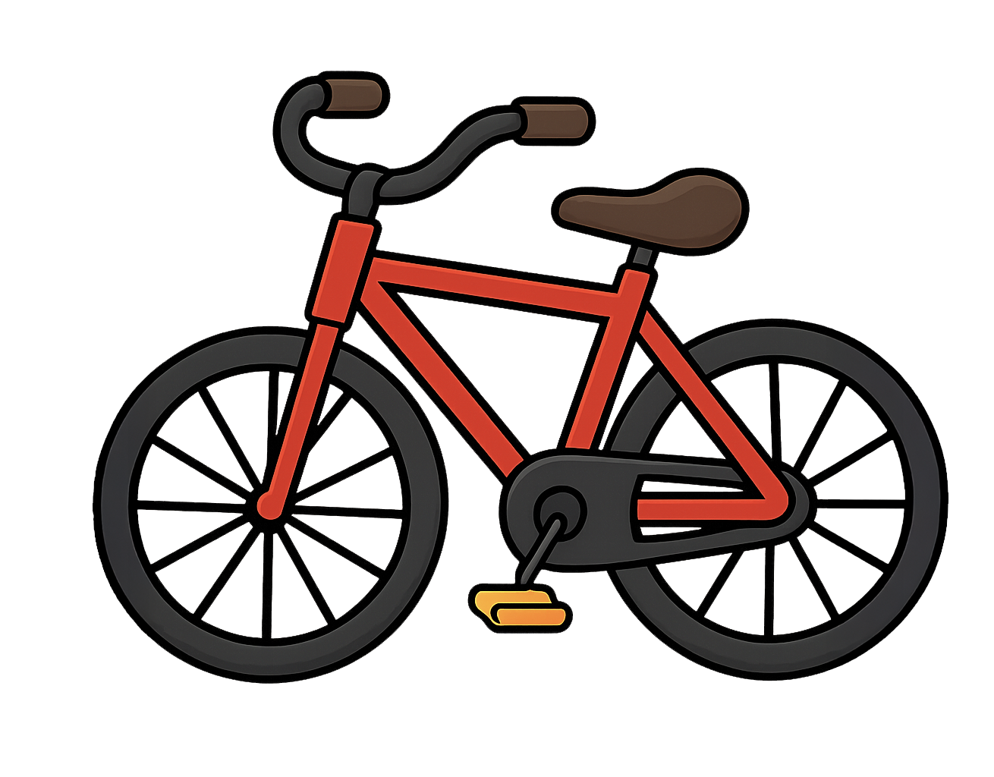

Slide 4


Slide 5


Slide 6


Slide 7


Slide 8


Slide 9
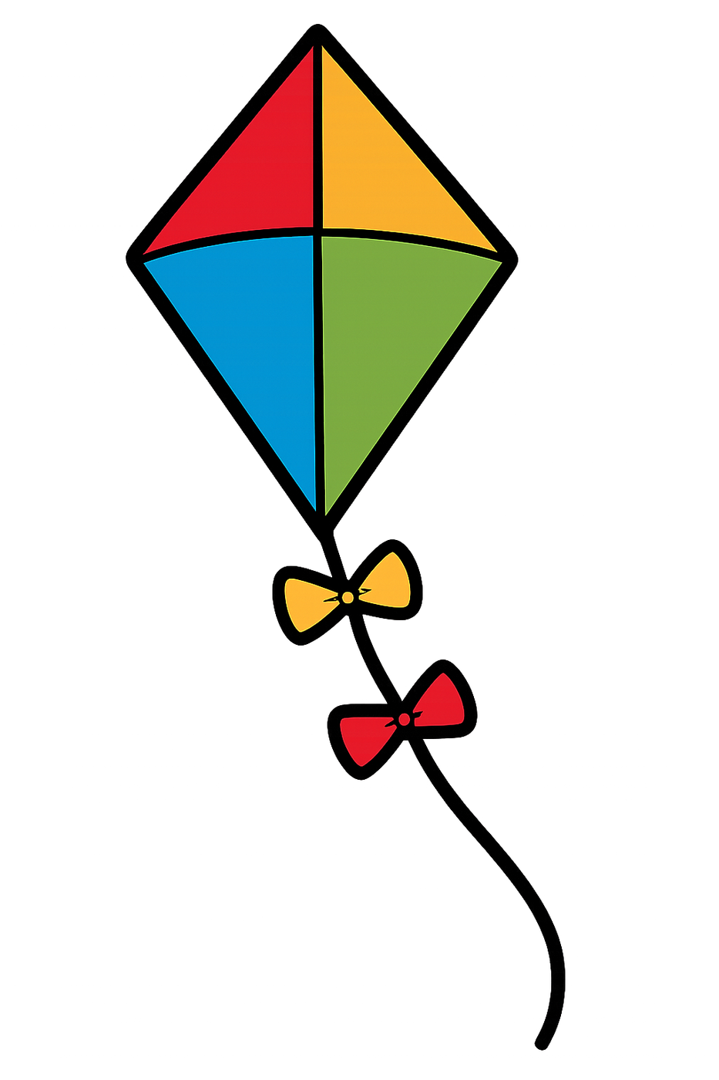

Slide 10


Slide 11
