Slide 1

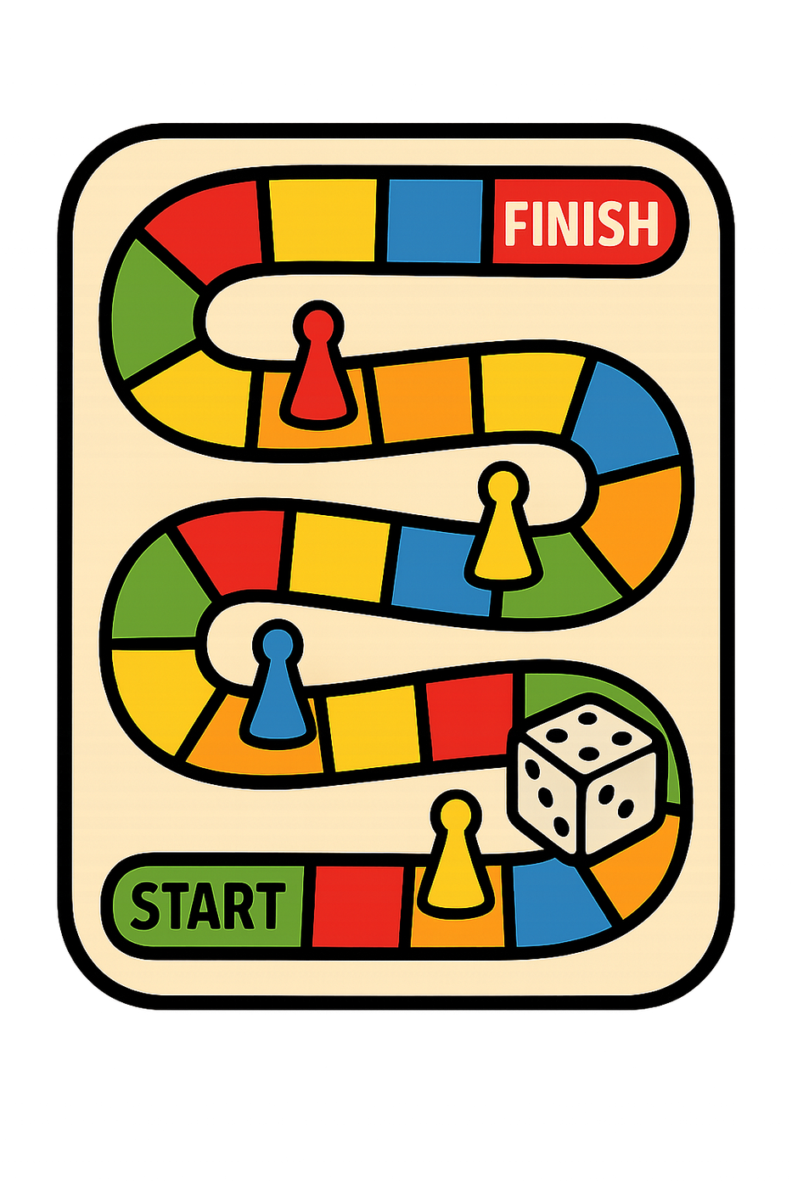

Long A (ā)
Cake
Game
Rain

Slide 2



Long E (ē)
Bee
Feet
Leaf

Slide 3
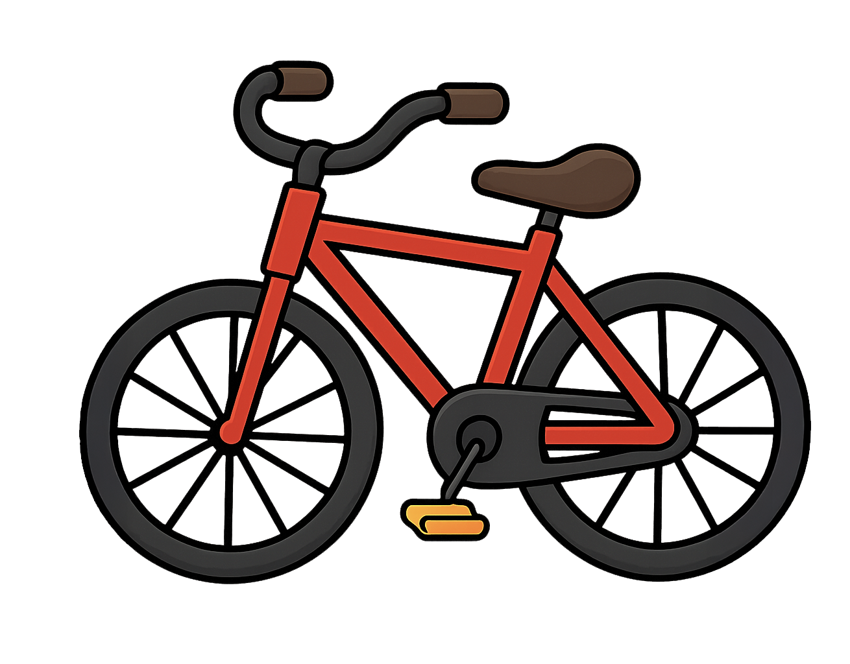


Long I (ī)
Bike
Kite
Ice

Slide 4



Long O (ō)
Bone
Rope
Cone

Slide 5


Long U (ū)
Cube
Unicorn

