Slide 1
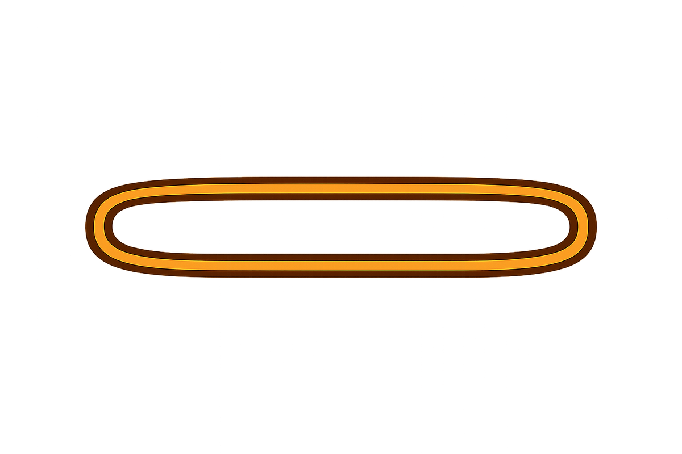
🎶 Rubber Band Drill
Say the word slowly and stretch the vowel sound.
Use a rubber band or your hands: Ayyyy, Ooooh!
Students repeat with you!

Slide 2
🎶 Rubber Band Drill
Say the word slowly and stretch the vowel sound.
Use a rubber band or your hands: Ayyyy, Ooooh!
Students repeat with you!

Slide 3
🎶 Rubber Band Drill
Say the word slowly and stretch the vowel sound.
Use a rubber band or your hands: Ayyyy, Ooooh!
Students repeat with you!

Slide 4

cube

Slide 5
cube

Slide 6
cube

Slide 7


CAKE

Slide 8
CAKE

Slide 9
CAKE

Slide 10

BEE

Slide 11
BEE

Slide 12
BEE

Slide 13
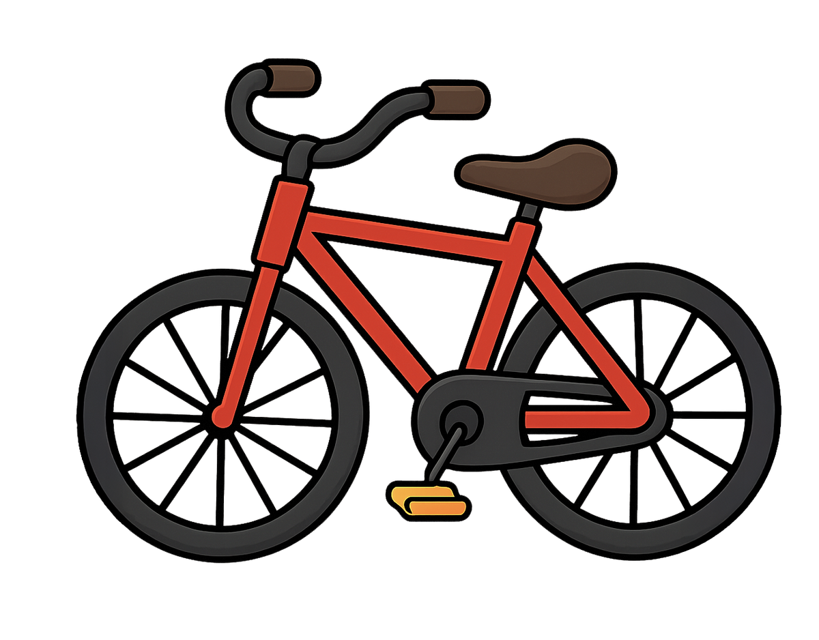
bike

Slide 14
bike

Slide 15
bike

Slide 16
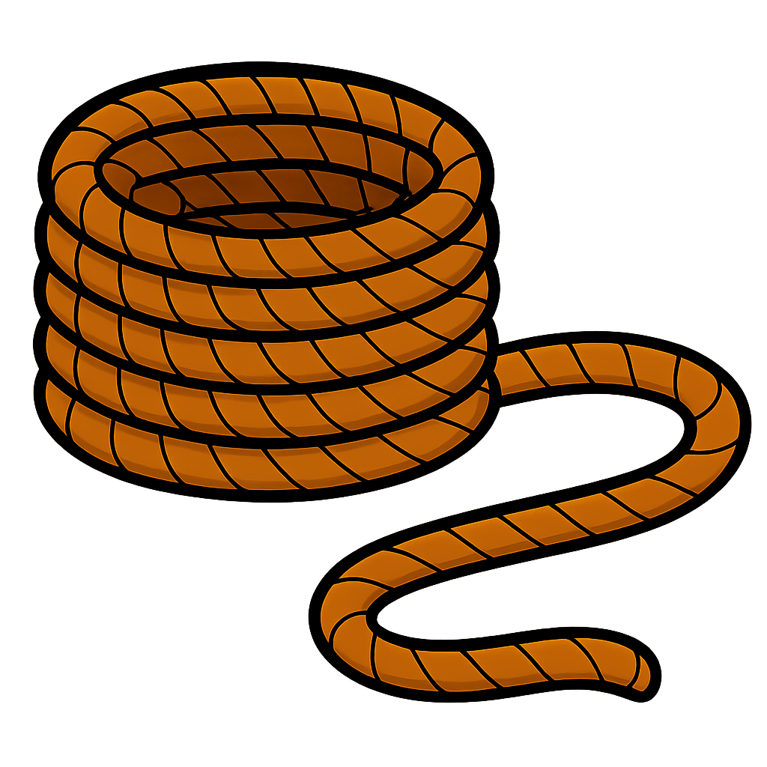
ROPE

Slide 17
ROPE

Slide 18
ROPE

