Slide 1
🎯 Sound Discrimination Game
Teacher says a word (e.g., 'bee'). Students point to the correct image.
Each slide has two images. Listen and choose the one you hear!

Slide 2



1
2

Slide 3
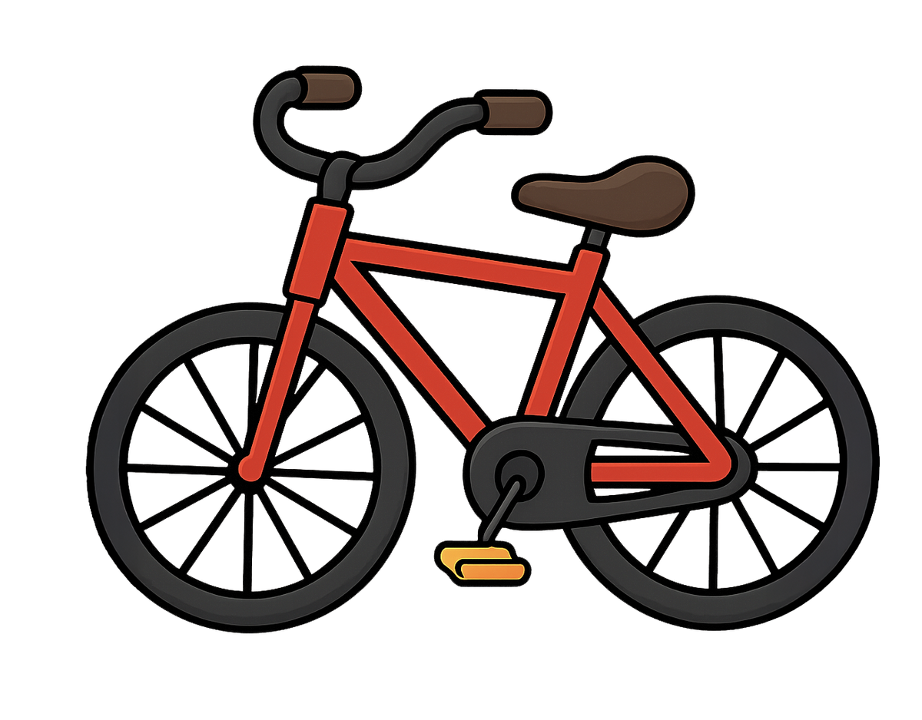
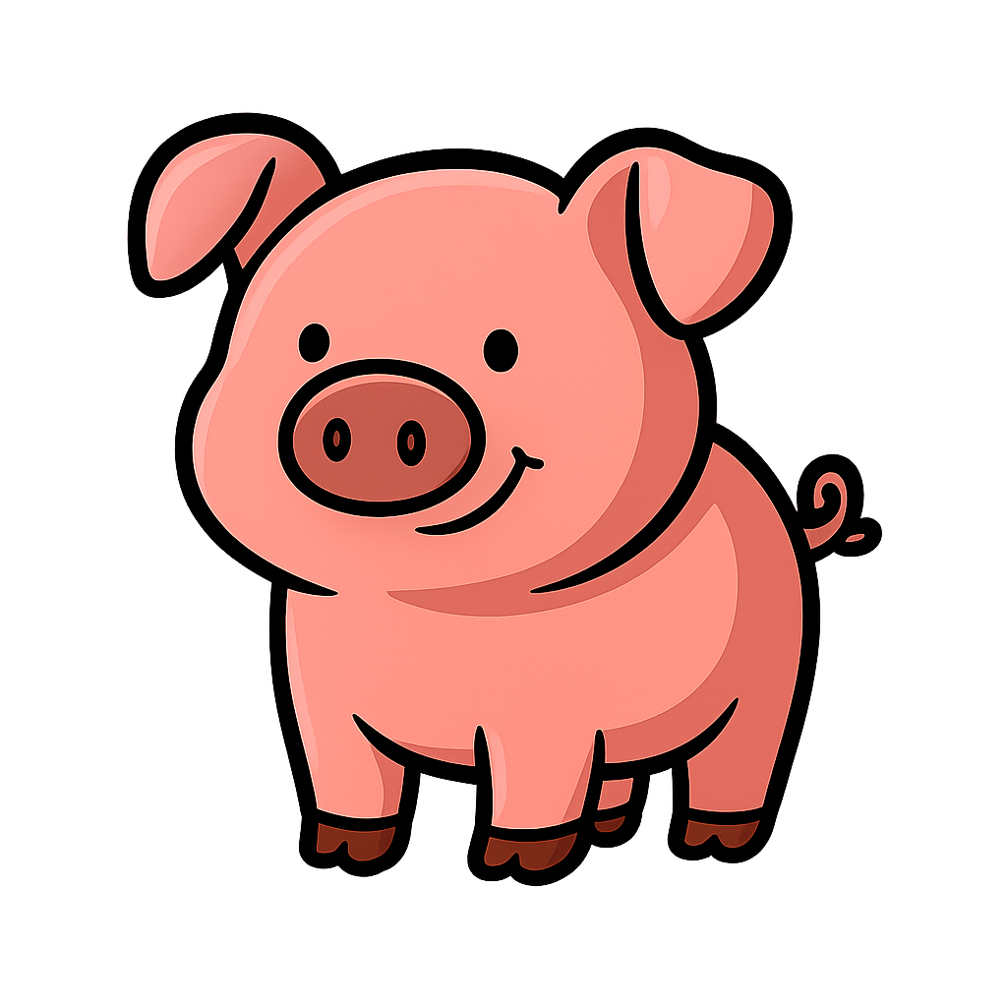
1
2

Slide 4


1
2

Slide 5


1
2

Slide 6


1
2

Slide 7


1
2

Slide 8
1
2

Slide 9
1
2

Slide 10
1
2

Slide 11
1
2

Slide 12
1
2

Slide 13
1
2

