Slide 1


cap or cab?
👂 Listen to ONE word.
👉 Point to the correct image!
CAB
CAP

Slide 2
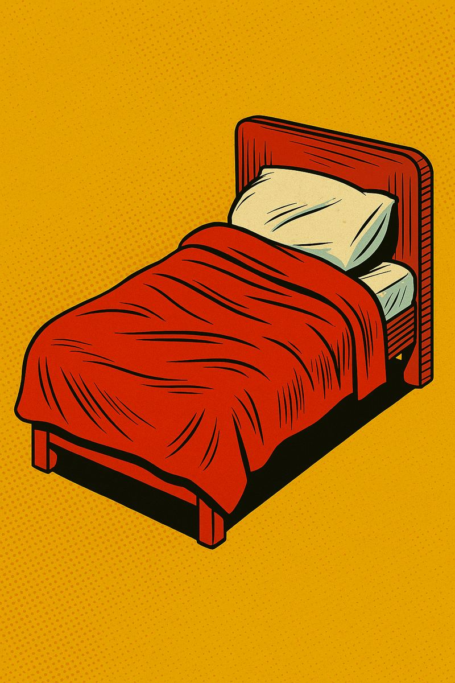
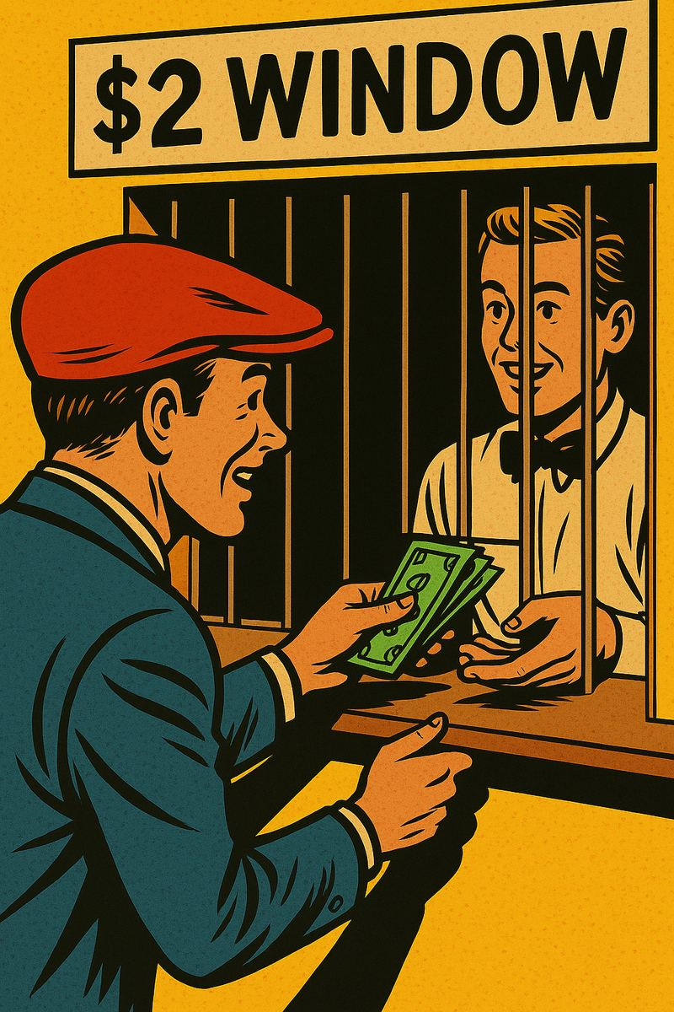
bed or bet?
👂 Listen to ONE word.
👉 Point to the correct image!
BED
BET

Slide 3
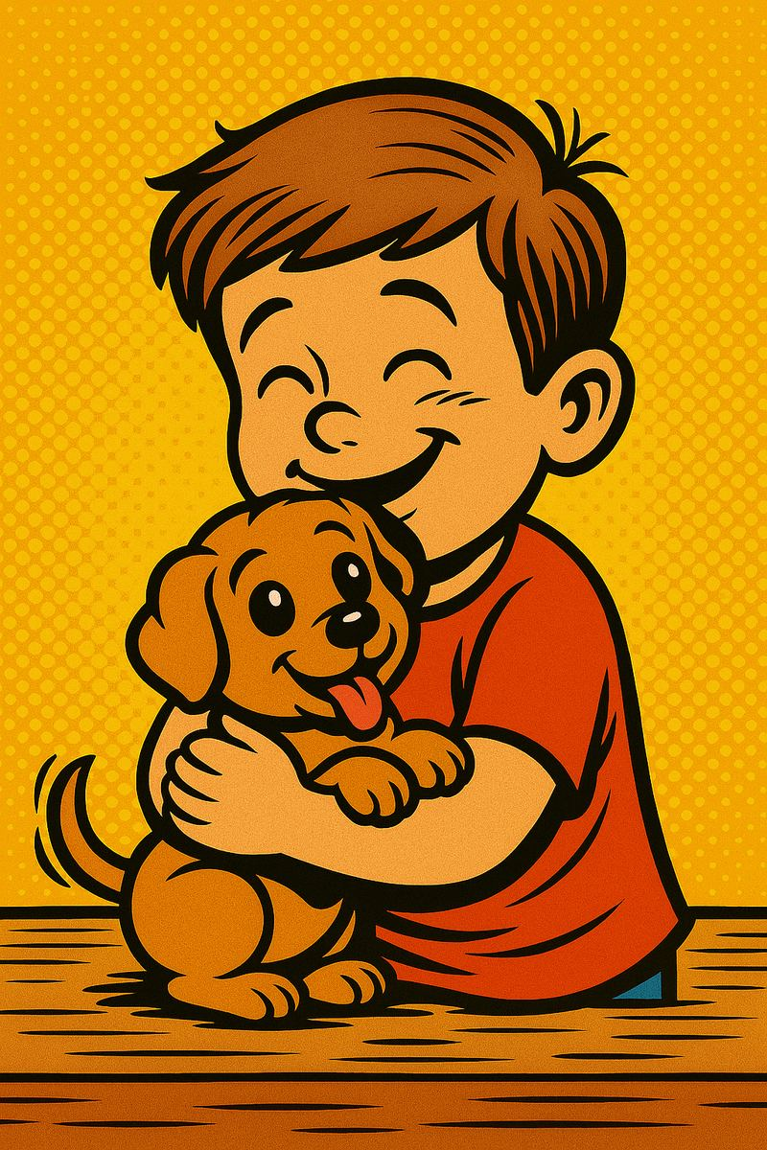
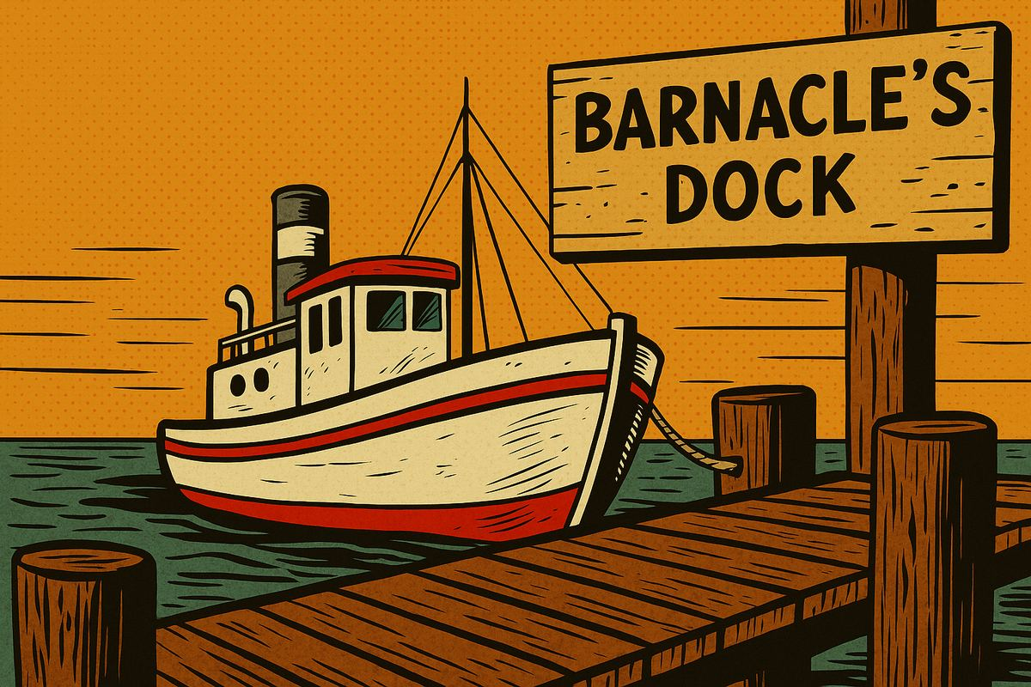
dog or dock?
👂 Listen to ONE word.
👉 Point to the correct image!
DOG
DOCK

Slide 4

pen or pet?
👂 Listen to ONE word.
👉 Point to the correct image!
PEN
PET

Slide 5


rice or right?
👂 Listen to ONE word.
👉 Point to the correct image!
RICE
RIGHT

Slide 6
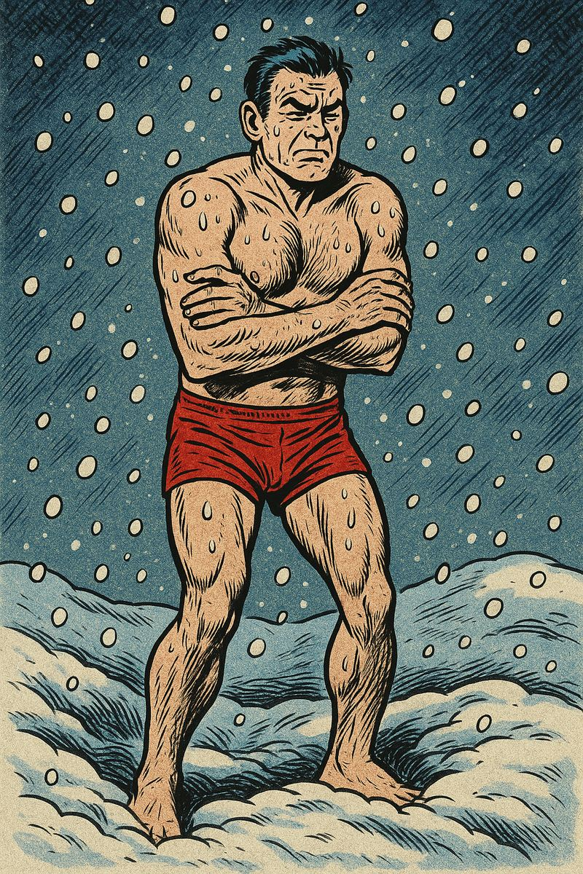
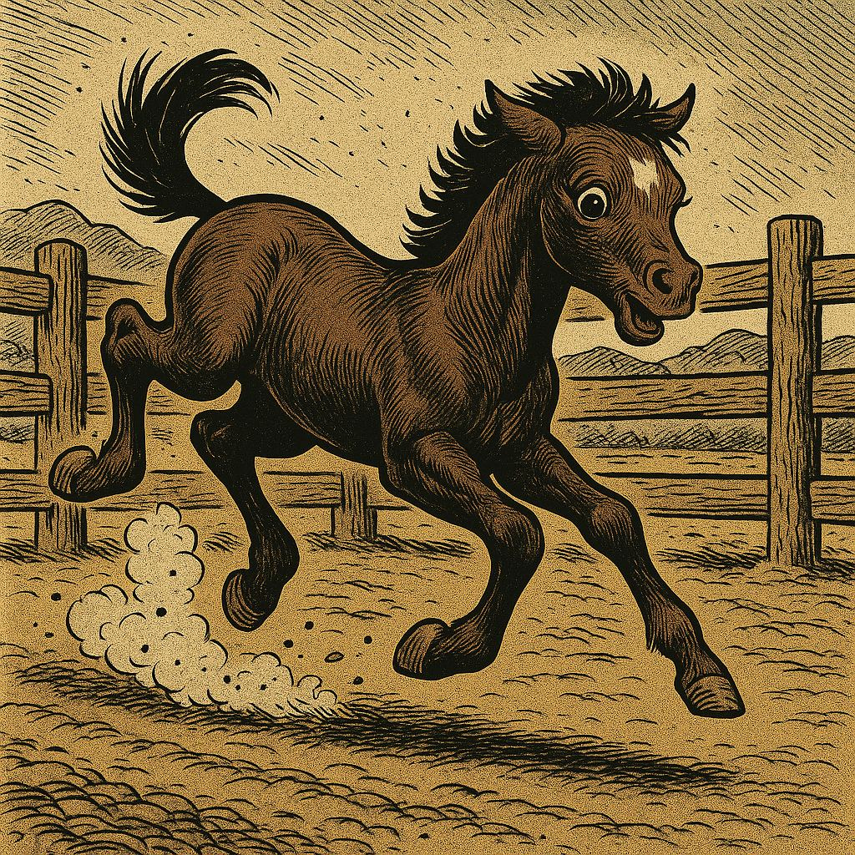
cold or colt?
👂 Listen to ONE word.
👉 Point to the correct image!
COLD
COLT

