Slide 1
M U R R A Y ' S E N G L I S H
Real Life Words
Big words from YOUR life — cut into beats
DAY 6
Notes:
ORIGINAL TEACHER INSTRUCTIONS (moved off slide 1):
👩‍🏫 Teacher Instructions
1. Show each image.
2. Ask students to say the word.
3. Clap and count syllables together.
4. Show the syllable breakdown (e.g., to-MA-to).
5. Emphasize the stressed syllable.
6. Optional: Have students write it in chat.
FLOW: play/say each word naturally → students clap + chin trick → typed count in chat → echo the breakdown (HOS-pi-tal) muted choral ×2 → quick circling: who has been to a hospital? Recordings: click the audio icon on each slide.

Slide 2


hospital
HOS-pi-tal
Notes:
Say/play 'hospital' naturally twice. Students clap + chin trick, type the beat count in chat. Then echo the breakdown together (muted choral ×2). Quick circling: a question connecting 'hospital' to their lives.

Slide 3

important
im-POR-tant
Notes:
Say/play 'important' naturally twice. Students clap + chin trick, type the beat count in chat. Then echo the breakdown together (muted choral ×2). Quick circling: a question connecting 'important' to their lives.

Slide 4
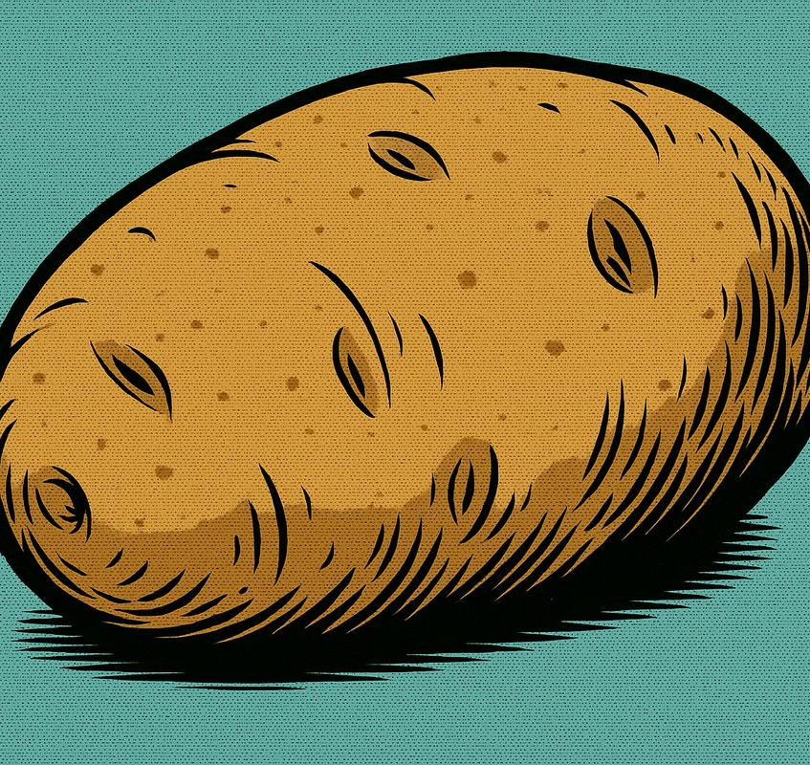
potato
po-TA-to
Notes:
Say/play 'potato' naturally twice. Students clap + chin trick, type the beat count in chat. Then echo the breakdown together (muted choral ×2). Quick circling: a question connecting 'potato' to their lives.

Slide 5
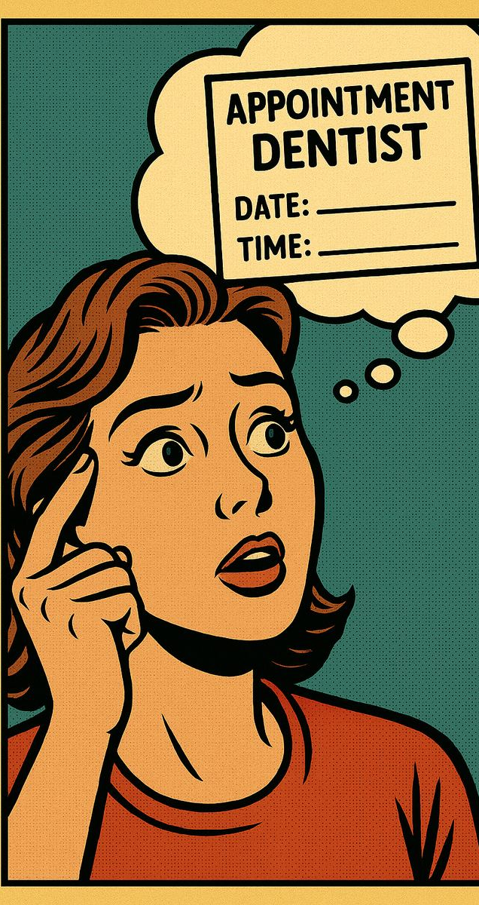
remember
re-MEM-ber
Notes:
Say/play 'remember' naturally twice. Students clap + chin trick, type the beat count in chat. Then echo the breakdown together (muted choral ×2). Quick circling: a question connecting 'remember' to their lives.

Slide 6

celebrate
CEL-e-brate
Notes:
Say/play 'celebrate' naturally twice. Students clap + chin trick, type the beat count in chat. Then echo the breakdown together (muted choral ×2). Quick circling: a question connecting 'celebrate' to their lives.

Slide 7
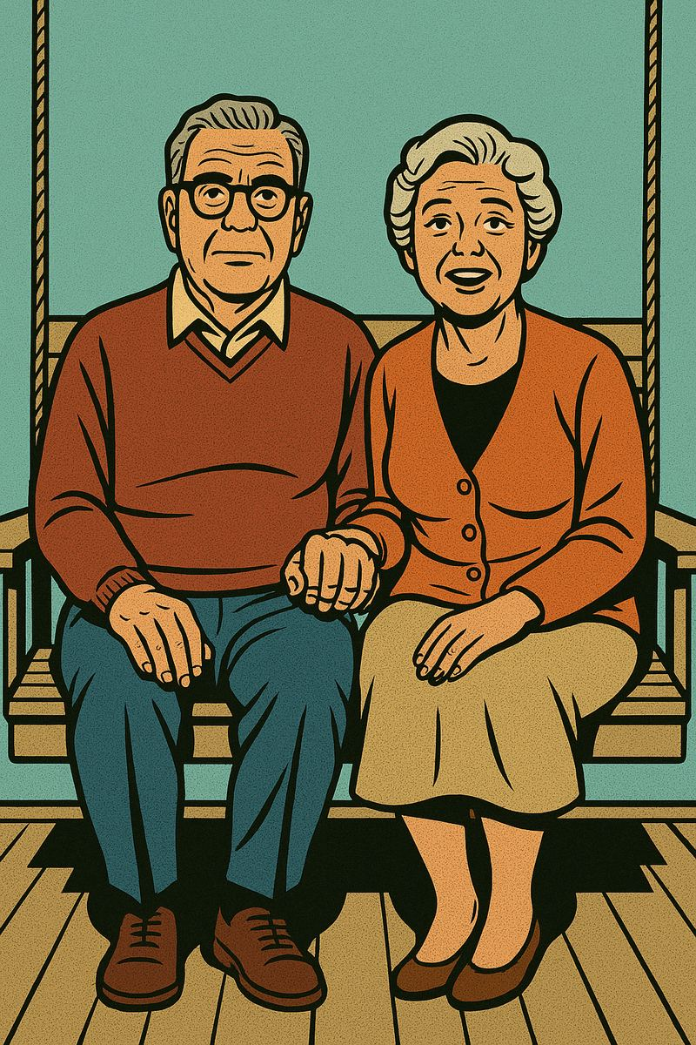
together
to-GETH-er
Notes:
Say/play 'together' naturally twice. Students clap + chin trick, type the beat count in chat. Then echo the breakdown together (muted choral ×2). Quick circling: a question connecting 'together' to their lives.

Slide 8

money
MON-ey
Notes:
Say/play 'money' naturally twice. Students clap + chin trick, type the beat count in chat. Then echo the breakdown together (muted choral ×2). Quick circling: a question connecting 'money' to their lives.

Slide 9
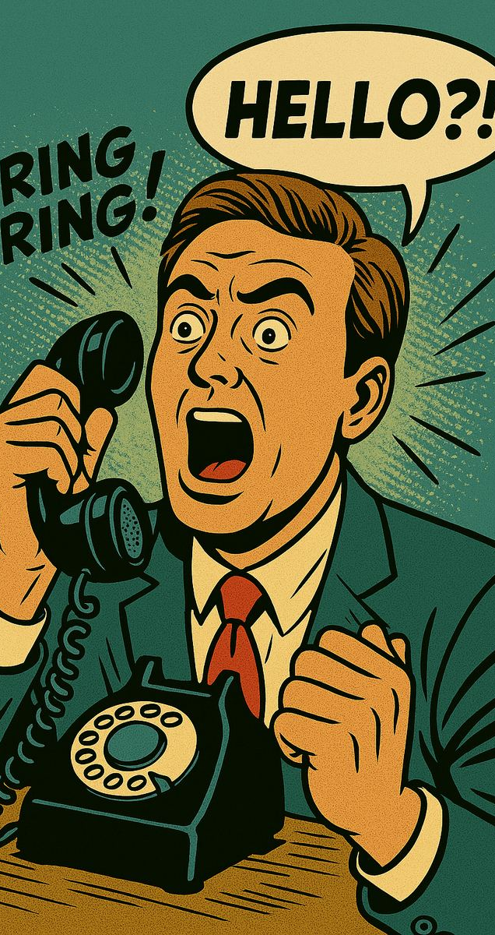
phone call
PHONE call
Notes:
Say/play 'phone call' naturally twice. Students clap + chin trick, type the beat count in chat. Then echo the breakdown together (muted choral ×2). Quick circling: a question connecting 'phone call' to their lives.

Slide 10
hello
hel-LO
Notes:
Say/play 'hello' naturally twice. Students clap + chin trick, type the beat count in chat. Then echo the breakdown together (muted choral ×2). Quick circling: a question connecting 'hello' to their lives.

Slide 11

surprise
sur-PRISE
Notes:
Say/play 'surprise' naturally twice. Students clap + chin trick, type the beat count in chat. Then echo the breakdown together (muted choral ×2). Quick circling: a question connecting 'surprise' to their lives.

