Slide 1
M U R R A Y ' S E N G L I S H
Syllable Stress
One beat is the boss — louder, longer, stronger 👑
DAY 7
Notes:
ORIGINAL TEACHER INSTRUCTIONS (moved off the old slide 1):
👨‍🏫 Teacher Instructions:
This deck is for introducing syllable stress. Each slide includes a word and a comic-style image.
- Say the word aloud.
- Have students repeat.
- Point out the stressed syllable visually.
- Ask students to identify which syllable is strong.
🎯 Goal: Help students hear and feel the rhythm of English words.
FLOW: each slide, say the word naturally → students punch-gesture on the boss beat → typed check in chat (which number beat is strong?) → echo with exaggerated stress, muted choral ×2.

Slide 2
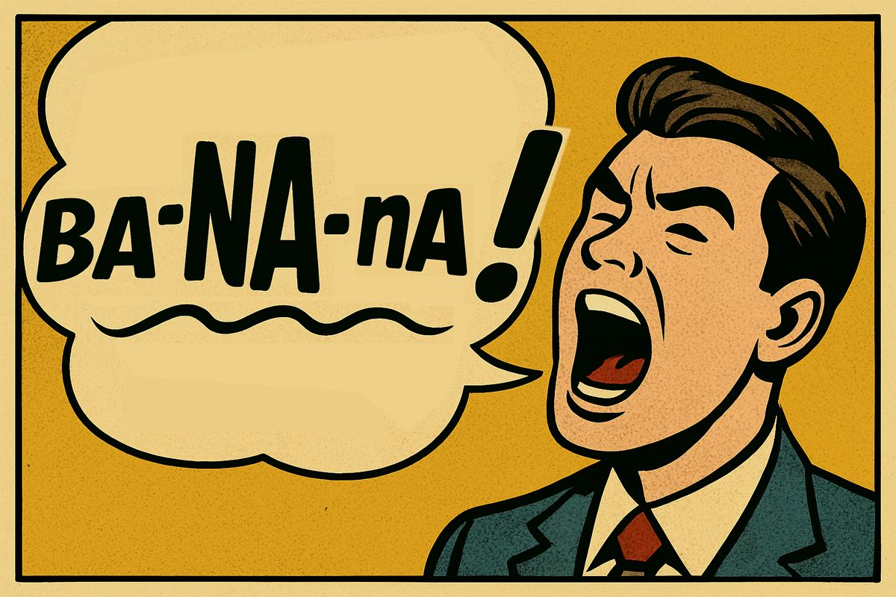
🎵 Syllable Stress
Notes:
Say the word naturally twice. Punch gesture on the strong beat — students copy. Ask: which beat is the boss? Type the number in chat. Then exaggerate it together (muted choral). LOUDER · LONGER · STRONGER.

Slide 3

Notes:
Say the word naturally twice. Punch gesture on the strong beat — students copy. Ask: which beat is the boss? Type the number in chat. Then exaggerate it together (muted choral). LOUDER · LONGER · STRONGER.

Slide 4

Notes:
Say the word naturally twice. Punch gesture on the strong beat — students copy. Ask: which beat is the boss? Type the number in chat. Then exaggerate it together (muted choral). LOUDER · LONGER · STRONGER.

Slide 5

Notes:
Say the word naturally twice. Punch gesture on the strong beat — students copy. Ask: which beat is the boss? Type the number in chat. Then exaggerate it together (muted choral). LOUDER · LONGER · STRONGER.

Slide 6

Notes:
Say the word naturally twice. Punch gesture on the strong beat — students copy. Ask: which beat is the boss? Type the number in chat. Then exaggerate it together (muted choral). LOUDER · LONGER · STRONGER.

Slide 7
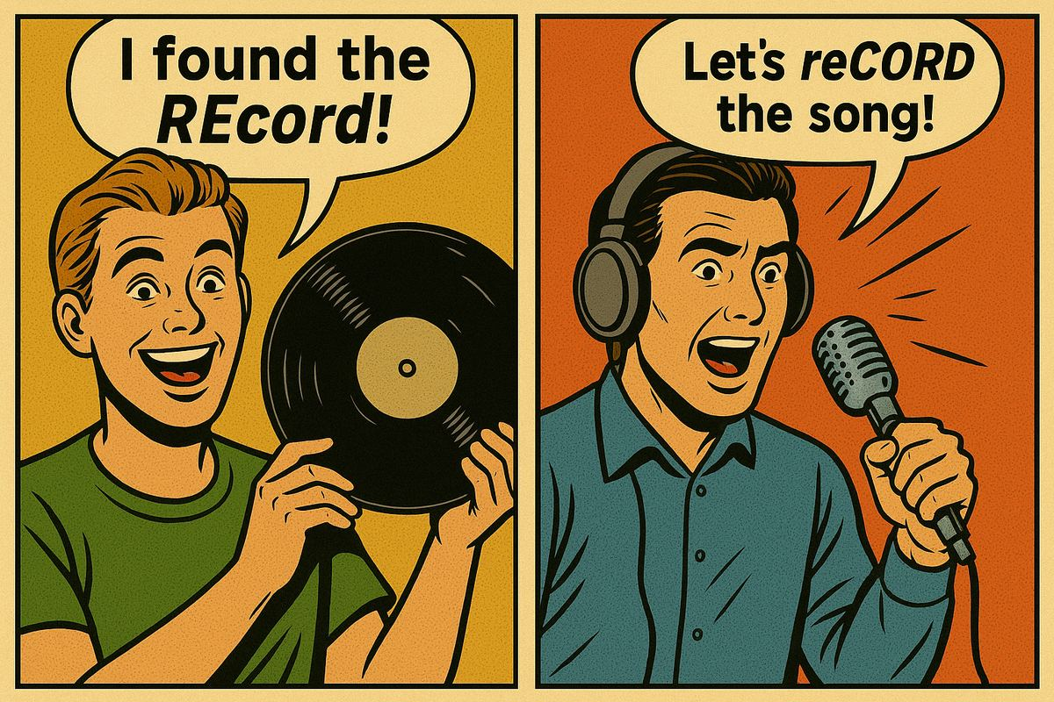
REcord vs reCORD
Notes:
Say the word naturally twice. Punch gesture on the strong beat — students copy. Ask: which beat is the boss? Type the number in chat. Then exaggerate it together (muted choral). LOUDER · LONGER · STRONGER.

Slide 8
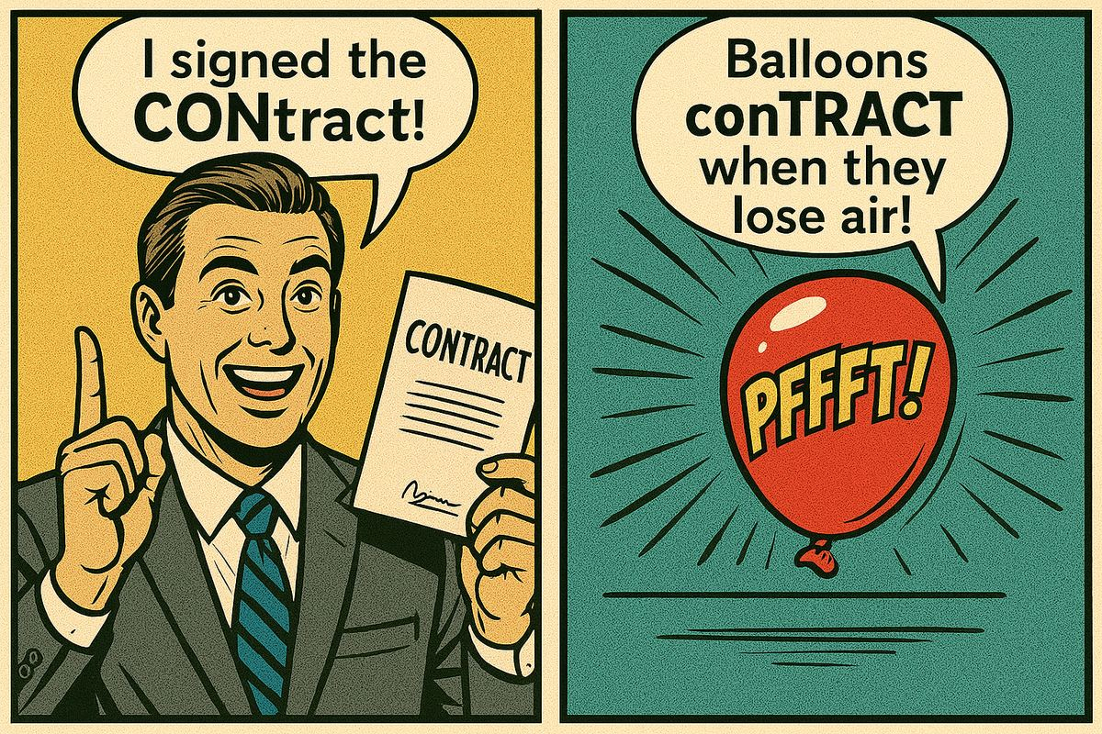
CONtract vs conTRACT
Notes:
Say the word naturally twice. Punch gesture on the strong beat — students copy. Ask: which beat is the boss? Type the number in chat. Then exaggerate it together (muted choral). LOUDER · LONGER · STRONGER.

Slide 9
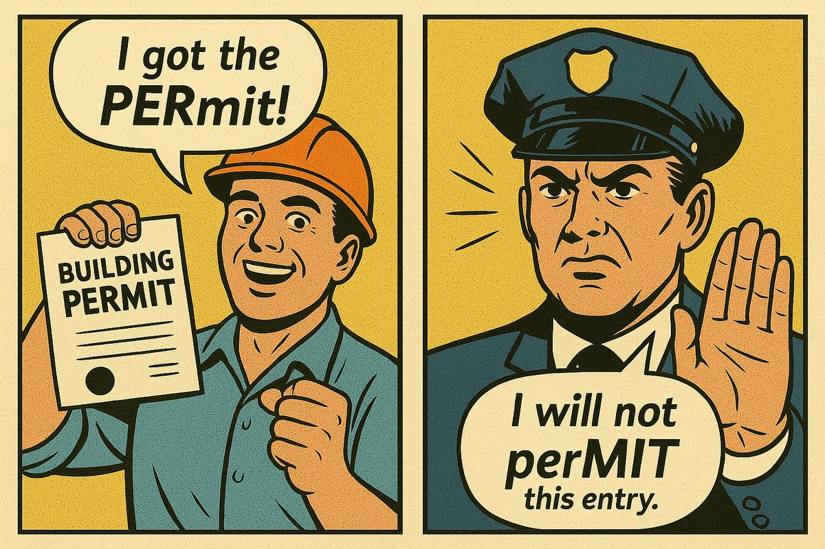
PERmit vs perMIT
Notes:
Say the word naturally twice. Punch gesture on the strong beat — students copy. Ask: which beat is the boss? Type the number in chat. Then exaggerate it together (muted choral). LOUDER · LONGER · STRONGER.

Slide 10
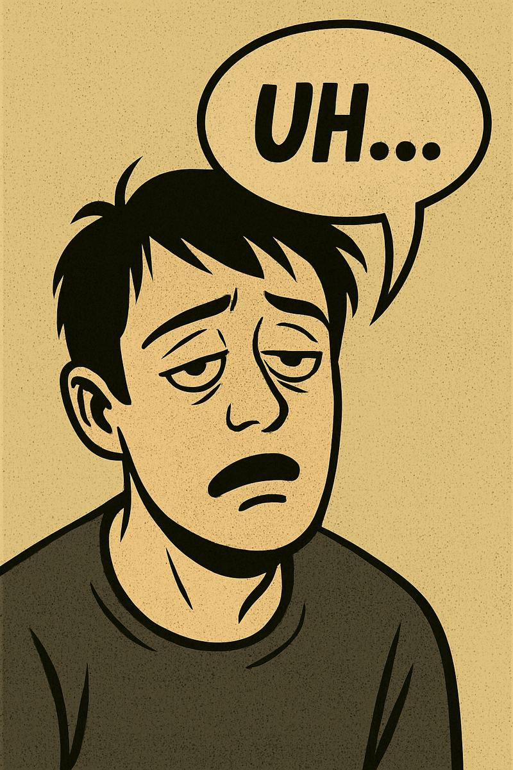
Lazy 'uh' face
“When a syllable isn’t stressed, it gets lazy! Your mouth barely moves. It turns into the lazy ‘uh’ sound.”
Notes:
💤 “Lazy ‘uh’ Face” Slide
This is a conceptual bridge to Schwa:
It signals to students:
“When a syllable isn’t stressed, it gets lazy! Your mouth barely moves. It turns into the lazy ‘uh’ sound.”
Invite students to make the tired/lazy face and say “uhhhh” with a relaxed jaw and lips.
This reinforces how English drops unstressed syllables (a big pronunciation “aha” for many learners).
You can even model it with earlier words (e.g. banana = buh-NA-nuh).

