Slide 1
M U R R A Y ' S E N G L I S H
Stress with Images
ba·NAN·a — SEE the boss beat 👑
DAY 7
Notes:
ORIGINAL SLIDE-1 TEXT (moved to notes):
Day 5: Syllables – Deck A
Syllable Stress Practice with Images
Say the word naturally twice. Students punch-gesture on the boss beat (the big/accented syllable on screen). Type which beat number is the boss. Echo with exaggerated stress, muted choral x2. LOUDER - LONGER - STRONGER.

Slide 2


ba·NAN·a
Notes:
Say the word naturally twice. Students punch-gesture on the boss beat (the big/accented syllable on screen). Type which beat number is the boss. Echo with exaggerated stress, muted choral x2. LOUDER - LONGER - STRONGER.

Slide 3

um-BREL-la
Notes:
Say the word naturally twice. Students punch-gesture on the boss beat (the big/accented syllable on screen). Type which beat number is the boss. Echo with exaggerated stress, muted choral x2. LOUDER - LONGER - STRONGER.

Slide 4

FAM-i-ly
Notes:
Say the word naturally twice. Students punch-gesture on the boss beat (the big/accented syllable on screen). Type which beat number is the boss. Echo with exaggerated stress, muted choral x2. LOUDER - LONGER - STRONGER.

Slide 5

com-PUT-er
Notes:
Say the word naturally twice. Students punch-gesture on the boss beat (the big/accented syllable on screen). Type which beat number is the boss. Echo with exaggerated stress, muted choral x2. LOUDER - LONGER - STRONGER.

Slide 6

EL-e-phant
Notes:
Say the word naturally twice. Students punch-gesture on the boss beat (the big/accented syllable on screen). Type which beat number is the boss. Echo with exaggerated stress, muted choral x2. LOUDER - LONGER - STRONGER.

Slide 7

e-MER-gen-cy
Notes:
Say the word naturally twice. Students punch-gesture on the boss beat (the big/accented syllable on screen). Type which beat number is the boss. Echo with exaggerated stress, muted choral x2. LOUDER - LONGER - STRONGER.

Slide 8
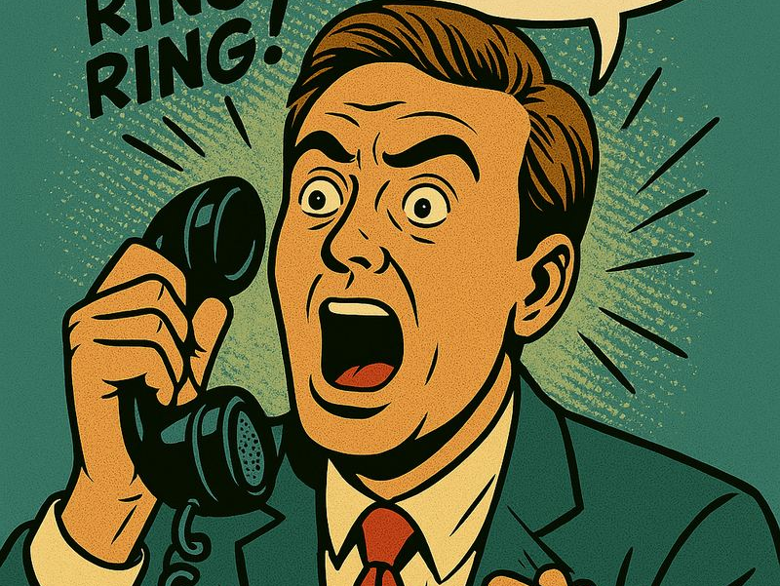
TEL-e-phone
Notes:
Say the word naturally twice. Students punch-gesture on the boss beat (the big/accented syllable on screen). Type which beat number is the boss. Echo with exaggerated stress, muted choral x2. LOUDER - LONGER - STRONGER.

Slide 9

im-POR-tant
Notes:
Say the word naturally twice. Students punch-gesture on the boss beat (the big/accented syllable on screen). Type which beat number is the boss. Echo with exaggerated stress, muted choral x2. LOUDER - LONGER - STRONGER.

