Slide 1
M U R R A Y ' S E N G L I S H
Syllables & Stress — Big Game
Step 1: count the beats · Step 2: find the boss 👑
DAY 7
Notes:
ORIGINAL SLIDE-1 TEXT (moved to notes):
🎯 Teacher Instructions
Use this deck on Zoom.
For each word:
1. Say the word clearly twice.
2. Ask students to type the syllables in chat (e.g., ba-nan-a).
3. Say the word again.
4. Ask: 'Which syllable is stressed?' Students type the number.
💡 Tip: Use your hand under your jaw to count syllables.
Two-step Zoom game per word: (1) say the word, students type the syllables in chat; (2) say it again, they type which beat is STRONG. Keep pace lively; choral the word with a punch on the boss beat after each reveal.

Slide 2
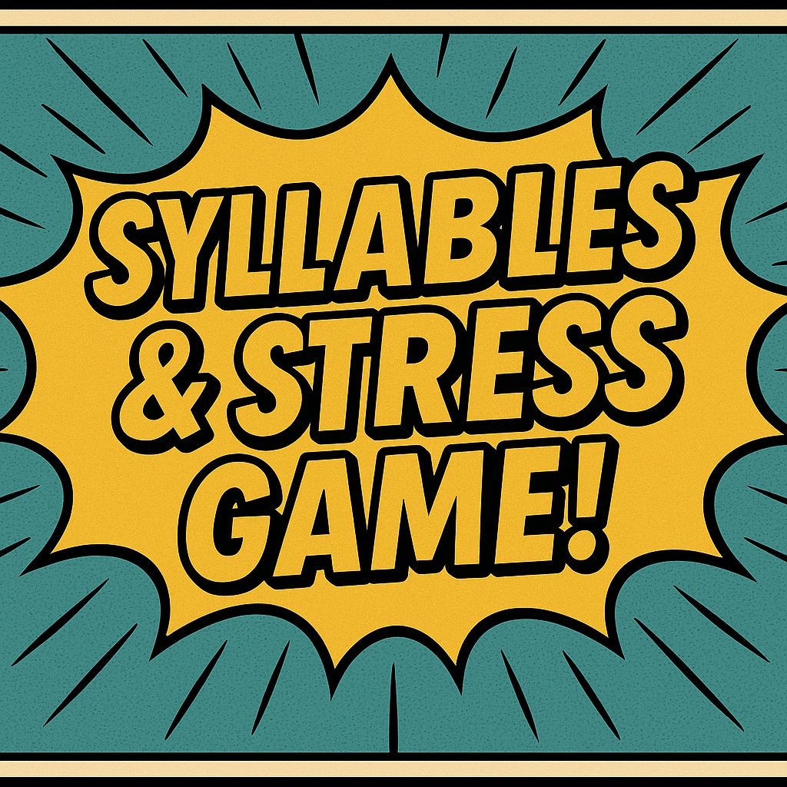
SYLLABLES & STRESS GAME!
Notes:
Two-step Zoom game per word: (1) say the word, students type the syllables in chat; (2) say it again, they type which beat is STRONG. Keep pace lively; choral the word with a punch on the boss beat after each reveal.

Slide 3
DAY 7
GAME
How to play — two steps!
1️⃣ 👂 I say a word — you type its beats: wa-ter
2️⃣ 👑 Which beat is the BOSS? Type the number: 1
💬 TYPE BOTH IN THE CHAT
Notes:
How-to slide rebuilt (the old one showed 'banana' — the first answer!). Demo with 'water': say it, type wa-ter, boss is beat 1 (WA-ter). Then start the game: first word is banana. Per word: step 1 type the syllables, step 2 type the boss number.

Slide 4


banana
ba-nan-a
Which syllable is stressed?
Notes:
Two-step Zoom game per word: (1) say the word, students type the syllables in chat; (2) say it again, they type which beat is STRONG. Keep pace lively; choral the word with a punch on the boss beat after each reveal.

Slide 5

elephant
el-e-phant
Which syllable is stressed?
Notes:
Two-step Zoom game per word: (1) say the word, students type the syllables in chat; (2) say it again, they type which beat is STRONG. Keep pace lively; choral the word with a punch on the boss beat after each reveal.

Slide 6

computer
com-put-er
Which syllable is stressed?
Notes:
Two-step Zoom game per word: (1) say the word, students type the syllables in chat; (2) say it again, they type which beat is STRONG. Keep pace lively; choral the word with a punch on the boss beat after each reveal.

Slide 7

umbrella
um-brel-la
Which syllable is stressed?
Notes:
Two-step Zoom game per word: (1) say the word, students type the syllables in chat; (2) say it again, they type which beat is STRONG. Keep pace lively; choral the word with a punch on the boss beat after each reveal.

Slide 8

family
fam-i-ly
Which syllable is stressed?
Notes:
Two-step Zoom game per word: (1) say the word, students type the syllables in chat; (2) say it again, they type which beat is STRONG. Keep pace lively; choral the word with a punch on the boss beat after each reveal.

Slide 9
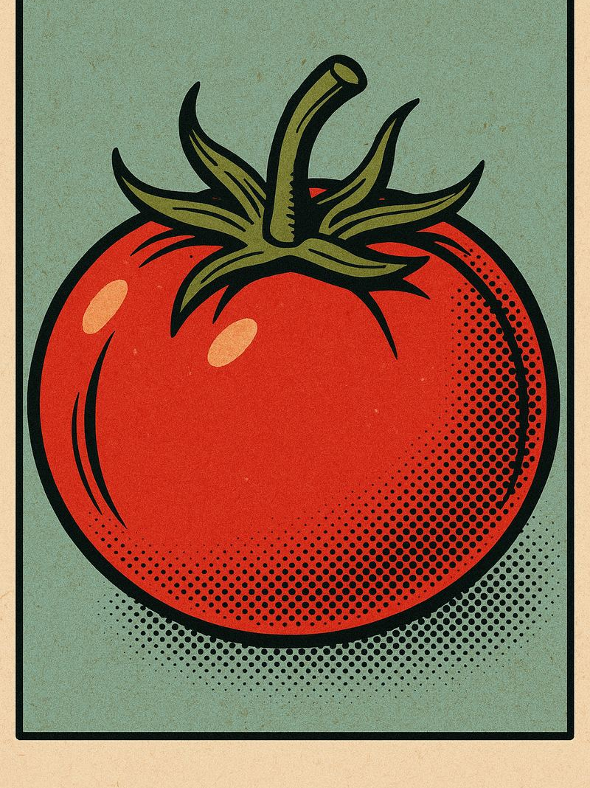
tomato
to-ma-to
Which syllable is stressed?
Notes:
Two-step Zoom game per word: (1) say the word, students type the syllables in chat; (2) say it again, they type which beat is STRONG. Keep pace lively; choral the word with a punch on the boss beat after each reveal.

Slide 10

zebra
ze-bra
Which syllable is stressed?
Notes:
Two-step Zoom game per word: (1) say the word, students type the syllables in chat; (2) say it again, they type which beat is STRONG. Keep pace lively; choral the word with a punch on the boss beat after each reveal.

Slide 11

giraffe
gi-raffe
Which syllable is stressed?
Notes:
Two-step Zoom game per word: (1) say the word, students type the syllables in chat; (2) say it again, they type which beat is STRONG. Keep pace lively; choral the word with a punch on the boss beat after each reveal.

Slide 12
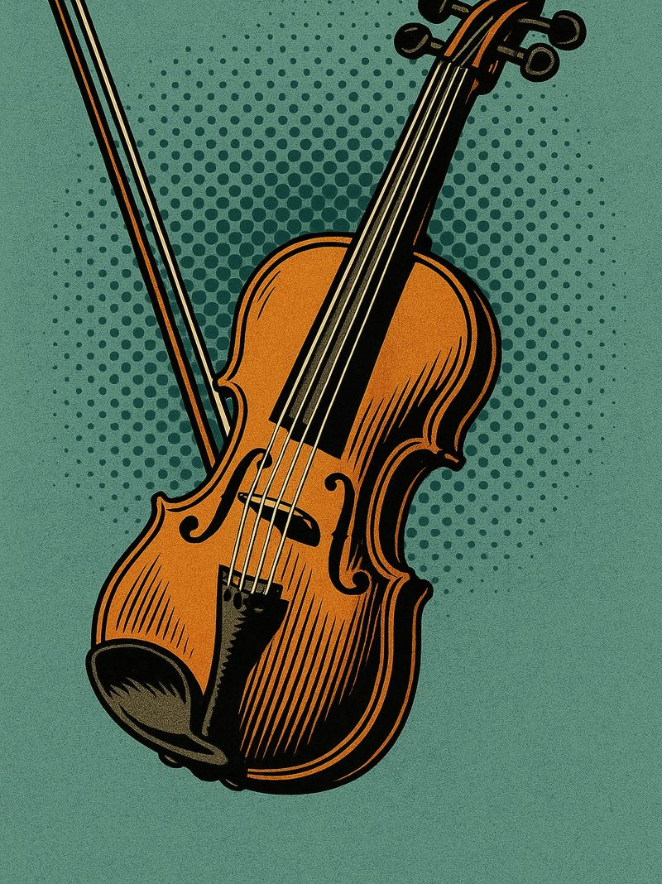
violin
vi-o-lin
Which syllable is stressed?
Notes:
Two-step Zoom game per word: (1) say the word, students type the syllables in chat; (2) say it again, they type which beat is STRONG. Keep pace lively; choral the word with a punch on the boss beat after each reveal.

