Slide 1
M U R R A Y ' S E N G L I S H
TH — Tongue Out!
thin or then? Feel your throat 👅
DAY 8
Notes:
ORIGINAL SLIDE-1 TEXT (moved to notes):
Voiced vs Unvoiced
th
Minimal Pairs
👉 “Usas tu voz. Puedes sentir la vibración en tu garganta.”
👉 “No usas tu voz. Solo aire. No hay vibración.
👉 «با صداست. گلویتان می‌لرزد.»
👉 «بی‌صداست. فقط هواست. گلویتان نمی‌لرزد.»
👉 “Ти використовуєш голос. Горло вібрує.”
👉 “Без голосу. Тільки повітря. Горло не вібрує.”
👉 “Ты используешь голос. Горло вибрирует.”
👉 “Без голоса. Только воздух. Горло не вибрирует.”
Per pair: model with tongue VISIBLY out (camera close-up). Voiced th (this, then) = throat buzzes; voiceless (thin, think) = no buzz. Hand on throat. Say one word, students type 1 or 2 in chat, reveal, choral x2. Spanish support from the original deck is in the slides.

Slide 2
DAY 8
TEACH
🖐️ Voiced or voiceless? The throat decides!
🐝 VOICED
🤫 VOICELESS
throat BUZZES
throat is QUIET
b · d · g · v · z
p · t · k · f · s
th in “this”
th in “think”
Same mouth shape — your hand on your throat tells you which!
Notes:
THE DIAGRAM (Murray's request): voiced vs voiceless, back from Day 5's throat trick. Everyone hand-on-throat: bzzzz (shakes) vs ssss (quiet). Punchline: TH comes in BOTH flavors — 'this' buzzes, 'think' doesn't. Same tongue position; the throat decides. This concept powers the whole TH deck.

Slide 3


🎧 Which word do you hear?
thin
then
Notes:
Per pair: model with tongue VISIBLY out (camera close-up). Voiced th (this, then) = throat buzzes; voiceless (thin, think) = no buzz. Hand on throat. Say one word, students type 1 or 2 in chat, reveal, choral x2. Spanish support from the original deck is in the slides.

Slide 4
Voiced vs Unvoiced TH: THIN vs THEN
thin
then
1
2
🎧 Which word do you hear?
👂 Teacher says one word. 👉 Point to the correct word.
Notes:
Per pair: model with tongue VISIBLY out (camera close-up). Voiced th (this, then) = throat buzzes; voiceless (thin, think) = no buzz. Hand on throat. Say one word, students type 1 or 2 in chat, reveal, choral x2. Spanish support from the original deck is in the slides.

Slide 5

🎧 Which word do you hear?
think
that
Notes:
Per pair: model with tongue VISIBLY out (camera close-up). Voiced th (this, then) = throat buzzes; voiceless (thin, think) = no buzz. Hand on throat. Say one word, students type 1 or 2 in chat, reveal, choral x2. Spanish support from the original deck is in the slides.

Slide 6
Voiced vs Unvoiced TH: THINK vs THAT
think
that
1
2
🎧 Which word do you hear?
👂 Teacher says one word. 👉 Point to the correct word.
Notes:
Per pair: model with tongue VISIBLY out (camera close-up). Voiced th (this, then) = throat buzzes; voiceless (thin, think) = no buzz. Hand on throat. Say one word, students type 1 or 2 in chat, reveal, choral x2. Spanish support from the original deck is in the slides.

Slide 7
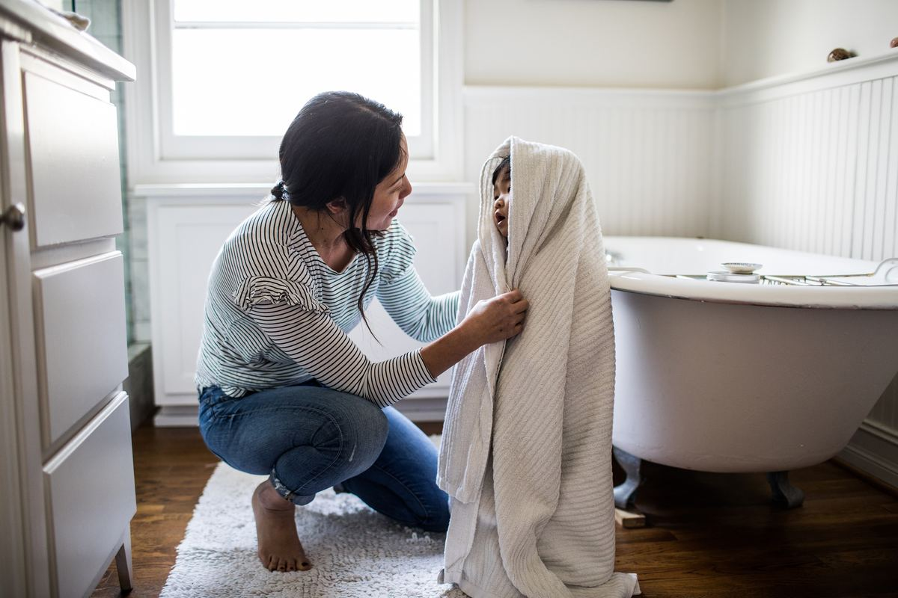
🎧 Which word do you hear?
bath
bathe
Notes:
Per pair: model with tongue VISIBLY out (camera close-up). Voiced th (this, then) = throat buzzes; voiceless (thin, think) = no buzz. Hand on throat. Say one word, students type 1 or 2 in chat, reveal, choral x2. Spanish support from the original deck is in the slides.

Slide 8
Voiced vs Unvoiced TH: BATH vs BATHE
bath
bathe
1
2
🎧 Which word do you hear?
👂 Teacher says one word. 👉 Point to the correct word.
Notes:
Per pair: model with tongue VISIBLY out (camera close-up). Voiced th (this, then) = throat buzzes; voiceless (thin, think) = no buzz. Hand on throat. Say one word, students type 1 or 2 in chat, reveal, choral x2. Spanish support from the original deck is in the slides.

Slide 9
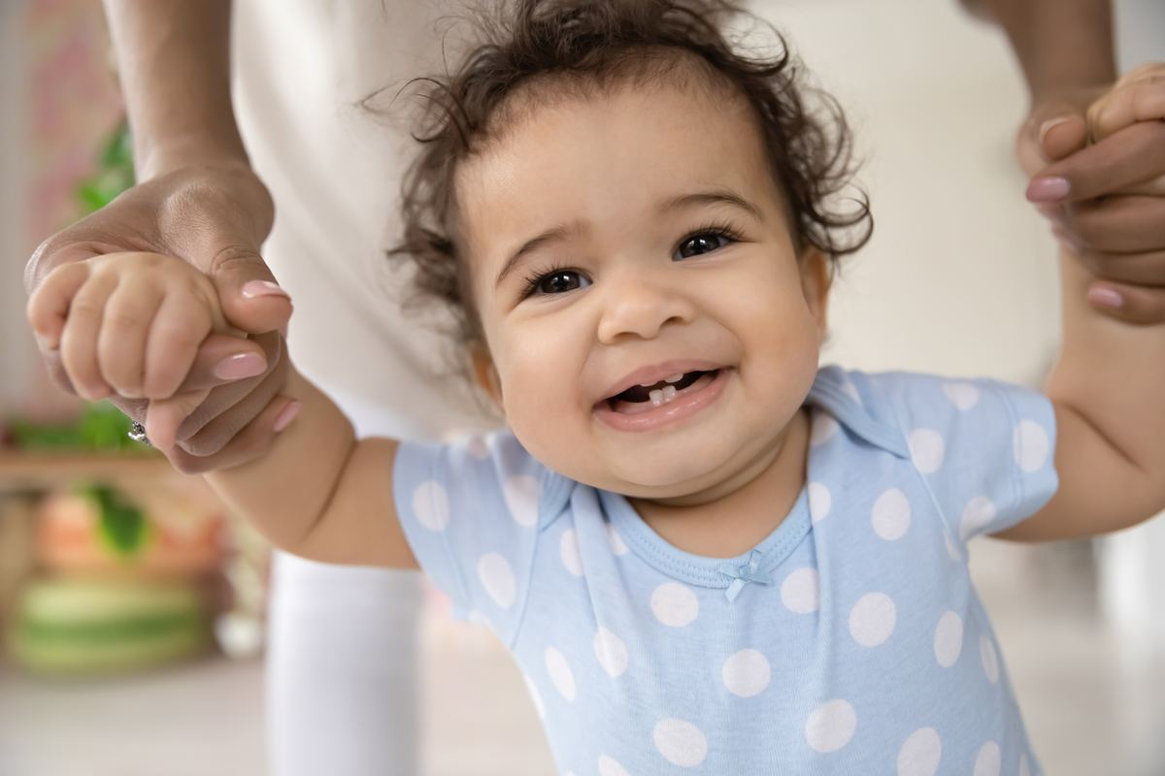
🎧 Which word do you hear?
teeth
teethe
Notes:
Per pair: model with tongue VISIBLY out (camera close-up). Voiced th (this, then) = throat buzzes; voiceless (thin, think) = no buzz. Hand on throat. Say one word, students type 1 or 2 in chat, reveal, choral x2. Spanish support from the original deck is in the slides.

Slide 10
Voiced vs Unvoiced TH: TEETH vs TEETHE
teeth
teethe
1
2
🎧 Which word do you hear?
👂 Teacher says one word. 👉 Point to the correct word.
Notes:
Per pair: model with tongue VISIBLY out (camera close-up). Voiced th (this, then) = throat buzzes; voiceless (thin, think) = no buzz. Hand on throat. Say one word, students type 1 or 2 in chat, reveal, choral x2. Spanish support from the original deck is in the slides.

Slide 11

thank
they
Notes:
Per pair: model with tongue VISIBLY out (camera close-up). Voiced th (this, then) = throat buzzes; voiceless (thin, think) = no buzz. Hand on throat. Say one word, students type 1 or 2 in chat, reveal, choral x2. Spanish support from the original deck is in the slides.

Slide 12
thank
they
1
2
🎧 Which word do you hear?
👂 Teacher says one word. 👉 Point to the correct word.
Notes:
Per pair: model with tongue VISIBLY out (camera close-up). Voiced th (this, then) = throat buzzes; voiceless (thin, think) = no buzz. Hand on throat. Say one word, students type 1 or 2 in chat, reveal, choral x2. Spanish support from the original deck is in the slides.

Slide 13
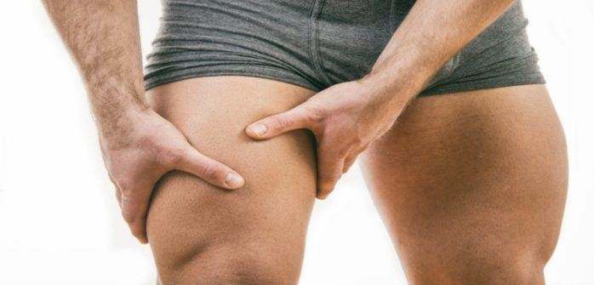
thigh
thy
Notes:
Per pair: model with tongue VISIBLY out (camera close-up). Voiced th (this, then) = throat buzzes; voiceless (thin, think) = no buzz. Hand on throat. Say one word, students type 1 or 2 in chat, reveal, choral x2. Spanish support from the original deck is in the slides.

Slide 14
thigh
thy
1
2
🎧 Which word do you hear?
👂 Teacher says one word. 👉 Point to the correct word.
Notes:
Per pair: model with tongue VISIBLY out (camera close-up). Voiced th (this, then) = throat buzzes; voiceless (thin, think) = no buzz. Hand on throat. Say one word, students type 1 or 2 in chat, reveal, choral x2. Spanish support from the original deck is in the slides.

Slide 15

thief
this
Notes:
Per pair: model with tongue VISIBLY out (camera close-up). Voiced th (this, then) = throat buzzes; voiceless (thin, think) = no buzz. Hand on throat. Say one word, students type 1 or 2 in chat, reveal, choral x2. Spanish support from the original deck is in the slides.

Slide 16
thief
this
1
2
🎧 Which word do you hear?
👂 Teacher says one word. 👉 Point to the correct word.
Notes:
Per pair: model with tongue VISIBLY out (camera close-up). Voiced th (this, then) = throat buzzes; voiceless (thin, think) = no buzz. Hand on throat. Say one word, students type 1 or 2 in chat, reveal, choral x2. Spanish support from the original deck is in the slides.

Slide 17
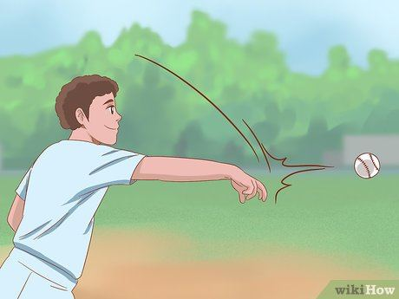
throw
those
Notes:
Per pair: model with tongue VISIBLY out (camera close-up). Voiced th (this, then) = throat buzzes; voiceless (thin, think) = no buzz. Hand on throat. Say one word, students type 1 or 2 in chat, reveal, choral x2. Spanish support from the original deck is in the slides.

Slide 18
throw
those
1
2
🎧 Which word do you hear?
👂 Teacher says one word. 👉 Point to the correct word.
Notes:
Per pair: model with tongue VISIBLY out (camera close-up). Voiced th (this, then) = throat buzzes; voiceless (thin, think) = no buzz. Hand on throat. Say one word, students type 1 or 2 in chat, reveal, choral x2. Spanish support from the original deck is in the slides.

Slide 19
third
there
Notes:
Per pair: model with tongue VISIBLY out (camera close-up). Voiced th (this, then) = throat buzzes; voiceless (thin, think) = no buzz. Hand on throat. Say one word, students type 1 or 2 in chat, reveal, choral x2. Spanish support from the original deck is in the slides.

Slide 20
third
there
1
2
🎧 Which word do you hear?
👂 Teacher says one word. 👉 Point to the correct word.
Notes:
Per pair: model with tongue VISIBLY out (camera close-up). Voiced th (this, then) = throat buzzes; voiceless (thin, think) = no buzz. Hand on throat. Say one word, students type 1 or 2 in chat, reveal, choral x2. Spanish support from the original deck is in the slides.

Slide 21
thought
though
Notes:
Per pair: model with tongue VISIBLY out (camera close-up). Voiced th (this, then) = throat buzzes; voiceless (thin, think) = no buzz. Hand on throat. Say one word, students type 1 or 2 in chat, reveal, choral x2. Spanish support from the original deck is in the slides.

Slide 22
thought
though
1
2
🎧 Which word do you hear?
👂 Teacher says one word. 👉 Point to the correct word.
Notes:
Per pair: model with tongue VISIBLY out (camera close-up). Voiced th (this, then) = throat buzzes; voiceless (thin, think) = no buzz. Hand on throat. Say one word, students type 1 or 2 in chat, reveal, choral x2. Spanish support from the original deck is in the slides.

Slide 23
thirty
The
Notes:
Per pair: model with tongue VISIBLY out (camera close-up). Voiced th (this, then) = throat buzzes; voiceless (thin, think) = no buzz. Hand on throat. Say one word, students type 1 or 2 in chat, reveal, choral x2. Spanish support from the original deck is in the slides.

Slide 24
thirty
the
1
2
🎧 Which word do you hear?
👂 Teacher says one word. 👉 Point to the correct word.
Notes:
Per pair: model with tongue VISIBLY out (camera close-up). Voiced th (this, then) = throat buzzes; voiceless (thin, think) = no buzz. Hand on throat. Say one word, students type 1 or 2 in chat, reveal, choral x2. Spanish support from the original deck is in the slides.

Slide 25
thick
them
Notes:
Per pair: model with tongue VISIBLY out (camera close-up). Voiced th (this, then) = throat buzzes; voiceless (thin, think) = no buzz. Hand on throat. Say one word, students type 1 or 2 in chat, reveal, choral x2. Spanish support from the original deck is in the slides.

