Slide 1
M U R R A Y ' S E N G L I S H
Cape or Cap?
Final listening challenge — vowels are back! 👂
DAY 8
Notes:
ORIGINAL SLIDE-1 TEXT (moved to notes):
cape or cap?
Quick closer game mixing the week's vowel pairs back in: say one word per slide, students point/type which image. Keeps Magic E alive during consonant week.

Slide 2

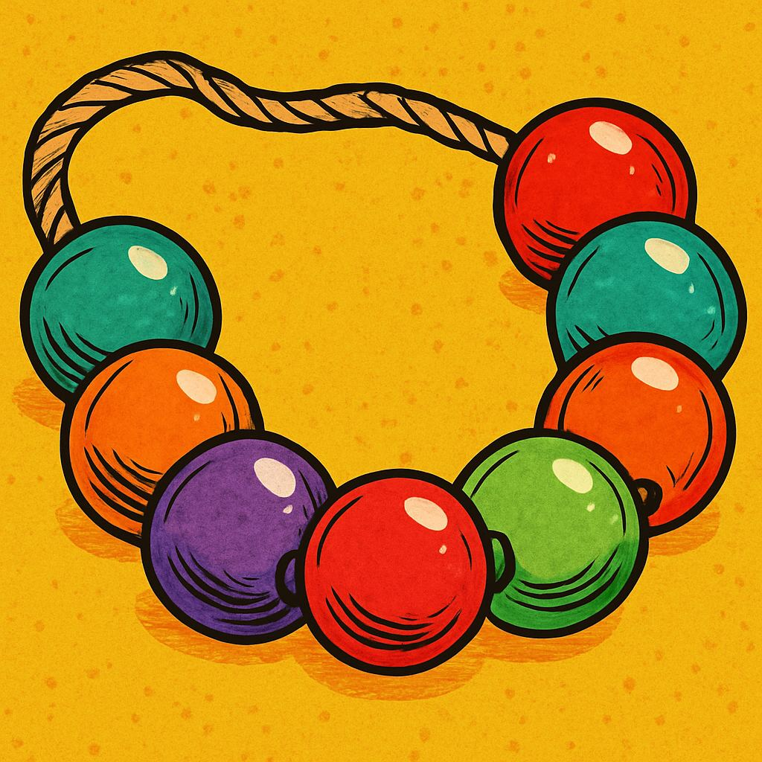
bed or bead?
Notes:
Quick closer game mixing the week's vowel pairs back in: say one word per slide, students point/type which image. Keeps Magic E alive during consonant week.

Slide 3

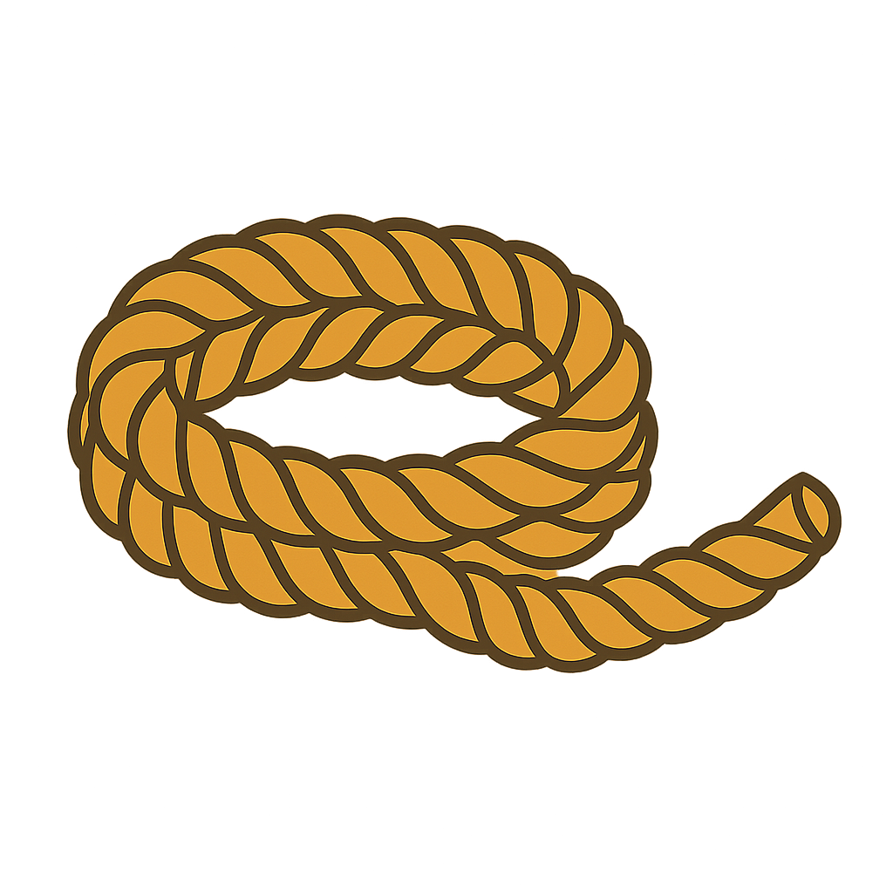
pot or rope?
Notes:
Quick closer game mixing the week's vowel pairs back in: say one word per slide, students point/type which image. Keeps Magic E alive during consonant week.

Slide 4
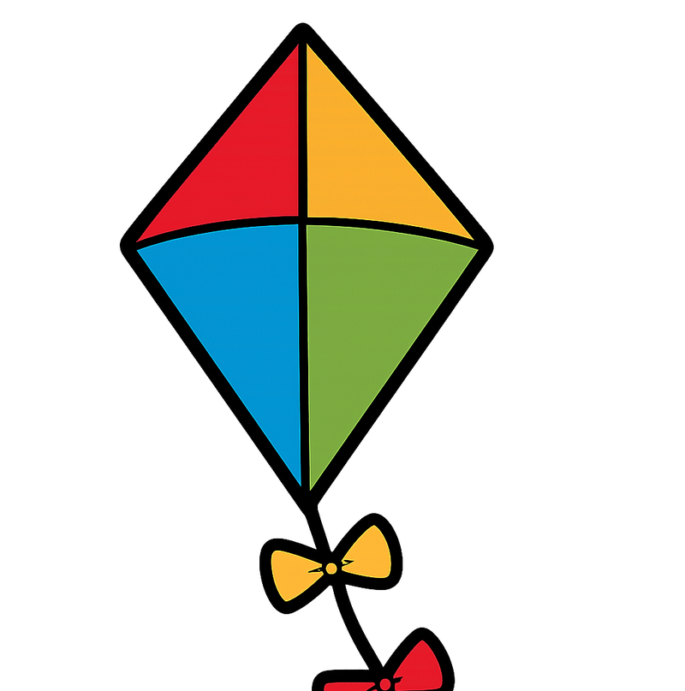
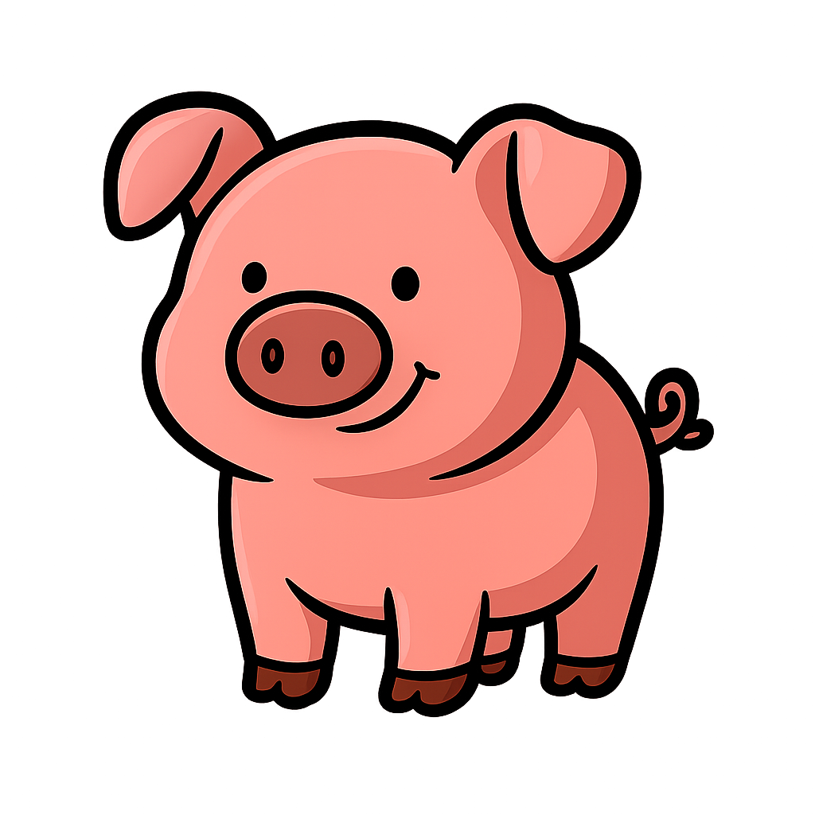
pig or kite?
Notes:
Quick closer game mixing the week's vowel pairs back in: say one word per slide, students point/type which image. Keeps Magic E alive during consonant week.

Slide 5
DAY 8
GAME
pin or pine?
1
2
📌
🌲
pin
pine
Notes:
Say 'pine' twice, natural speed. Students point or type 1/2. Then the other word. Short = quick (fist), long = stretch.

Slide 6
DAY 8
GAME
cub or cube?
1
2
🐻
🧊
cub
cube
Notes:
Say 'cub' twice, natural speed. Students point or type 1/2. Then the other word. Short = quick (fist), long = stretch.

Slide 7
DAY 8
GAME
tub or tube?
1
2
🛁
🧪
tub
tube
Notes:
Say 'tube' twice, natural speed. Students point or type 1/2. Then the other word. Short = quick (fist), long = stretch.

