Slide 1
M U R R A Y ' S E N G L I S H
The Mystery of the Lazy Uh
The schwa comic — English's most relaxed sound 😴
DAY 9
Notes:
The comic deck — let it breathe. Read each panel dramatically, students echo the schwa words. The lazy uh: mouth relaxed, jaw loose, zero effort. Have everyone make the laziest possible 'uh' — like falling onto a sofa.

Slide 2
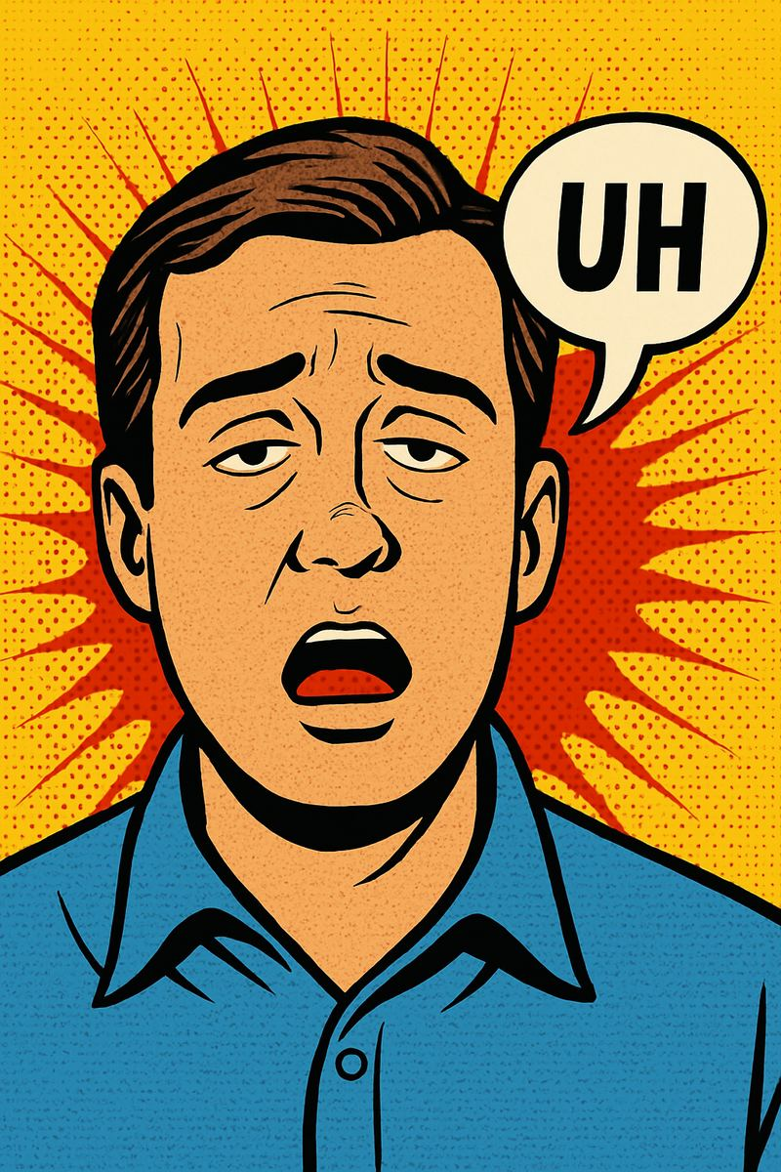
The Mystery of the
Lazy Uh
The most common
(and most relaxed) sound in English!
Notes:
The comic deck — let it breathe. Read each panel dramatically, students echo the schwa words. The lazy uh: mouth relaxed, jaw loose, zero effort. Have everyone make the laziest possible 'uh' — like falling onto a sofa.

Slide 3
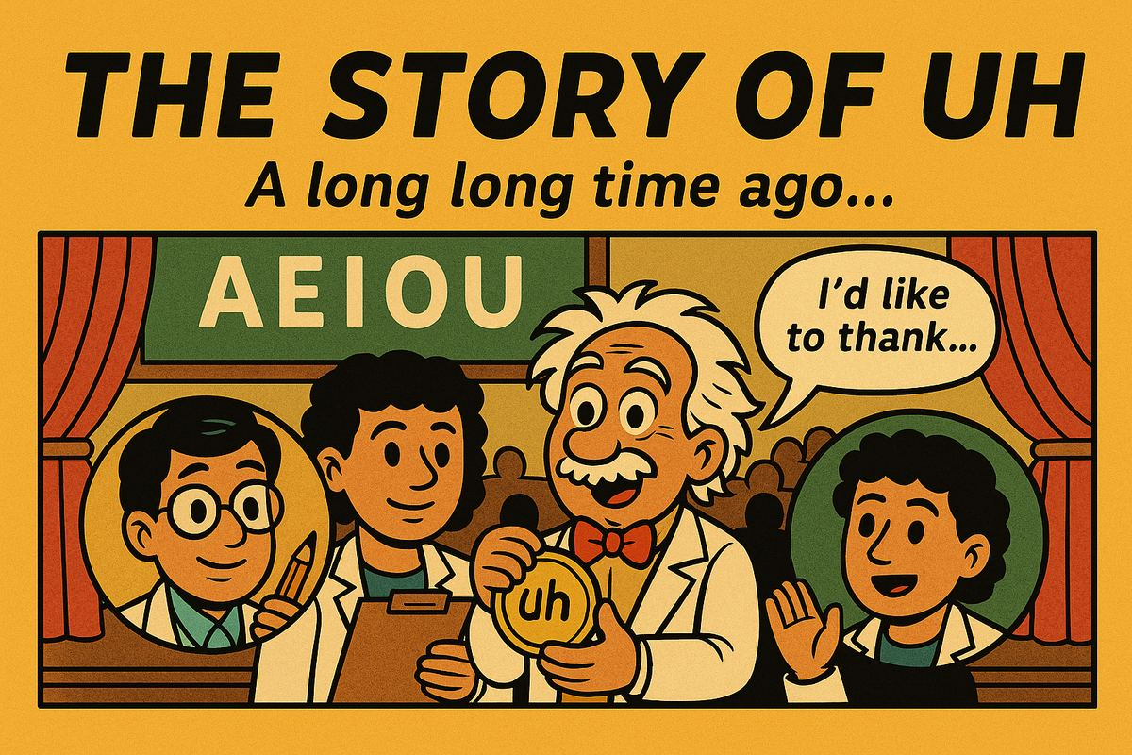
Notes:
The comic deck — let it breathe. Read each panel dramatically, students echo the schwa words. The lazy uh: mouth relaxed, jaw loose, zero effort. Have everyone make the laziest possible 'uh' — like falling onto a sofa.

Slide 4
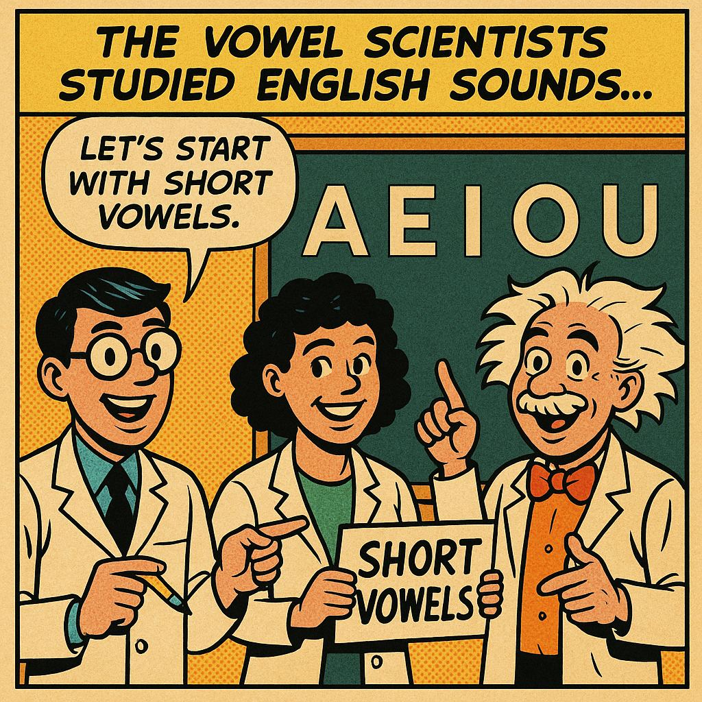
Notes:
The comic deck — let it breathe. Read each panel dramatically, students echo the schwa words. The lazy uh: mouth relaxed, jaw loose, zero effort. Have everyone make the laziest possible 'uh' — like falling onto a sofa.

Slide 5
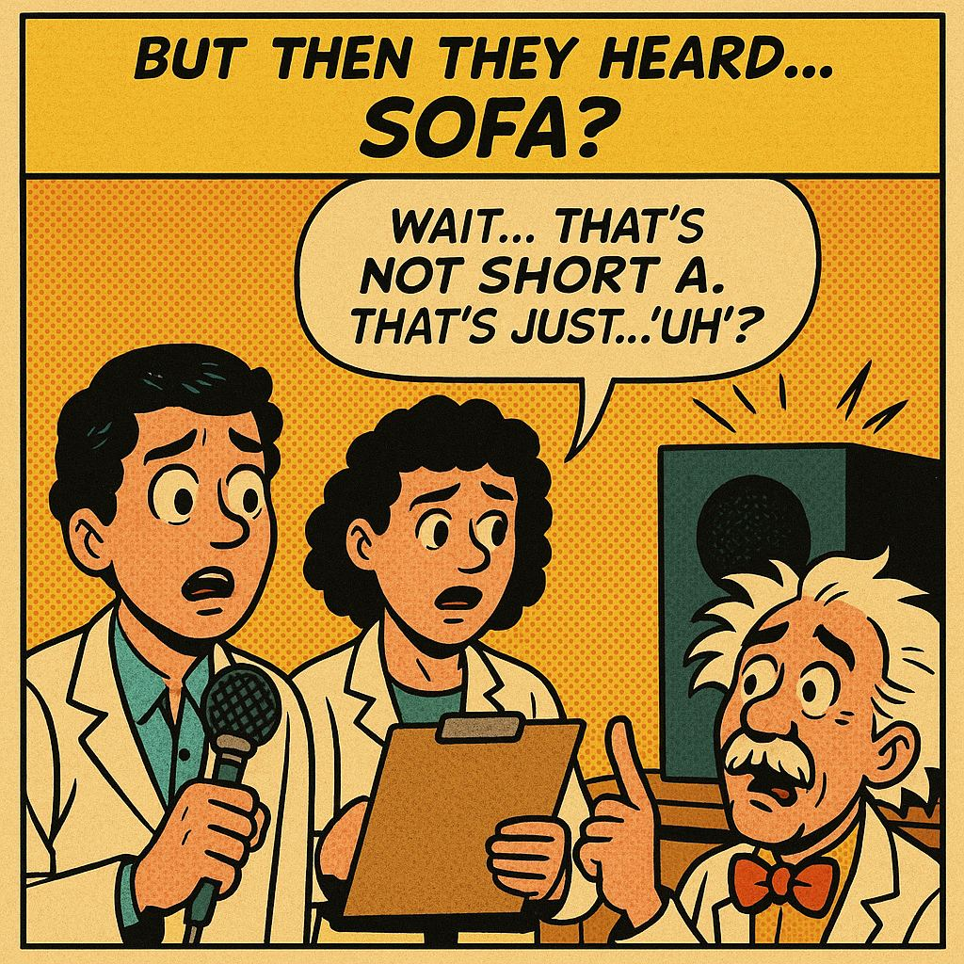
Notes:
The comic deck — let it breathe. Read each panel dramatically, students echo the schwa words. The lazy uh: mouth relaxed, jaw loose, zero effort. Have everyone make the laziest possible 'uh' — like falling onto a sofa.

Slide 6
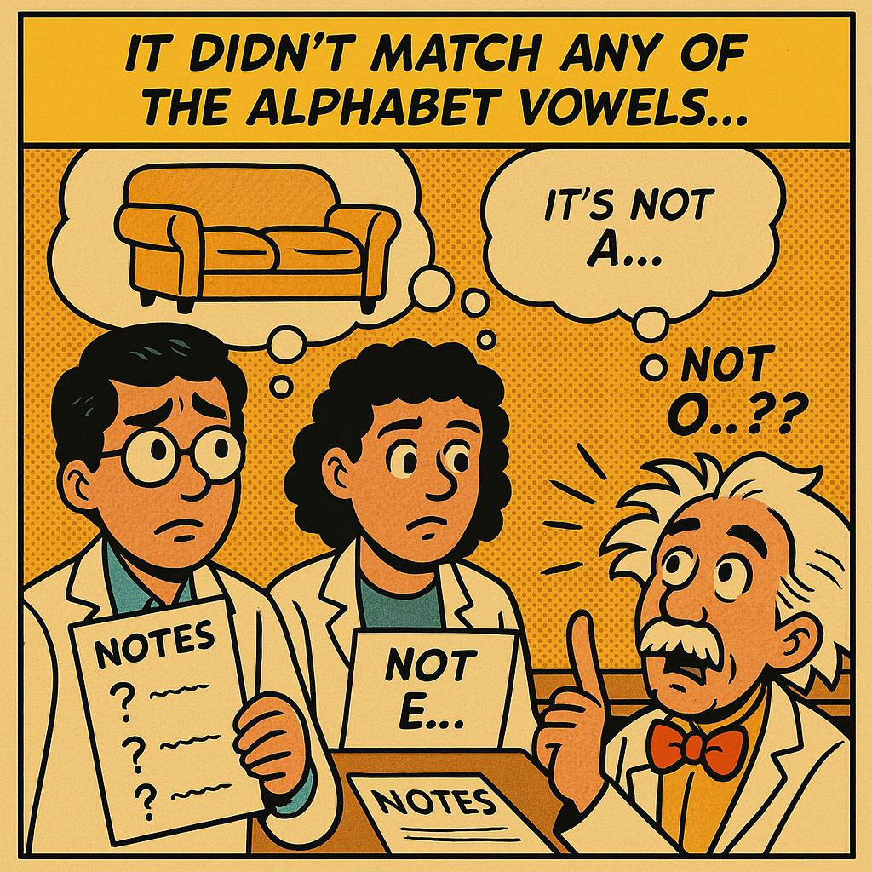
Notes:
The comic deck — let it breathe. Read each panel dramatically, students echo the schwa words. The lazy uh: mouth relaxed, jaw loose, zero effort. Have everyone make the laziest possible 'uh' — like falling onto a sofa.

Slide 7
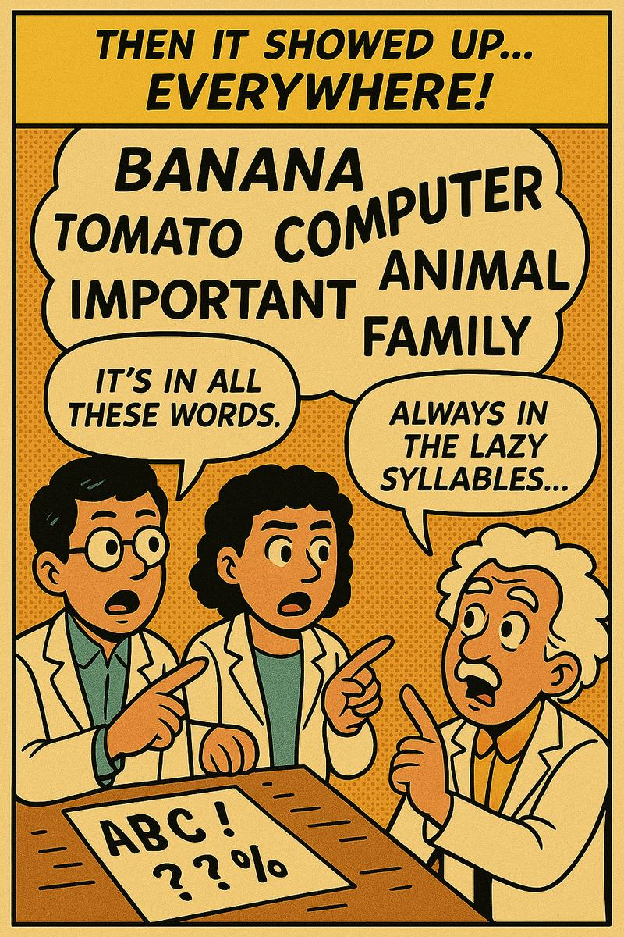
Notes:
The comic deck — let it breathe. Read each panel dramatically, students echo the schwa words. The lazy uh: mouth relaxed, jaw loose, zero effort. Have everyone make the laziest possible 'uh' — like falling onto a sofa.

Slide 8
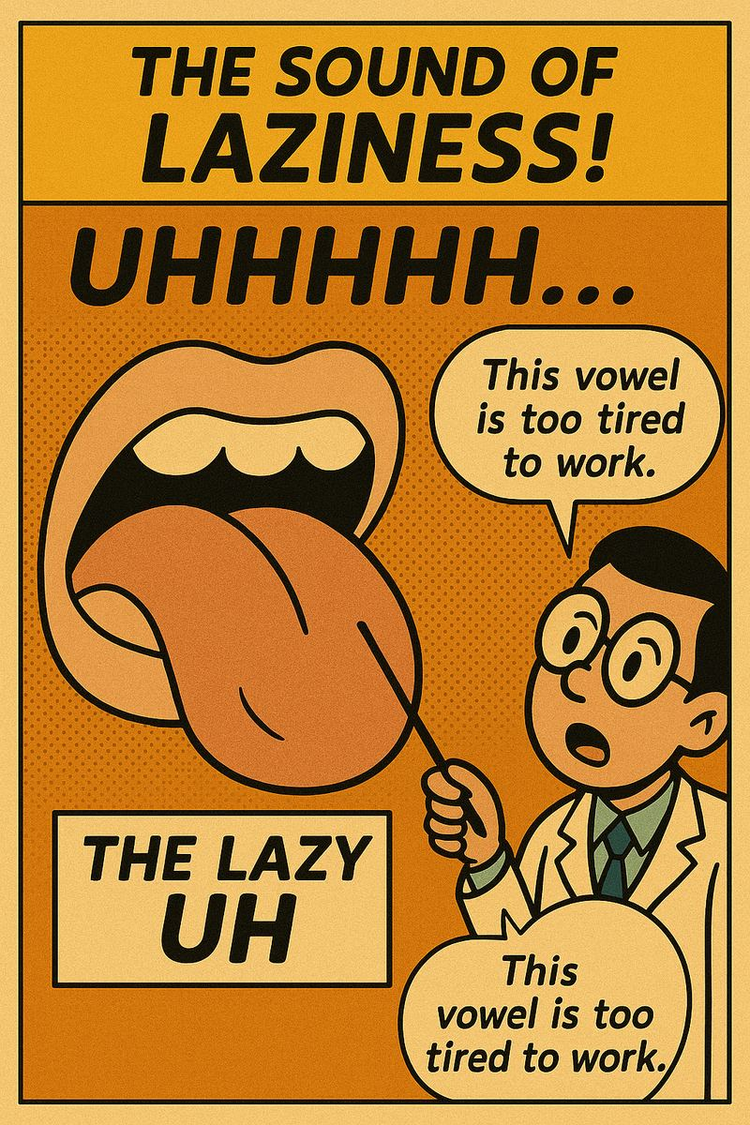
Notes:
The comic deck — let it breathe. Read each panel dramatically, students echo the schwa words. The lazy uh: mouth relaxed, jaw loose, zero effort. Have everyone make the laziest possible 'uh' — like falling onto a sofa.

Slide 9
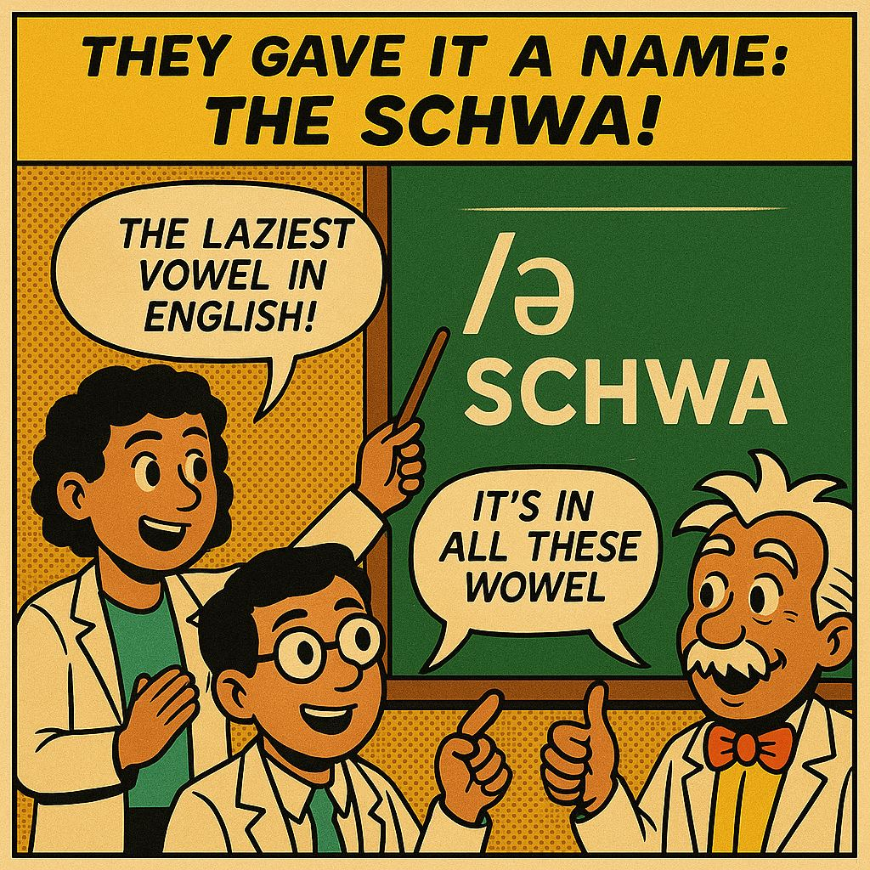
Notes:
The comic deck — let it breathe. Read each panel dramatically, students echo the schwa words. The lazy uh: mouth relaxed, jaw loose, zero effort. Have everyone make the laziest possible 'uh' — like falling onto a sofa.

Slide 10
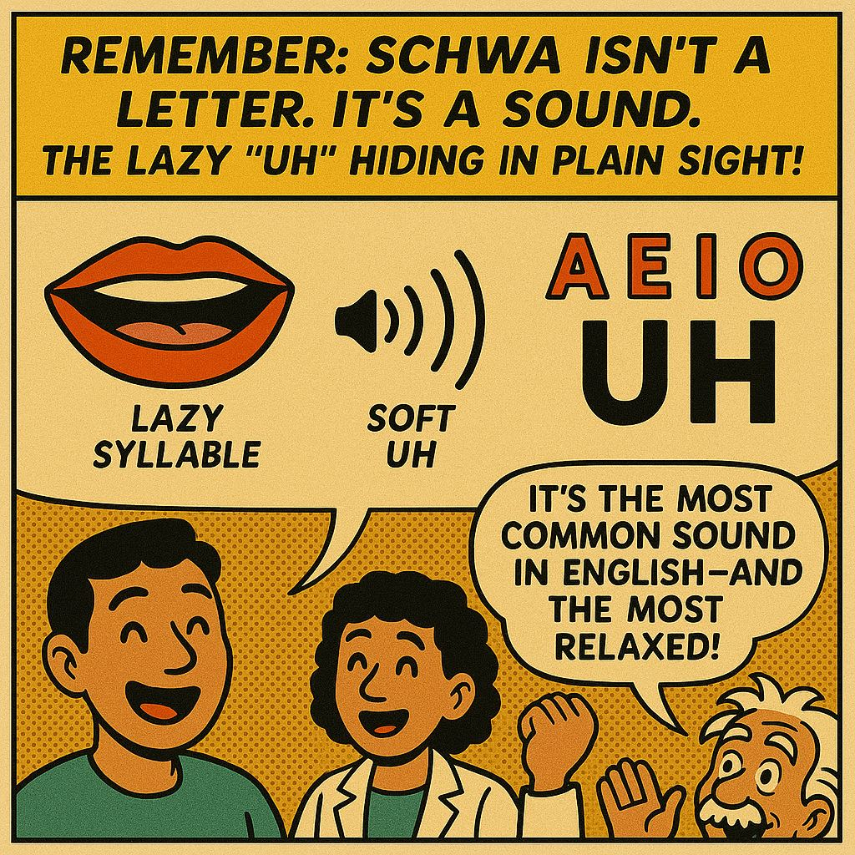
Notes:
The comic deck — let it breathe. Read each panel dramatically, students echo the schwa words. The lazy uh: mouth relaxed, jaw loose, zero effort. Have everyone make the laziest possible 'uh' — like falling onto a sofa.

Slide 11
DAY 9
TEACH
So… what IS the schwa?
😴
👑
🅰️
The LAZY uh
Never the boss
Any letter can hide it
mouth relaxed, zero effort
only in NOT-strong beats
a · e · i · o · u — all can say uh!
Notes:
Recap after the comic: three facts. The third is the mind-blower — write 'about, taken, pencil, lemon, circus' if asked: five different letters, all saying uh. Most common sound in English!

Slide 12
DAY 9
TEACH
So… what IS the schwa?
😴
👑
🅰️
The LAZY uh
Never the boss
Any letter can hide it
mouth relaxed, zero effort
only in NOT-strong beats
a · e · i · o · u — all can say uh!
Notes:
Recap after the comic: three facts. The third is the mind-blower — write 'about, taken, pencil, lemon, circus' if asked: five different letters, all saying uh. Most common sound in English!

Slide 13
DAY 9
TEACH
The lazy uh in real words
about
uh-BOUT
banana
buh-NAN-uh
sofa
SOH-fuh
doctor
DAHK-ter
family
FAM-uh-lee
computer
kuhm-PYOO-ter
gold = the lazy uh 😴
Notes:
Read each pair: normal word, then the sound-spelling. Gold = schwa. Choral the lazy versions. Ask: where is the boss beat in each? (CAPS). Note 'computer' has TWO schwas — most big words do!

Slide 14
DAY 9
TRICK
🖐️ Feel it — the jaw trick!
👑 BOSS beat
😴 lazy uh
😮
😐
BIG jaw drop!
tiny drop … almost nothing
Notes:
Same hand-under-chin trick from syllable day! Say buh-NAN-uh: chin drops BIG on NAN, barely moves on the uh's. Everyone acts out banana: big mouth on NAN, floppy face on the schwas. Funniest 2 minutes of the day.

Slide 15
DAY 9
WATCH
🎬 Watch: the schwa explained!
▶ Rachel's English — What is the Schwa?
(click to play — share your sound on Zoom!)
Notes:
Optional closer: Rachel's English schwa video. Check 'Share sound' in Zoom screen share. 3-4 minutes; stop early if energy is high and go to 09-2 instead.

