Slide 1
M U R R A Y ' S E N G L I S H
Schwa Practice
Formal vs lazy — real words, real schwa
DAY 9
Notes:
ORIGINAL SLIDE-1 TEXT (moved to notes):
Schwa Mini Deck C
Real Words, Real Schwa – Lazy 'Uh' Practice
Per word: say the FORMAL version (every vowel clear), then the REAL version (schwa). Students vote in chat which one Americans actually say (always the lazy one!). Then choral the lazy version x2.

Slide 2


Formal: ba-NAN-a
Schwa: buh-NAN-uh
Notes:
Do you like bananas? How many bananas do you eat a week? Do your kids like bananas?

Slide 3

Formal: AN-i-mal
Schwa: AN-uh-mul
Notes:
Per word: say the FORMAL version (every vowel clear), then the REAL version (schwa). Students vote in chat which one Americans actually say (always the lazy one!). Then choral the lazy version x2.

Slide 4

Formal: FAM-i-ly
Schwa: FAM-uh-lee
Notes:
Per word: say the FORMAL version (every vowel clear), then the REAL version (schwa). Students vote in chat which one Americans actually say (always the lazy one!). Then choral the lazy version x2.

Slide 5
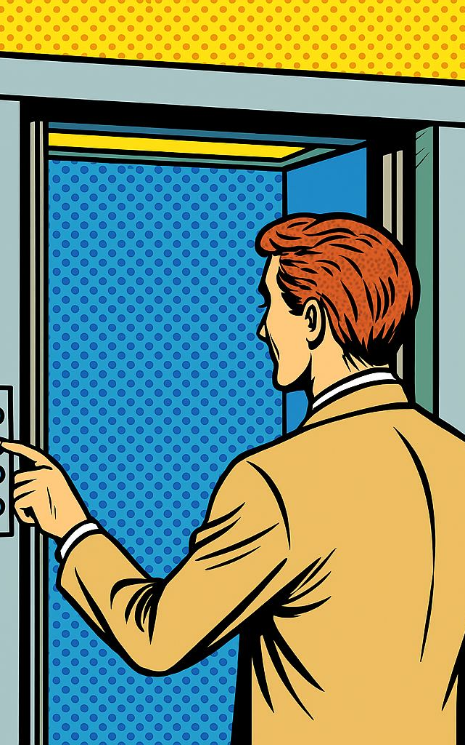
Formal: EL-e va tor
Schwa: EL-uh-vay-ter
Notes:
Do you remember the first time you road in an eleveator?

Slide 6
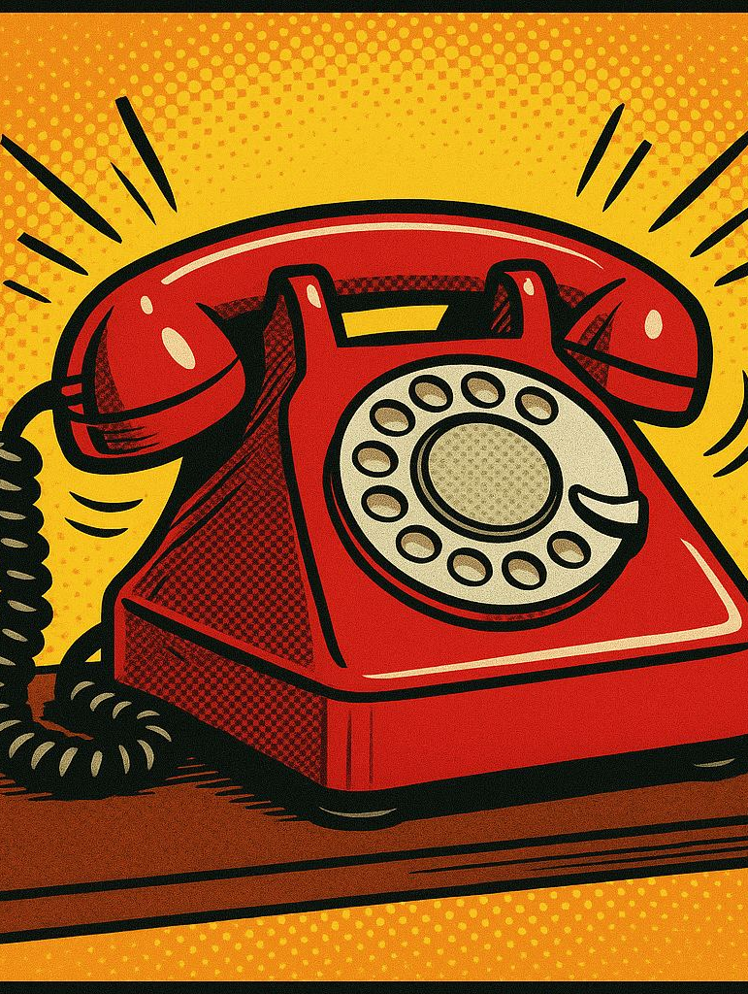
Formal:
TEL-e-phone
Schwa: TEL-uh-fone
Notes:
When did you get your first cell phone?

Slide 7

Formal: im-POR-tant
Schwa: im-POR-tunt
Notes:
Do you always remember your husband or wife’s birthday?

Slide 8

Formal:
e-MER-gen-cy
Schwa:
uh-MER-juhn-see
Notes:
Have you ever called 911?

Slide 9

Formal: com-PUT-er
Schwa: kuhm-PYOO-ter
Notes:
Do you own a computer?

Slide 10

Formal:
um-BREL-la
Schwa: uhm-BREL-uh
Notes:
Per word: say the FORMAL version (every vowel clear), then the REAL version (schwa). Students vote in chat which one Americans actually say (always the lazy one!). Then choral the lazy version x2.

Slide 11
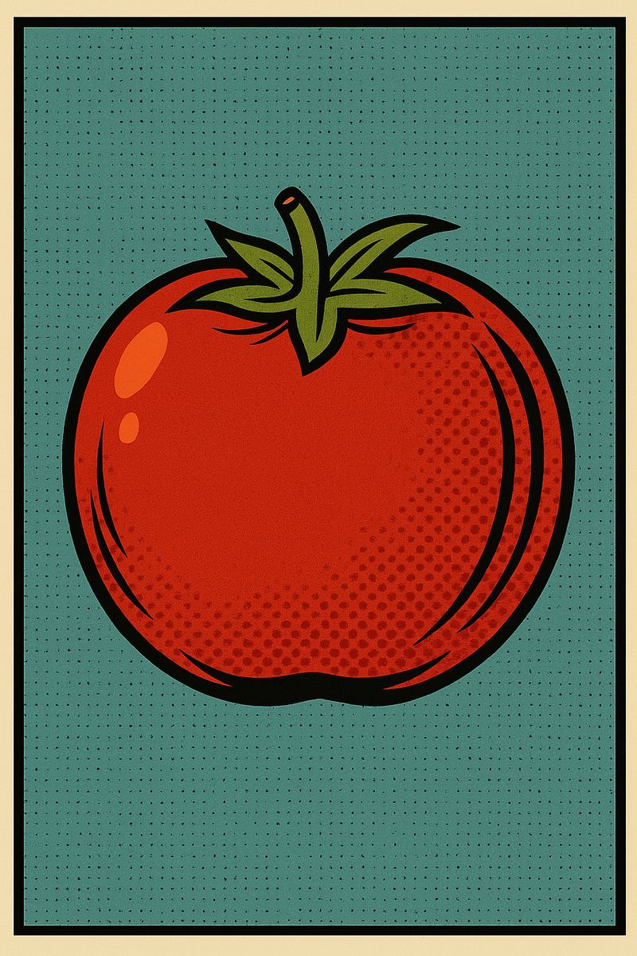
Formal: to-MA-to
Schwa: tuh-MAY-toh
Notes:
Do you like tomato soup?

Slide 12

Formal: DOC-tor
Schwa:
DAHK-ter
Notes:
Do you have a regular doctor? Is your doctor a man or a woman?

Slide 13

Formal: PEN-cil
Schwa:
PEN-suhl
Notes:
Do you use a pencil any more?

Slide 14
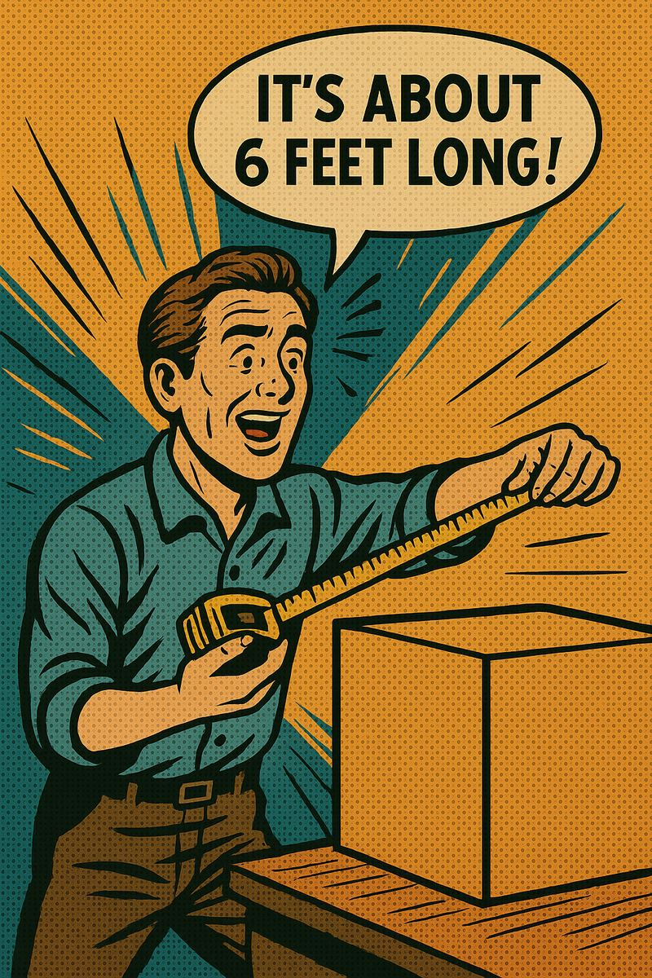
Formal: a-BOUT
Schwa:
uh-BOUT
Notes:
Approximately. Mas or menos

