Slide 1
M U R R A Y ' S E N G L I S H
Schwa in Action
Real sentences, lazy sounds 💬
DAY 9
Notes:
Real phrases: model natural speed first (schwa everywhere), then slow, then natural again. Students echo the NATURAL version — the goal is sounding relaxed, not careful.

Slide 2
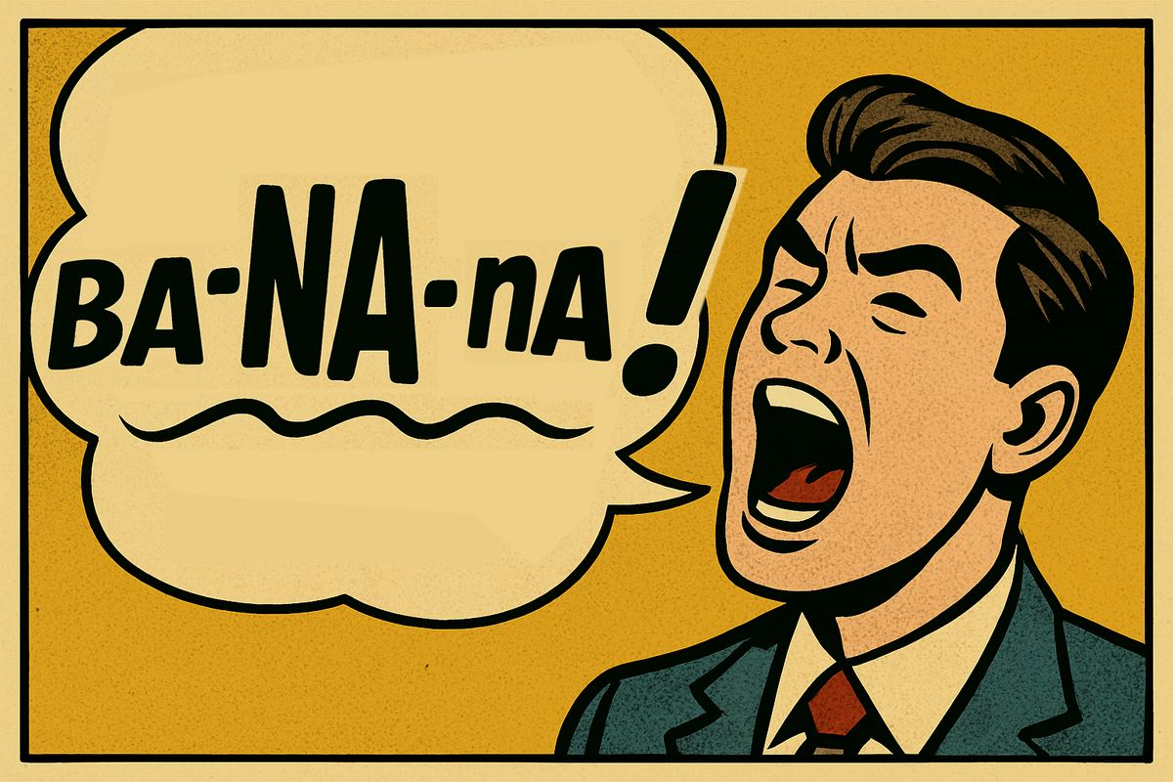
I want a banana.
Schwa: buh-NAN-uh
Notes:
Real phrases: model natural speed first (schwa everywhere), then slow, then natural again. Students echo the NATURAL version — the goal is sounding relaxed, not careful.

Slide 3

This is my family.
Schwa: FAM-uh-lee
Notes:
Do you havve a picture of your family.

Slide 4

Call the doctor.
Schwa:
DAHK-ter
Notes:
Real phrases: model natural speed first (schwa everywhere), then slow, then natural again. Students echo the NATURAL version — the goal is sounding relaxed, not careful.

Slide 5
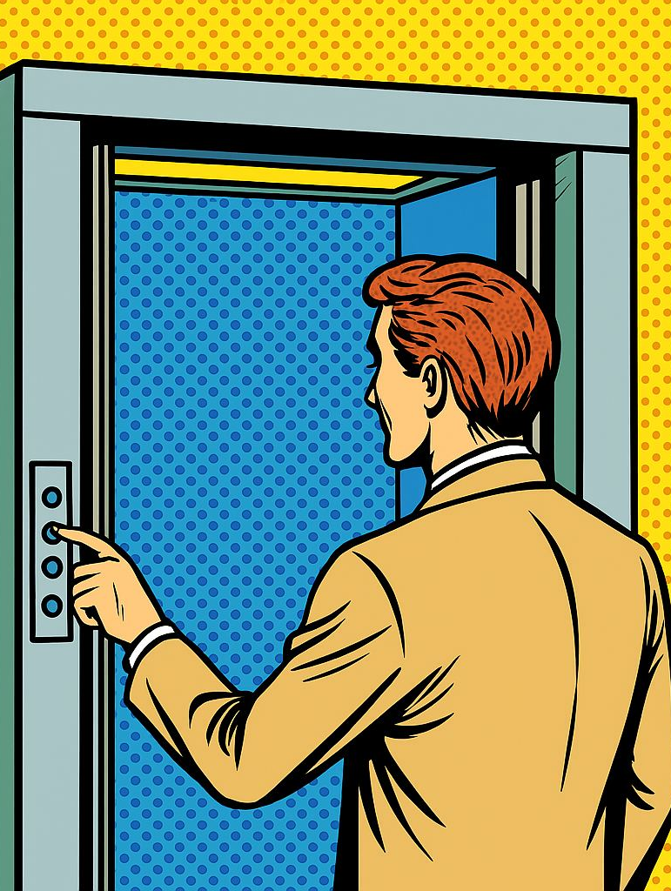
He's in the elevator.
Schwa: EL-uh-vay-ter
Notes:
Real phrases: model natural speed first (schwa everywhere), then slow, then natural again. Students echo the NATURAL version — the goal is sounding relaxed, not careful.

Slide 6

It's an emergency!
Schwa:
uh-MER-juhn-see
Notes:
Real phrases: model natural speed first (schwa everywhere), then slow, then natural again. Students echo the NATURAL version — the goal is sounding relaxed, not careful.

Slide 7

Where's my computer?
Schwa: kuhm-PYOO-ter
Notes:
Real phrases: model natural speed first (schwa everywhere), then slow, then natural again. Students echo the NATURAL version — the goal is sounding relaxed, not careful.

Slide 8

I need the telephone.
Schwa: TEL-uh-fone
Notes:
Real phrases: model natural speed first (schwa everywhere), then slow, then natural again. Students echo the NATURAL version — the goal is sounding relaxed, not careful.

Slide 9

I love tomato soup.
Schwa: tuh-MAY-toh
Notes:
What’s your favorite soup?

Slide 10

I forgot my umbrella!
Schwa:
uhm-BREL-uh
Notes:
Real phrases: model natural speed first (schwa everywhere), then slow, then natural again. Students echo the NATURAL version — the goal is sounding relaxed, not careful.

Slide 11
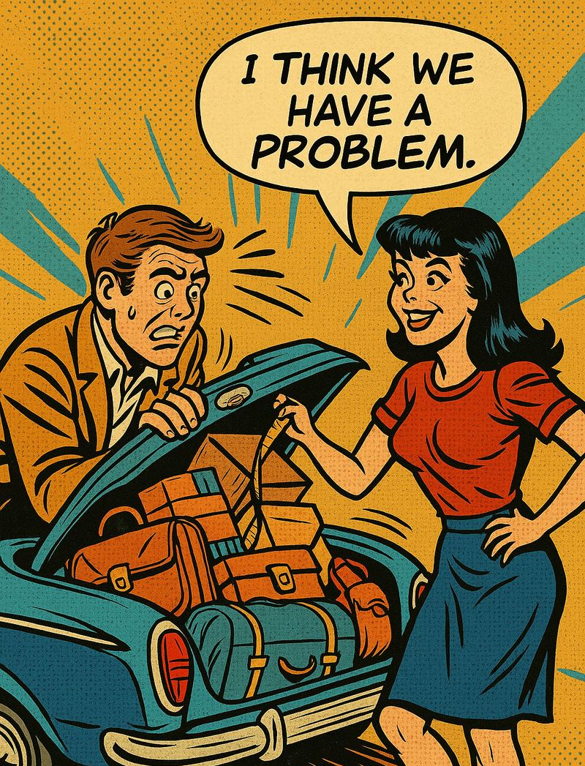
It's not a problem.
Schwa:
PRAH-bluhm
Notes:
Real phrases: model natural speed first (schwa everywhere), then slow, then natural again. Students echo the NATURAL version — the goal is sounding relaxed, not careful.

