Slide 1
M U R R A Y ' S E N G L I S H
Schwa Review Game
What's this? Say it the LAZY way! 🎮
DAY 9
Notes:
Game: image/word appears, students say it the lazy way (muted choral), 2-3 unmuted answers, click for the schwa spelling. Type-in-chat option: they type which beat is the schwa.

Slide 2

What’s this?
a banana
uh buh-NAN-uh
Notes:
Game: image/word appears, students say it the lazy way (muted choral), 2-3 unmuted answers, click for the schwa spelling. Type-in-chat option: they type which beat is the schwa.

Slide 3

What’s this?
A doctor
→ uh DAHK-ter
Notes:
Game: image/word appears, students say it the lazy way (muted choral), 2-3 unmuted answers, click for the schwa spelling. Type-in-chat option: they type which beat is the schwa.

Slide 4
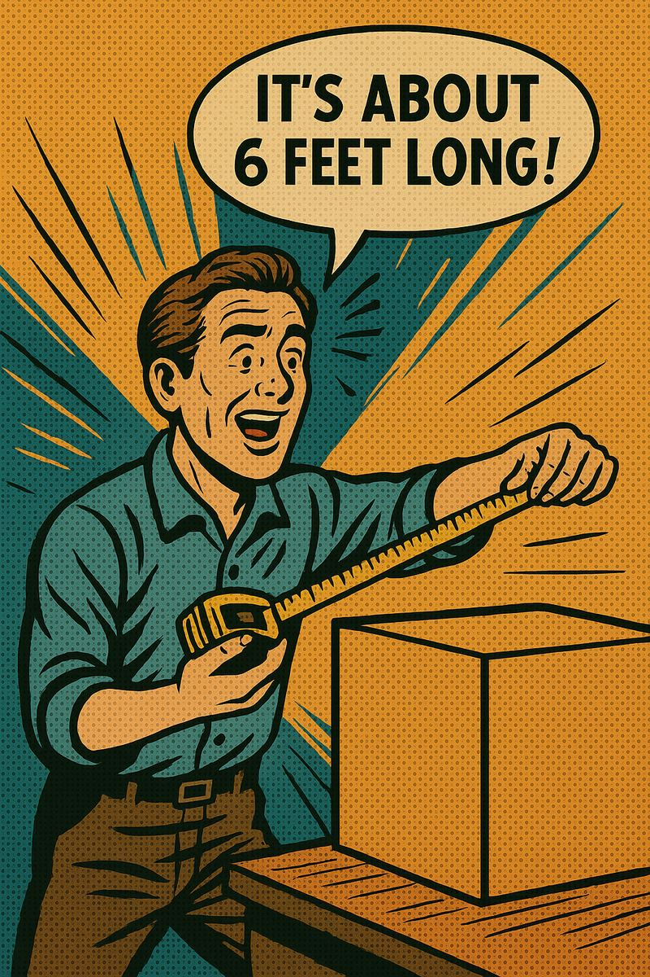
How do you say this?
about
→ uh-BOUT
Notes:
Game: image/word appears, students say it the lazy way (muted choral), 2-3 unmuted answers, click for the schwa spelling. Type-in-chat option: they type which beat is the schwa.

Slide 5
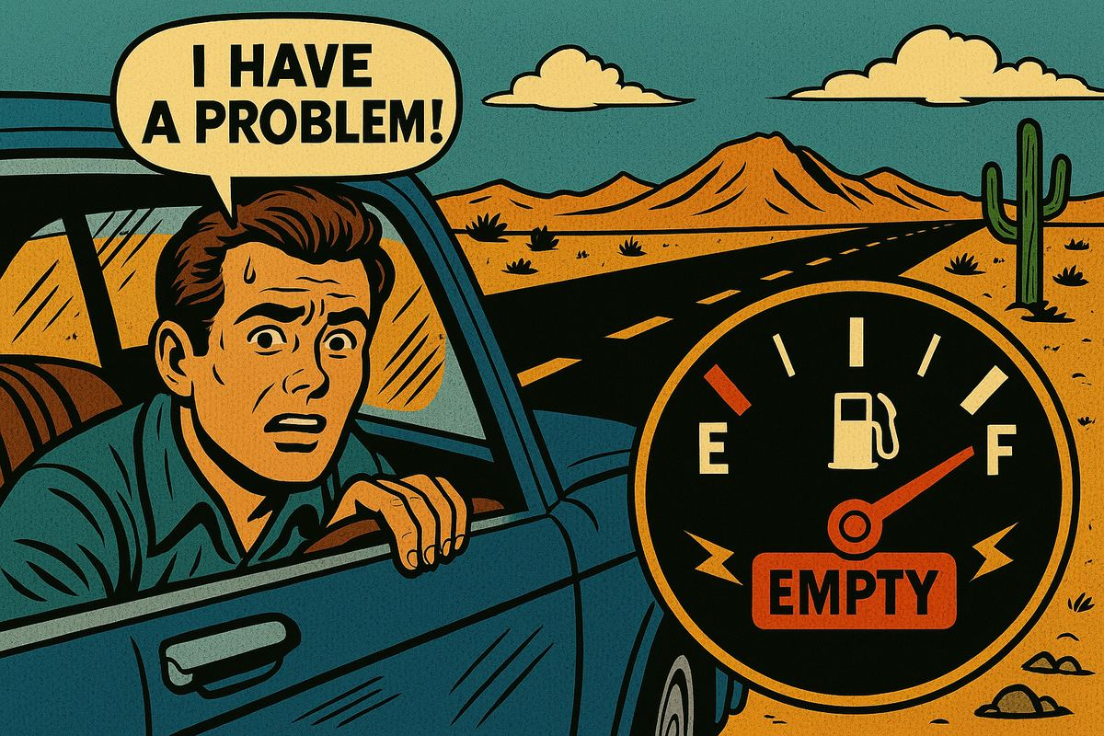
What’s this?
A problem
→ uh PRAH-bluhm
What’s the
problem?
I’m out of (outa) gas!
Notes:
Game: image/word appears, students say it the lazy way (muted choral), 2-3 unmuted answers, click for the schwa spelling. Type-in-chat option: they type which beat is the schwa.

Slide 6

What’s this?
A pencil
→ uh PEN-suhl
Notes:
Game: image/word appears, students say it the lazy way (muted choral), 2-3 unmuted answers, click for the schwa spelling. Type-in-chat option: they type which beat is the schwa.

Slide 7
I’m going to go.
I’m gonna go
Notes:
Game: image/word appears, students say it the lazy way (muted choral), 2-3 unmuted answers, click for the schwa spelling. Type-in-chat option: they type which beat is the schwa.

Slide 8
I have to eat
I gotta eat
Notes:
Game: image/word appears, students say it the lazy way (muted choral), 2-3 unmuted answers, click for the schwa spelling. Type-in-chat option: they type which beat is the schwa.

Slide 9
Do you want to come?
Do ya wanna come?
Notes:
Game: image/word appears, students say it the lazy way (muted choral), 2-3 unmuted answers, click for the schwa spelling. Type-in-chat option: they type which beat is the schwa.

Slide 10
Let me know!
Lemme know!
Notes:
Game: image/word appears, students say it the lazy way (muted choral), 2-3 unmuted answers, click for the schwa spelling. Type-in-chat option: they type which beat is the schwa.

Slide 11
Call the doctor.
Call thuh DAHK-ter.
Notes:
Game: image/word appears, students say it the lazy way (muted choral), 2-3 unmuted answers, click for the schwa spelling. Type-in-chat option: they type which beat is the schwa.

Slide 12
It’s about a pencil.
It’s uh-BOUT uh PEN-suhl.
Notes:
Game: image/word appears, students say it the lazy way (muted choral), 2-3 unmuted answers, click for the schwa spelling. Type-in-chat option: they type which beat is the schwa.

Slide 13

I saw an
uhm-BREL-uh.
Notes:
Game: image/word appears, students say it the lazy way (muted choral), 2-3 unmuted answers, click for the schwa spelling. Type-in-chat option: they type which beat is the schwa.

