Slide 1
M U R R A Y ' S E N G L I S H
Reductions & Linking
want to → wanna · formal → fast 🏃
DAY 10
Notes:
ORIGINAL SLIDE-1 TEXT (moved to notes):
Reductions & Linking Deck (with Formal ➜ Informal)
Comic-style visuals with sentence comparisons
Per slide: say the FORMAL version slowly, then the FAST version naturally. Students echo the fast one (muted choral). Goal today = understanding fast English; speaking it is a bonus, not a requirement.

Slide 2
🏃
PART 1 — Reductions
Some words melt together when we speak fast
Notes:
Section break. Reductions = words MELTING: want to → wanna. Seven examples coming, each with its comic. Pattern per slide: meaning first (formal version), then the fast version, then muted choral of the fast one.

Slide 3
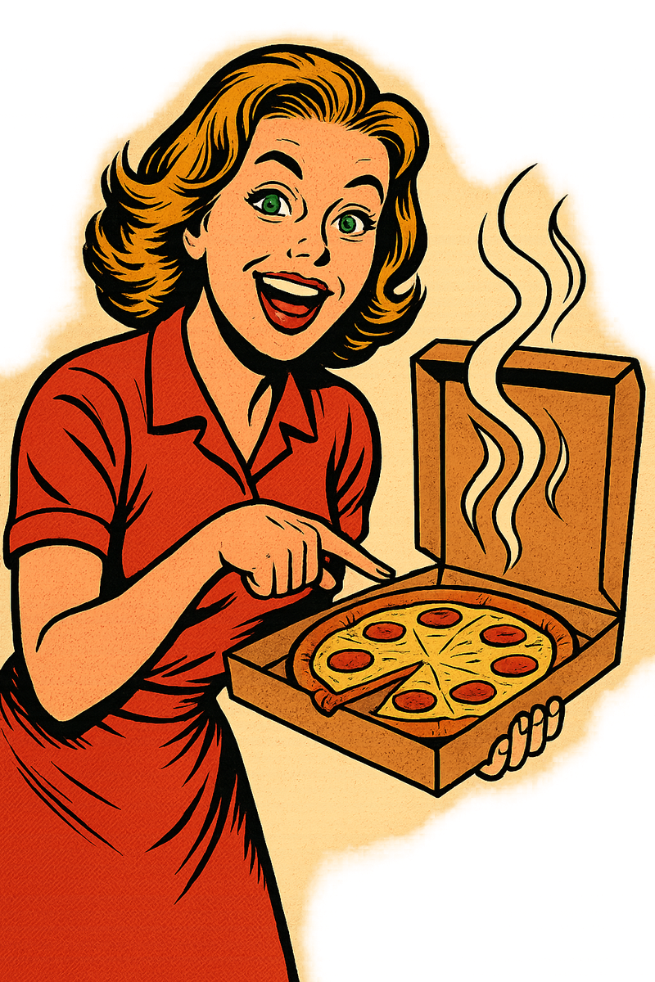
Do you want to eat? → Do you wanna eat?
Notes:
TEACHER NOTE (moved off-slide): Practice the meaning first: 'Do you want to eat?', then say it fast: 'Do you wanna eat?' Then muted choral of the fast version x2; unmute 2 students.

Slide 4

Do you want to dance? → Do you wanna dance?
Notes:
TEACHER NOTE (moved off-slide): Practice the meaning first: 'Do you want to dance?', then say it fast: 'Do you wanna dance?' Then muted choral of the fast version x2; unmute 2 students.

Slide 5
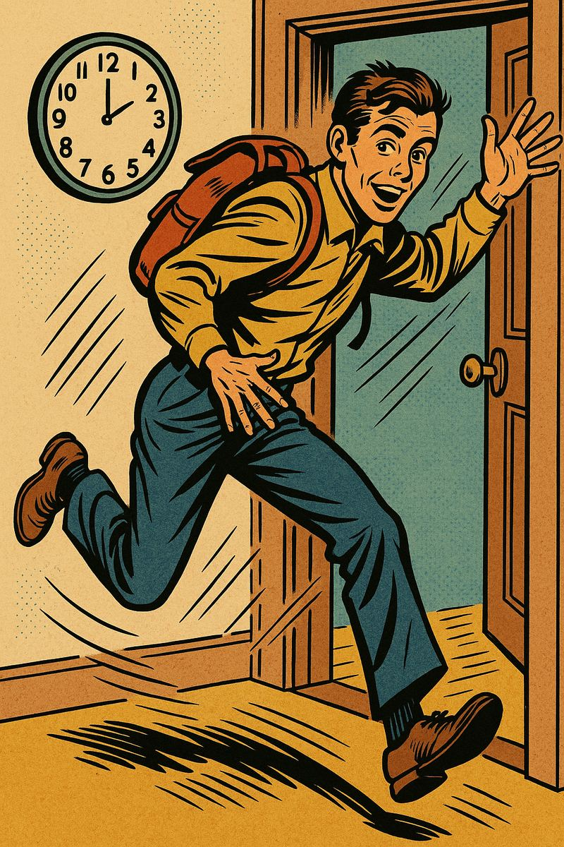
I am going to go now. → I’m gonna go now.
Notes:
TEACHER NOTE (moved off-slide): Practice the meaning first: 'I am going to go now.', then say it fast: 'I’m gonna go now.' Then muted choral of the fast version x2; unmute 2 students.

Slide 6

She is going to call me. → She’s gonna call me.
Notes:
TEACHER NOTE (moved off-slide): Practice the meaning first: 'She is going to call me.', then say it fast: 'She’s gonna call me.' Then muted choral of the fast version x2; unmute 2 students.

Slide 7

I have to go. → I gotta go.
Notes:
TEACHER NOTE (moved off-slide): Practice the meaning first: 'I have to go.', then say it fast: 'I gotta go.' Then muted choral of the fast version x2; unmute 2 students.

Slide 8
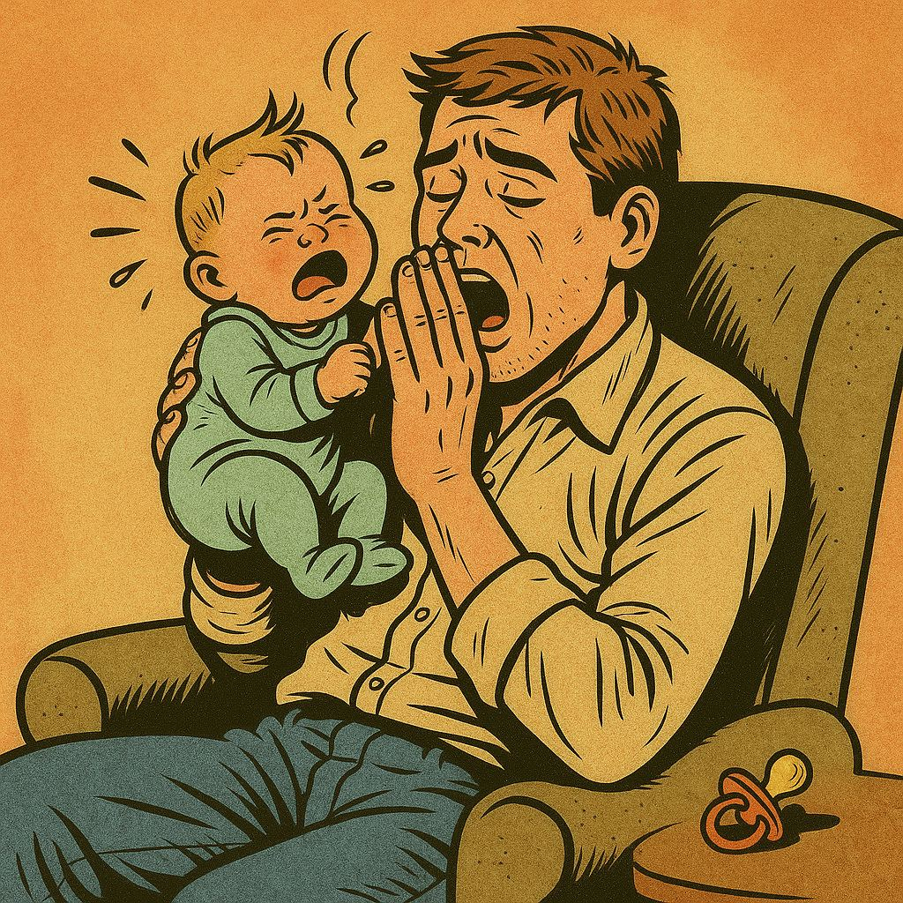
I have to sleep. → I gotta sleep.
Notes:
TEACHER NOTE (moved off-slide): Practice the meaning first: 'I have to sleep.', then say it fast: 'I gotta sleep.' Then muted choral of the fast version x2; unmute 2 students.

Slide 9

I have to finish this. → I gotta finish this.
Notes:
TEACHER NOTE (moved off-slide): Practice the meaning first: 'I have to finish this.', then say it fast: 'I gotta finish this.' Then muted choral of the fast version x2; unmute 2 students.

Slide 10
🔗
PART 2 — Linking
Words hold hands: turn-it-off → turnitoff
Notes:
Section break. Linking = words HOLDING HANDS — no space between them. Six examples. Gesture: interlace your fingers as you say the linked version.

Slide 11
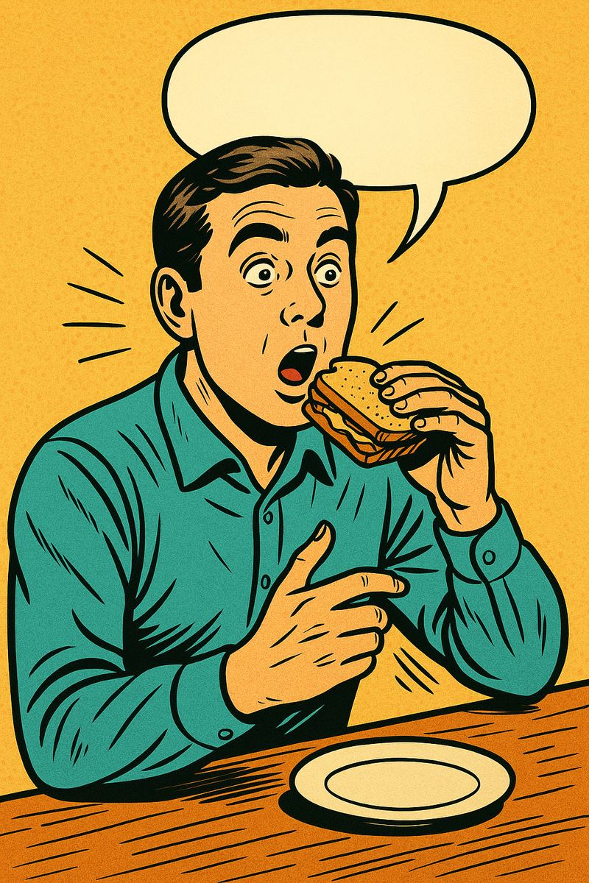
Did you eat? → Didja eat?
Notes:
TEACHER NOTE (moved off-slide): Say the full version, then the linked version. Hear the connection! Then muted choral of the fast version x2; unmute 2 students.

Slide 12
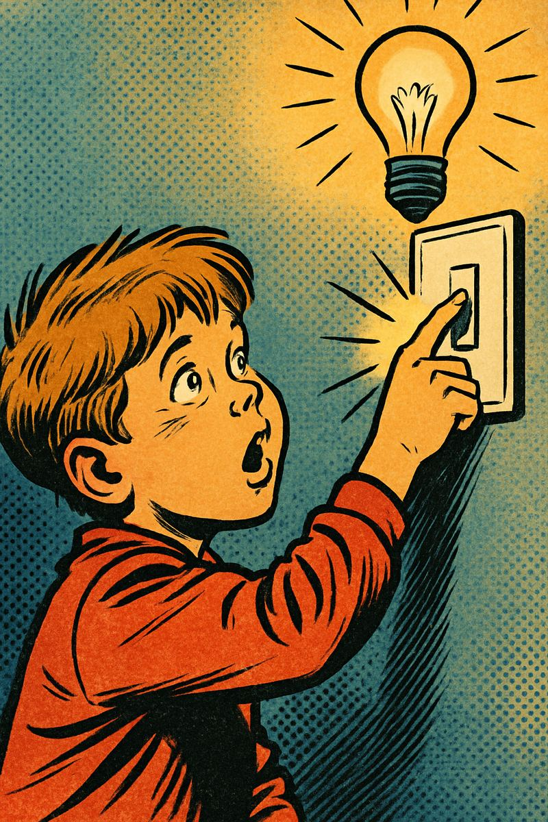
Turn it off. → Turnitoff.
Notes:
TEACHER NOTE (moved off-slide): Say the full version, then the linked version. Hear the connection! Then muted choral of the fast version x2; unmute 2 students.

Slide 13
Pick it up. → Pickitup.
Notes:
TEACHER NOTE (moved off-slide): Say the full version, then the linked version. Hear the connection! Then muted choral of the fast version x2; unmute 2 students.

Slide 14
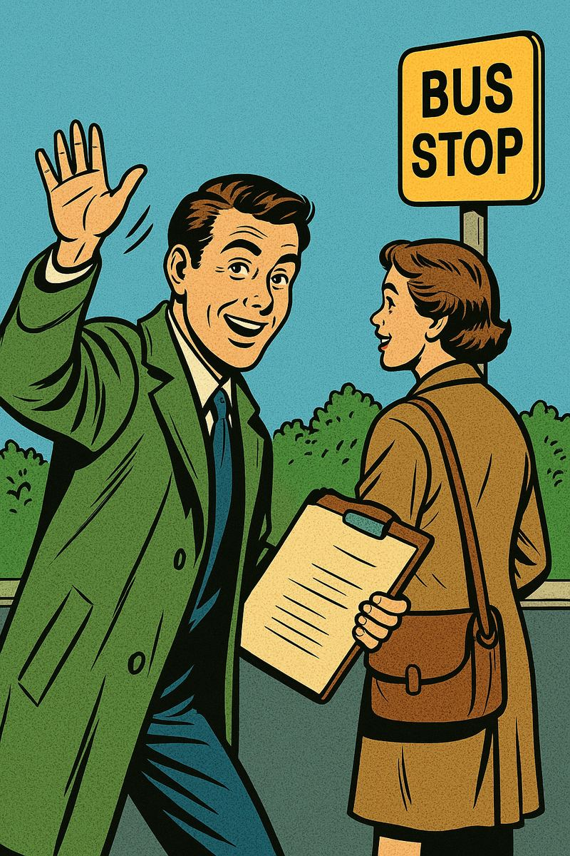
Get in line. → Getinline.
Notes:
TEACHER NOTE (moved off-slide): Say the full version, then the linked version. Hear the connection! Then muted choral of the fast version x2; unmute 2 students.

Slide 15

Give it to me. → Giveittome.
Notes:
TEACHER NOTE (moved off-slide): Say the full version, then the linked version. Hear the connection! Then muted choral of the fast version x2; unmute 2 students.

Slide 16
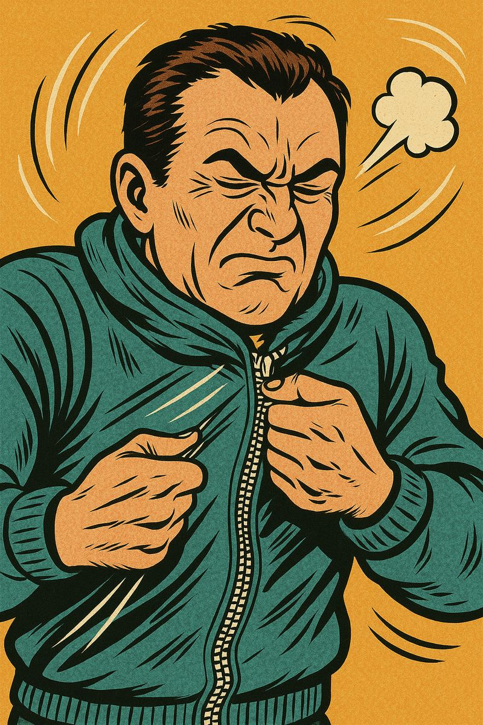
Zip it up. → Zipitup.
Notes:
TEACHER NOTE (moved off-slide): Say the full version, then the linked version. Hear the connection! Then muted choral of the fast version x2; unmute 2 students.

