Slide 1
M U R R A Y ' S E N G L I S H
Reductions in Conversations
I dunno · whaddaya think? 💬
DAY 10
Notes:
Read each formal/fast pair. Chat game: you say the FAST version, they type the formal words ('I dunno' -> 'I do not know'). Decoding fast speech back to real words = the listening skill.

Slide 2
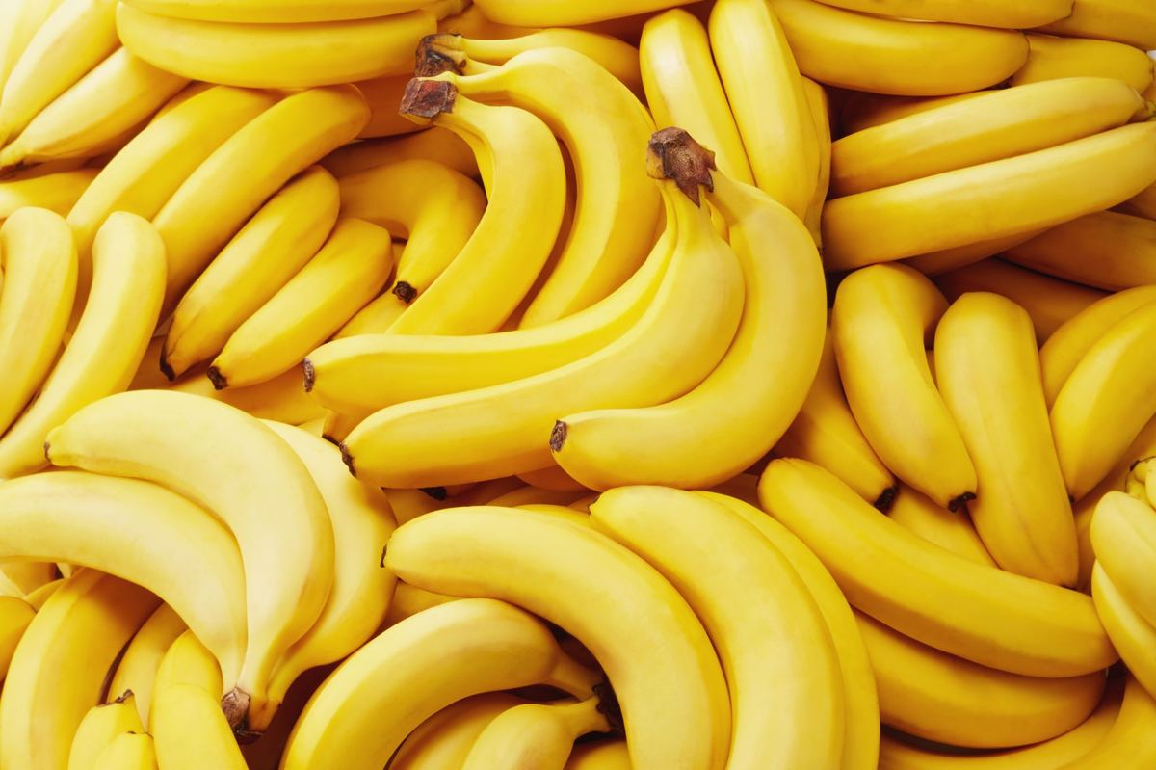
🍌
I want
to get bananas.
➡️
I wanna get bananas.
Notes:
Read each formal/fast pair. Chat game: you say the FAST version, they type the formal words ('I dunno' -> 'I do not know'). Decoding fast speech back to real words = the listening skill.

Slide 3
🤷
I don’t know.
➡️
I dunno.
Notes:
Read each formal/fast pair. Chat game: you say the FAST version, they type the formal words ('I dunno' -> 'I do not know'). Decoding fast speech back to real words = the listening skill.

Slide 4

🤔
What do you think?
➡️
Whaddaya think?
Notes:
Read each formal/fast pair. Chat game: you say the FAST version, they type the formal words ('I dunno' -> 'I do not know'). Decoding fast speech back to real words = the listening skill.

Slide 5
📝
I have to fill out this form.
➡️
I hafta fill out this form.
Notes:
Read each formal/fast pair. Chat game: you say the FAST version, they type the formal words ('I dunno' -> 'I do not know'). Decoding fast speech back to real words = the listening skill.

Slide 6
🙋
Would you help me?
➡️
Wouldja help me?
Notes:
Read each formal/fast pair. Chat game: you say the FAST version, they type the formal words ('I dunno' -> 'I do not know'). Decoding fast speech back to real words = the listening skill.

Slide 7
🍌🍌
Give me two bunches.
➡️
Gimme two bunches.
Notes:
Read each formal/fast pair. Chat game: you say the FAST version, they type the formal words ('I dunno' -> 'I do not know'). Decoding fast speech back to real words = the listening skill.

Slide 8
🩺
Let me know what the doctor says.
➡️
Lemme know what the doctor says.
Notes:
Read each formal/fast pair. Chat game: you say the FAST version, they type the formal words ('I dunno' -> 'I do not know'). Decoding fast speech back to real words = the listening skill.

Slide 9
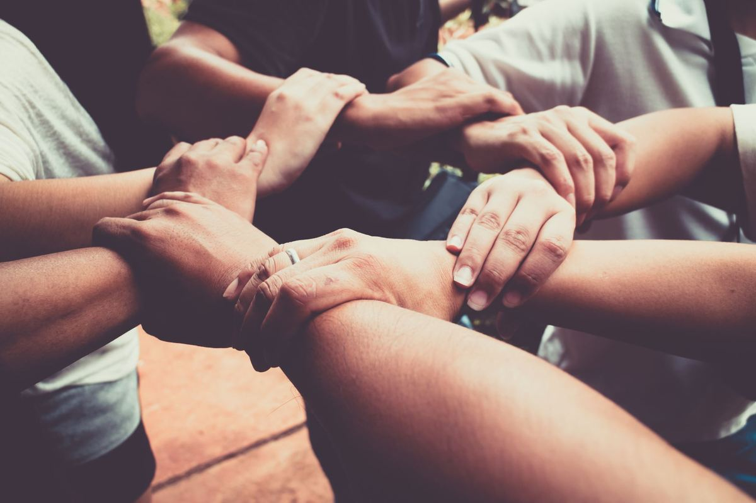
🤝
We should turn it in together.
➡️
We should turnitin together.
Notes:
Read each formal/fast pair. Chat game: you say the FAST version, they type the formal words ('I dunno' -> 'I do not know'). Decoding fast speech back to real words = the listening skill.

Slide 10
⏰
I am out of time.
➡️
I’m outta time.
Notes:
Read each formal/fast pair. Chat game: you say the FAST version, they type the formal words ('I dunno' -> 'I do not know'). Decoding fast speech back to real words = the listening skill.

