Slide 1
M U R R A Y ' S E N G L I S H
Intonation — the Music!
Your voice goes UP ↗ and DOWN ↘
DAY 10
Notes:
ORIGINAL INSTRUCTIONS: Teacher Instructions:
- Show the comic and intonation images.
- Model the phrase and have students repeat.
- Go to next slide and insert video.
- Play the video, repeat together.
NEW FLOW (Murray's design): per phrase: comic+melody image → video at normal speed → 🐌 SLOW version → 🎤 practice slide (say it 3x WITH the video). Conduct the melody with your hand throughout.
AUDIT NOTES (June 13) — read before teaching:
1. SEE YOU LATER group: the diagram's arrow RISES — that's WRONG for a farewell (statements fall). MODEL IT FALLING with your hand; corrected diagram coming in the image run.
2. ARE WE DONE YET group: the flat arrow matches the clip's BORED delivery — teach it as 'bored = flat' (a feature, not a bug). Note the arrow reads right-to-left; conduct left-to-right yourself.
3. RING group: the diagram teaches 'Do you like the ring?' (yes/no = RISE) but the movie clip says 'How do you like it?' (wh = FALL). Point out the difference — it's actually a great teachable contrast.
4. GUESS WHAT I GOT: rising arrow is fine for excited announcements — mention that normal statements fall.

Slide 2



Notes:
Per slide: play the clip / model the phrase, exaggerating the melody. Hand conducts the pitch like an orchestra — students conduct along (cameras on). Rule of thumb for Level 1: yes/no questions go UP at the end; statements and wh-questions go DOWN.

Slide 3
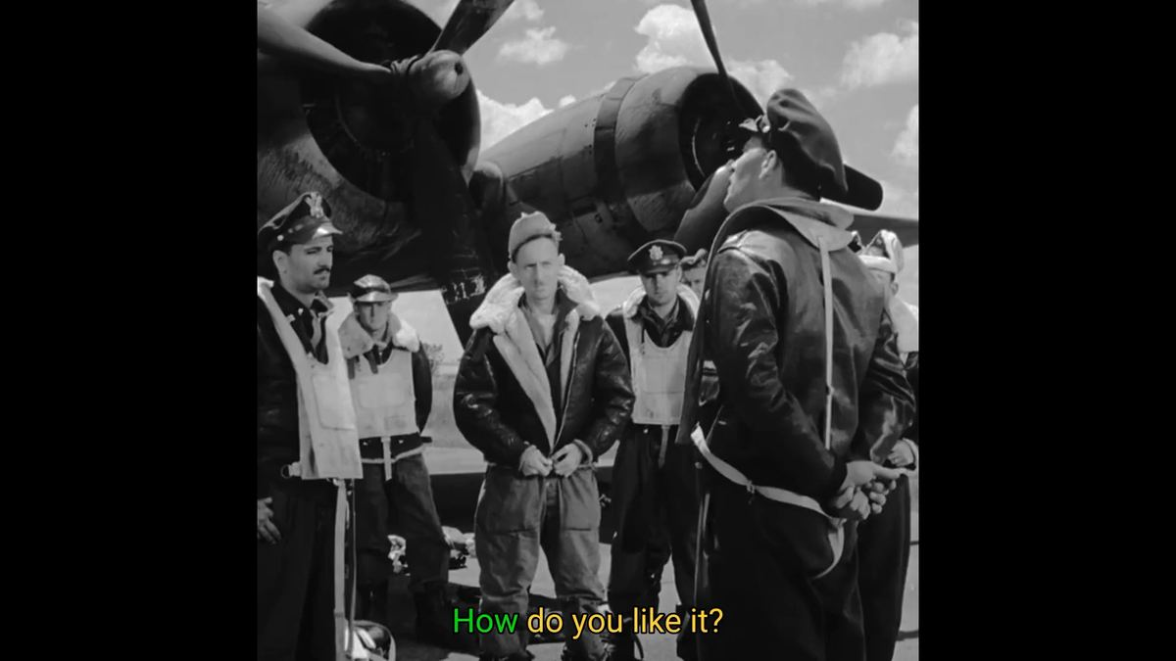
Notes:
Per slide: play the clip / model the phrase, exaggerating the melody. Hand conducts the pitch like an orchestra — students conduct along (cameras on). Rule of thumb for Level 1: yes/no questions go UP at the end; statements and wh-questions go DOWN.

Slide 4

DAY 10
SLOW 🐌
🐌 Once more — slowly!
Listen to the melody go up ↗ and down ↘
Notes:
Slow version (72% speed, same pitch). Conduct the melody with your hand; students conduct along. Where does the voice go UP? Where DOWN?

Slide 5
DAY 10
YOU! 🎤
🎤 Your turn — say it WITH the video!
Play it again — speak along ×3, muted, big mouths!
Notes:
Practice round, normal speed again: play and everyone speaks ALONG with it (shadowing — muted choral). 3 plays. Then unmute 2 volunteers to perform solo with the video.

Slide 6


Notes:
Per slide: play the clip / model the phrase, exaggerating the melody. Hand conducts the pitch like an orchestra — students conduct along (cameras on). Rule of thumb for Level 1: yes/no questions go UP at the end; statements and wh-questions go DOWN.

Slide 7
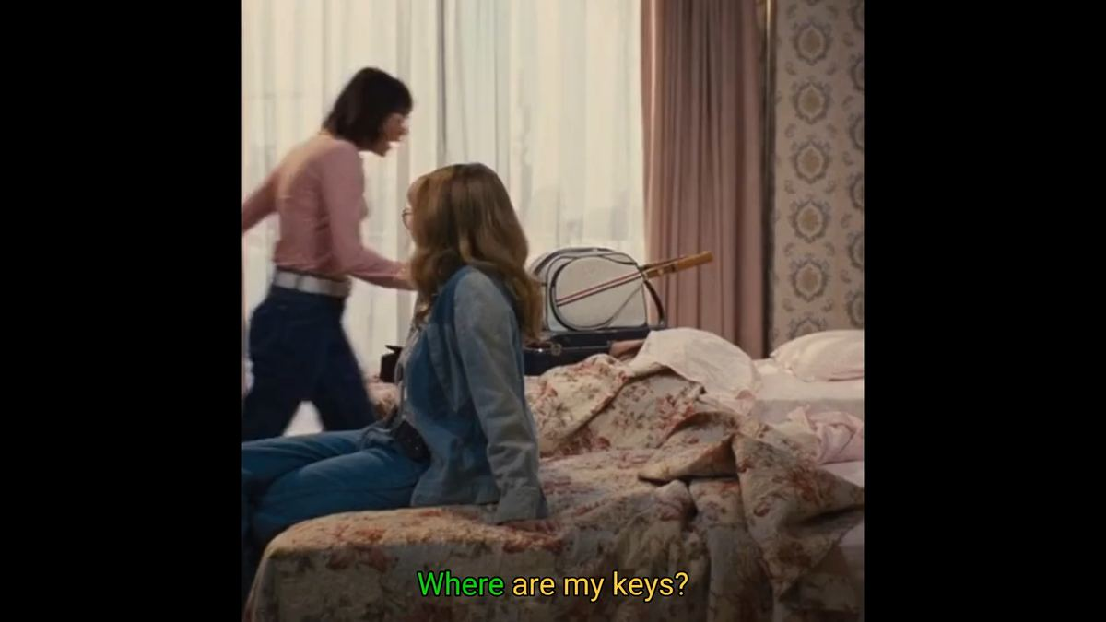
Notes:
Per slide: play the clip / model the phrase, exaggerating the melody. Hand conducts the pitch like an orchestra — students conduct along (cameras on). Rule of thumb for Level 1: yes/no questions go UP at the end; statements and wh-questions go DOWN.

Slide 8
DAY 10
SLOW 🐌
🐌 Once more — slowly!
Listen to the melody go up ↗ and down ↘
Notes:
Slow version (72% speed, same pitch). Conduct the melody with your hand; students conduct along. Where does the voice go UP? Where DOWN?

Slide 9
DAY 10
YOU! 🎤
🎤 Your turn — say it WITH the video!
Play it again — speak along ×3, muted, big mouths!
Notes:
Practice round, normal speed again: play and everyone speaks ALONG with it (shadowing — muted choral). 3 plays. Then unmute 2 volunteers to perform solo with the video.

Slide 10


Notes:
Per slide: play the clip / model the phrase, exaggerating the melody. Hand conducts the pitch like an orchestra — students conduct along (cameras on). Rule of thumb for Level 1: yes/no questions go UP at the end; statements and wh-questions go DOWN.

Slide 11
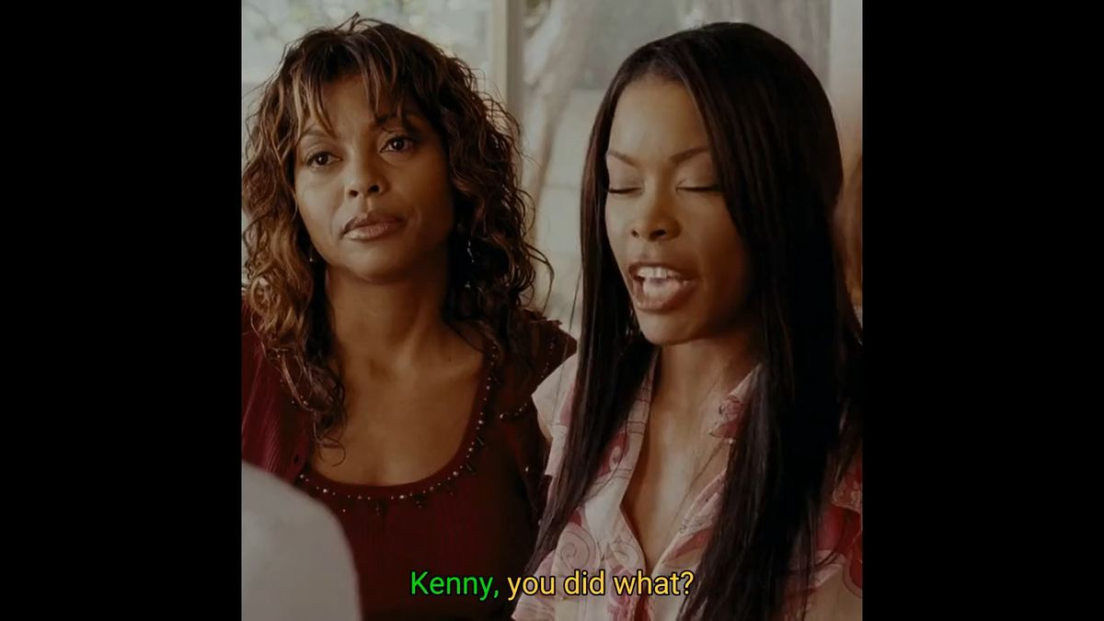
Notes:
Per slide: play the clip / model the phrase, exaggerating the melody. Hand conducts the pitch like an orchestra — students conduct along (cameras on). Rule of thumb for Level 1: yes/no questions go UP at the end; statements and wh-questions go DOWN.

Slide 12
DAY 10
SLOW 🐌
🐌 Once more — slowly!
Listen to the melody go up ↗ and down ↘
Notes:
Slow version (72% speed, same pitch). Conduct the melody with your hand; students conduct along. Where does the voice go UP? Where DOWN?

Slide 13
DAY 10
YOU! 🎤
🎤 Your turn — say it WITH the video!
Play it again — speak along ×3, muted, big mouths!
Notes:
Practice round, normal speed again: play and everyone speaks ALONG with it (shadowing — muted choral). 3 plays. Then unmute 2 volunteers to perform solo with the video.

Slide 14



Notes:
Per slide: play the clip / model the phrase, exaggerating the melody. Hand conducts the pitch like an orchestra — students conduct along (cameras on). Rule of thumb for Level 1: yes/no questions go UP at the end; statements and wh-questions go DOWN.

Slide 16
DAY 10
SLOW 🐌
🐌 Once more — slowly!
Listen to the melody go up ↗ and down ↘
Notes:
Slow version (72% speed, same pitch). Conduct the melody with your hand; students conduct along. Where does the voice go UP? Where DOWN?

Slide 17
DAY 10
YOU! 🎤
🎤 Your turn — say it WITH the video!
Play it again — speak along ×3, muted, big mouths!
Notes:
Practice round, normal speed again: play and everyone speaks ALONG with it (shadowing — muted choral). 3 plays. Then unmute 2 volunteers to perform solo with the video.

Slide 18


Notes:
Per slide: play the clip / model the phrase, exaggerating the melody. Hand conducts the pitch like an orchestra — students conduct along (cameras on). Rule of thumb for Level 1: yes/no questions go UP at the end; statements and wh-questions go DOWN.

Slide 19
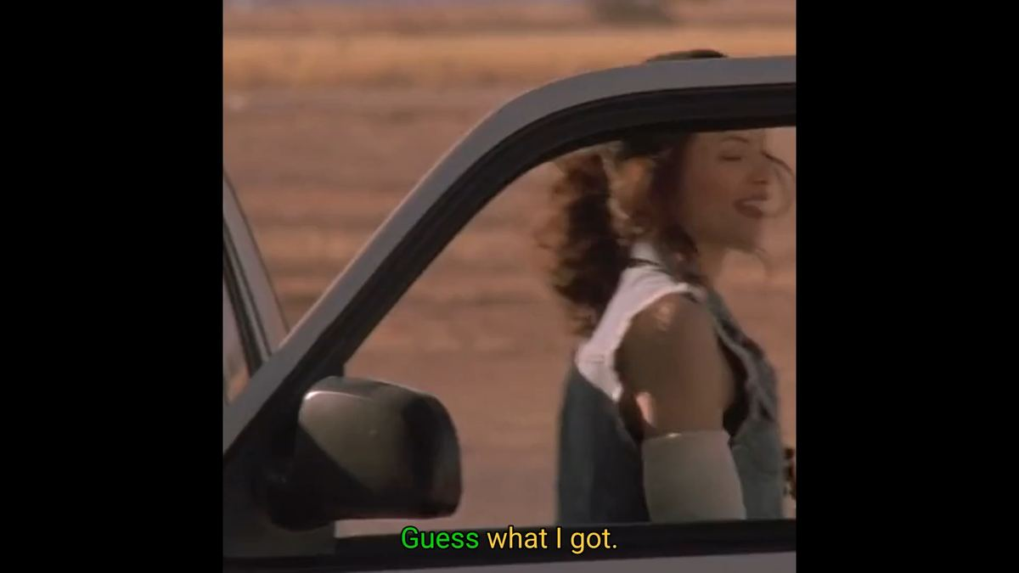
Notes:
Per slide: play the clip / model the phrase, exaggerating the melody. Hand conducts the pitch like an orchestra — students conduct along (cameras on). Rule of thumb for Level 1: yes/no questions go UP at the end; statements and wh-questions go DOWN.

Slide 20
DAY 10
SLOW 🐌
🐌 Once more — slowly!
Listen to the melody go up ↗ and down ↘
Notes:
Slow version (72% speed, same pitch). Conduct the melody with your hand; students conduct along. Where does the voice go UP? Where DOWN?

Slide 21
DAY 10
YOU! 🎤
🎤 Your turn — say it WITH the video!
Play it again — speak along ×3, muted, big mouths!
Notes:
Practice round, normal speed again: play and everyone speaks ALONG with it (shadowing — muted choral). 3 plays. Then unmute 2 volunteers to perform solo with the video.

Slide 22


Notes:
Per slide: play the clip / model the phrase, exaggerating the melody. Hand conducts the pitch like an orchestra — students conduct along (cameras on). Rule of thumb for Level 1: yes/no questions go UP at the end; statements and wh-questions go DOWN.

Slide 23
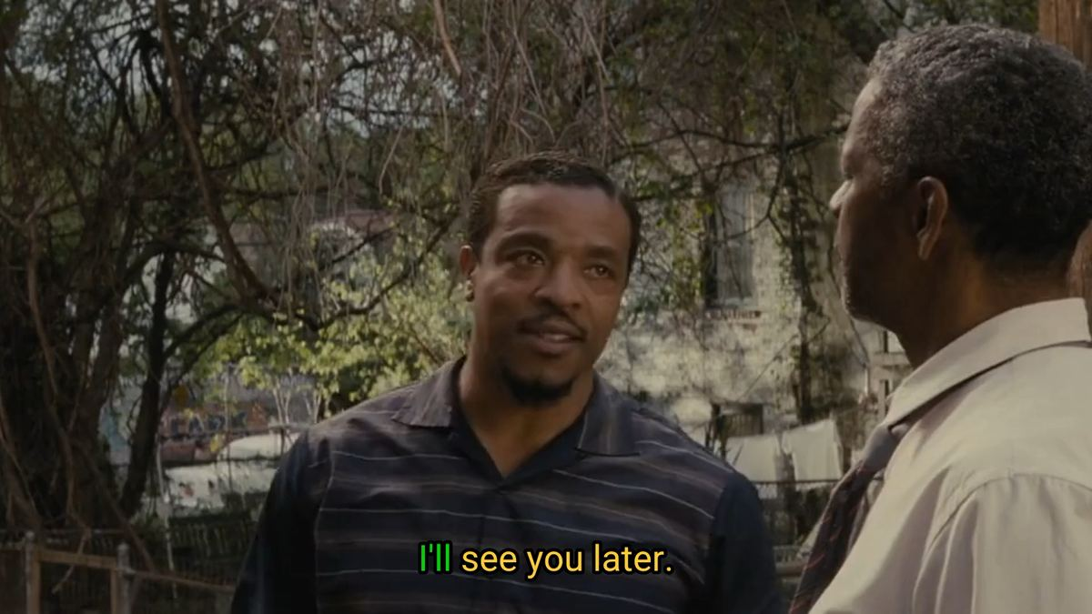
Notes:
Per slide: play the clip / model the phrase, exaggerating the melody. Hand conducts the pitch like an orchestra — students conduct along (cameras on). Rule of thumb for Level 1: yes/no questions go UP at the end; statements and wh-questions go DOWN.

Slide 24
DAY 10
SLOW 🐌
🐌 Once more — slowly!
Listen to the melody go up ↗ and down ↘
Notes:
Slow version (72% speed, same pitch). Conduct the melody with your hand; students conduct along. Where does the voice go UP? Where DOWN?

Slide 25
DAY 10
YOU! 🎤
🎤 Your turn — say it WITH the video!
Play it again — speak along ×3, muted, big mouths!
Notes:
Practice round, normal speed again: play and everyone speaks ALONG with it (shadowing — muted choral). 3 plays. Then unmute 2 volunteers to perform solo with the video.

