Slide 1
M U R R A Y ' S E N G L I S H
At the Grocery Store
Eva & Noah shop — fast English in real life 🛒
DAY 10
murraycohen.com
Notes:
REBUILT (was rough: empty vocab slide, schwa respelling inside the dialogue text, blank slide). Now: vocab cards → meet the scene → slow dialogue → fast dialogue → role-play. The fast slide keeps real spelling; the schwa pronunciation lives in YOUR mouth and the notes.

Slide 2
DAY 10
WORDS
🗣️ Today's fast words
wanna
dunno
whaddaya
= want to
= don’t know
= what do you
gimme
gotit
checkout
= give me
= got it
= pay and go 💳
Notes:
Six cards = the dialogue's whole reduction vocabulary, pre-taught. Choral each: formal then fast. They'll meet every one in 60 seconds.

Slide 3
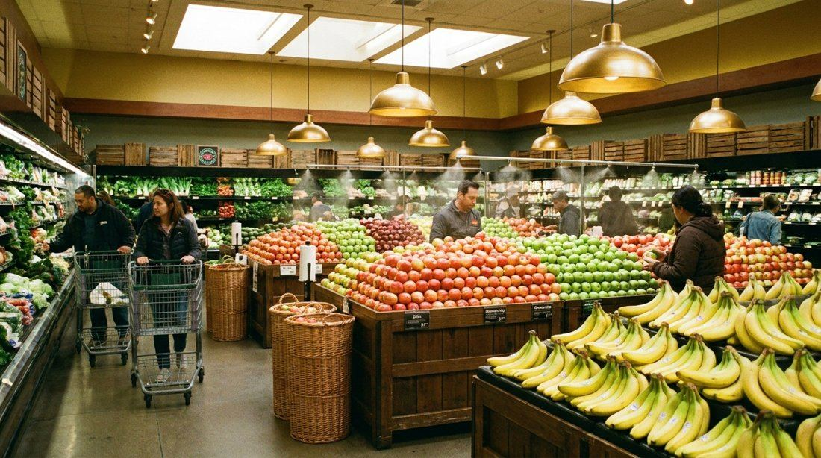
DAY 10
SCENE
Eva and Noah are at the grocery store.
What should they buy — apples 🍎 or bananas 🍌?
Notes:
Set the scene + a prediction vote in chat: type 🍎 or 🍌 — what will they buy? (Answer: bananas — they're cheaper!) Personal circle: where do you shop? Apples or bananas at YOUR house?

Slide 4
DAY 10
SLOW 🐢
🛒 At the Grocery Store — slow
Eva: Hey! Do you want to get apples or bananas?
Noah: Hmm… I don’t know. What do you think?
Eva: Bananas are cheaper. Give me two bunches, please.
Noah: Got it. Let’s check out.
Notes:
SLOW version first: read together, check meaning (circle: who is talking? what do they want?). Everyone understands BEFORE we speed up. Then next slide: the fast version.

Slide 5
DAY 10
FAST 🏃
🛒 At the Grocery Store — fast!
Eva: Hey! Do you wanna get apples or bananas?
Noah: Hmm… I dunno. Whaddaya think?
Eva: Bananas are cheaper. Gimme two bunches, please.
Noah: Gotit. Let’s checkout.
⚡ wanna · dunno · whaddaya · gimme · gotit
Notes:
FAST version: gold = the melted words. Read at natural speed, students echo line by line, then role-play (you=left, class=right; then swap). Reductions: wanna · dunno · whaddaya · gimme · gotit

Slide 6
DAY 10
PLAY
🎭 Your turn — be Eva and Noah!
1 I read Eva 🗣️ — everyone reads Noah (muted, big mouths!)
2 Switch! You're Eva now.
3 Two volunteers perform — unmuted, full speed! 👏
Notes:
Role-play ladder. Bonus pronunciation moment: when YOU say bananas, say it the real way — buh-NAN-uhz — and ask: did you hear the lazy uhs? (Spelling stays real on screen; schwa lives in the voice.)

