Slide 1
M U R R A Y ' S E N G L I S H
THE BIG GAME SHOW! 🎪
One round for every day you conquered
DAY 11
murraycohen.com
Notes:
REBUILD of old 'Review and Celebrate' (was 7 text slides). Nine rounds, one per day of the course, all type-in-chat. Keep score if you like (teams: left half vs right half of gallery view) or just play for joy.

Slide 2
DAY 1
ROUND 1
💬 TYPE YOUR ANSWER IN THE CHAT
🌙
Type the letter that says /mmm/
Notes:
ROUND 1 (DAY 1 material): Letter sounds — where it all began. Answer: m. Celebrate right answers BY NAME.

Slide 3
DAY 1
ROUND 1
✅ m
🌙

Slide 4
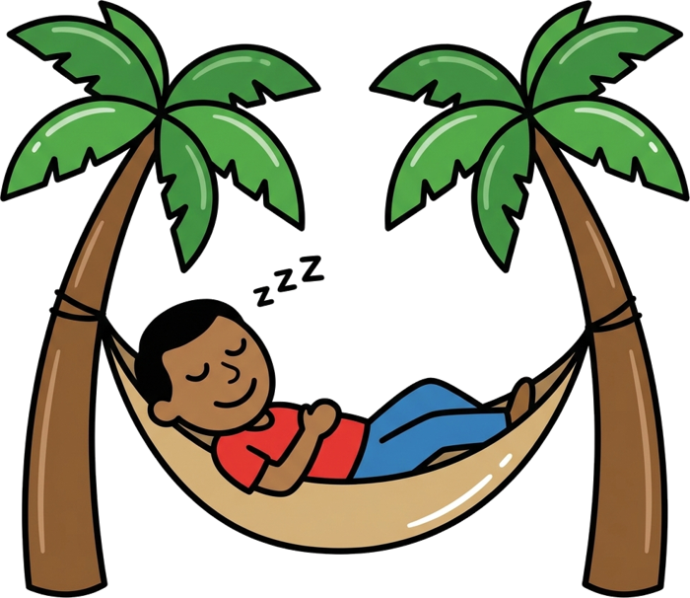
DAY 2
ROUND 2
💬 TYPE YOUR ANSWER IN THE CHAT
I say /n/ /æ/ /p/ — type the WORD!
Notes:
ROUND 2 (DAY 2 material): Blending! Say the three sounds slowly, they type the word. Answer: nap. Celebrate right answers BY NAME.

Slide 5
DAY 2
ROUND 2
✅ nap

Slide 6

DAY 3
ROUND 3
💬 TYPE YOUR ANSWER IN THE CHAT
can + magic e = type it!
Notes:
ROUND 3 (DAY 3 material): Magic E! Bonus: ask what the e says (nothing — it's silent!). Answer: cane. Celebrate right answers BY NAME.

Slide 7
DAY 3
ROUND 3
✅ cane

Slide 8

DAY 4
ROUND 4
💬 TYPE YOUR ANSWER IN THE CHAT
Which is LONG — type 1 or 2: cap … cape
Notes:
ROUND 4 (DAY 4 material): Say both words; they pick the long one. Answer: 2. Celebrate right answers BY NAME.

Slide 9
DAY 4
ROUND 4
✅ 2

Slide 10
DAY 5
ROUND 5
💬 TYPE YOUR ANSWER IN THE CHAT
💵
I say a number — type it! (listen close!)
Notes:
ROUND 5 (DAY 5 material): thirTEEN … THIRty … 15 … 50. The money round! Answer: 13 / 30. Celebrate right answers BY NAME.

Slide 11
DAY 5
ROUND 5
✅ 13 / 30
💵

Slide 12
DAY 6
ROUND 6
💬 TYPE YOUR ANSWER IN THE CHAT
🍉
Clap it — type the beats: watermelon
Notes:
ROUND 6 (DAY 6 material): wa-ter-mel-on. Chin trick if they're stuck. Answer: 4. Celebrate right answers BY NAME.

Slide 13
DAY 6
ROUND 6
✅ 4
🍉

Slide 14
DAY 7
ROUND 7
💬 TYPE YOUR ANSWER IN THE CHAT
🍌
Type beats + boss: banana
Notes:
ROUND 7 (DAY 7 material): The two-number answer they know: ba-NAN-a. Answer: 3, 2. Celebrate right answers BY NAME.

Slide 15
DAY 7
ROUND 7
✅ 3, 2
🍌

Slide 16
DAY 8
ROUND 8
💬 TYPE YOUR ANSWER IN THE CHAT
🫐
Which do you hear — 1 berry or 2 very?
Notes:
ROUND 8 (DAY 8 material): Say one of them; lips visible! Then wet/vet for round two. Answer: …. Celebrate right answers BY NAME.

Slide 17
DAY 8
ROUND 8
✅ …
🫐

Slide 18
DAY 9
ROUND 9
💬 TYPE YOUR ANSWER IN THE CHAT
💻
Decode the lazy spelling: kuhm-PYOO-ter
Notes:
ROUND 9 (DAY 9 material): They translate schwa-spelling back to the real word. Big skill! Answer: computer. Celebrate right answers BY NAME.

Slide 19
DAY 9
ROUND 9
✅ computer
💻

Slide 20
DAY 10
ROUND 10
💬 TYPE YOUR ANSWER IN THE CHAT
🤷
'I dunno' — type the REAL words!
Notes:
ROUND 10 (DAY 10 material): Fast English decoded. Bonus: whaddaya → what do you. Answer: I do not know. Celebrate right answers BY NAME.

Slide 21
DAY 10
ROUND 10
✅ I do not know
🤷

Slide 22
🏆 YOU WON THE WHOLE COURSE!
Eleven days ago: letters. Today: ENGLISH.
Notes:
Hold this slide. Let it land. Then: 'There's one more thing… have you met… CATMAN?' → 11-6.

