Slide 1
M U R R A Y ' S E N G L I S H
At the Bank
Luis opens an account 🏦
DAY 11
murraycohen.com
Notes:
FULL TREATMENT (Murray's note): vocab comparison cards → scene → slow/fast in two parts → role-play. HeyGen two-avatar video gets embedded on the scene slide when it's ready. Spelling standardized: hafta, gonna (was haf-tuh, guhnuh).

Slide 2
DAY 11
WORDS
🗣️ Today's fast words
wanna
lemme
hafta
= want to
= let me
= have to
gonna
nope
you're all set
= going to
= no (casual)
= = everything is done ✅
Notes:
Pre-teach the reduction vocabulary: choral each card, formal then fast. Every one appears in the dialogue.

Slide 3
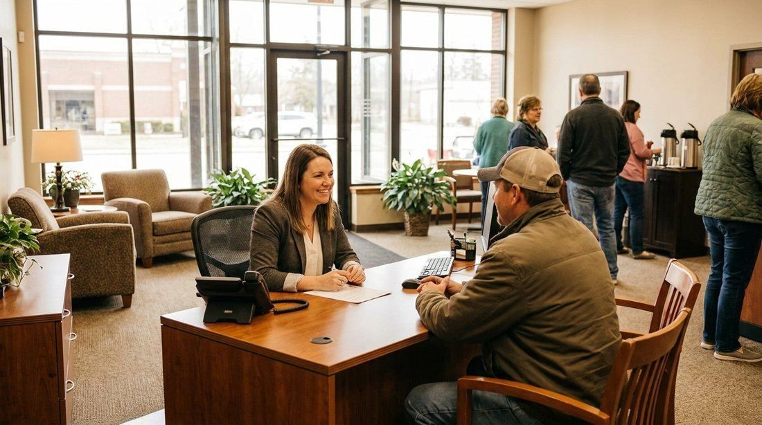
DAY 11
SCENE
Luis is opening a bank account.
What will he ask about? (fees! the card!)
Notes:
Scene + prediction: type in chat what Luis will ask about. ▶ VIDEO SLOT: when the HeyGen two-avatar video lands, it goes on this slide — watch the scene FIRST, then read it.

Slide 4
DAY 11
WATCH ▶
🎬 Watch the conversation
Notes:
Play the HeyGen video. It's interactive: the avatar speaks one role, the OTHER role appears as text for your students to say out loud in the pauses. Play once to listen, once to speak along. Then go to the slow/fast slides.

Slide 5
DAY 11
SLOW 🐢
🏦 At the Bank — part 1 — slow
Luis: Good morning. I’m here to open a new account.
Manager: Sure! Do you want to open a checking account or a savings account?
Luis: A checking account.
Manager: Okay. Let me get the forms for you.
Notes:
SLOW version first — meaning before speed. Circle: who's talking? where? what do they want? Then the fast version.

Slide 6
DAY 11
FAST 🏃
🏦 At the Bank — part 1 — fast!
Luis: Good morning. I’m here to open a new account.
Manager: Sure! You wanna open a checking account or a savings account?
Luis: A checking account.
Manager: Okay. Lemme grab the forms for you.
⚡ wanna · lemme
Notes:
FAST version: gold = melted words. Natural speed, echo line by line, then role-play. Reductions: wanna · lemme

Slide 7
DAY 11
SLOW 🐢
🏦 At the Bank — part 2 — slow
Luis: Do I have to pay a fee every month?
Manager: No — there are no fees for basic accounts.
Luis: Nice! When am I going to get my card?
Manager: In about a week.
Luis: Awesome. Thanks so much.
Manager: No problem! You’re all set.
Notes:
SLOW version first — meaning before speed. Circle: who's talking? where? what do they want? Then the fast version.

Slide 8
DAY 11
FAST 🏃
🏦 At the Bank — part 2 — fast!
Luis: Do I hafta pay a fee every month?
Manager: Nope — no fees for basic accounts.
Luis: Nice! When am I gonna get my card?
Manager: In about a week.
Luis: Awesome. Thanks so much.
Manager: No problem! You’re all set.
⚡ hafta · nope · gonna · you’re all set
Notes:
FAST version: gold = melted words. Natural speed, echo line by line, then role-play. Reductions: hafta · nope · gonna · you’re all set

Slide 9
DAY 11
PLAY
🎭 Your turn — open an account!
1 I'm the Manager — everyone is Luis (muted, big mouths!)
2 Switch! You're the Manager now.
3 Two volunteers perform — full speed! 👏
Notes:
Role-play ladder. Real-life transfer circle: who has a checking account? What did the bank ask YOU?

