Slide 1
M U R R A Y ' S E N G L I S H
Going to the Clinic
Maria & Abel talk health 🩺
DAY 11
murraycohen.com
Notes:
Full treatment: vocab → scene (video slot) → slow/fast ×2 parts → role-play.

Slide 2
DAY 11
WORDS
🗣️ Today's fast words
gotta
gonna
lemme
= have to / got to
= going to
= let me
awful
super tired
awesome
= very bad 😖
= very, very tired
= wonderful 🙌
Notes:
Pre-teach the reduction vocabulary: choral each card, formal then fast. Every one appears in the dialogue.

Slide 3
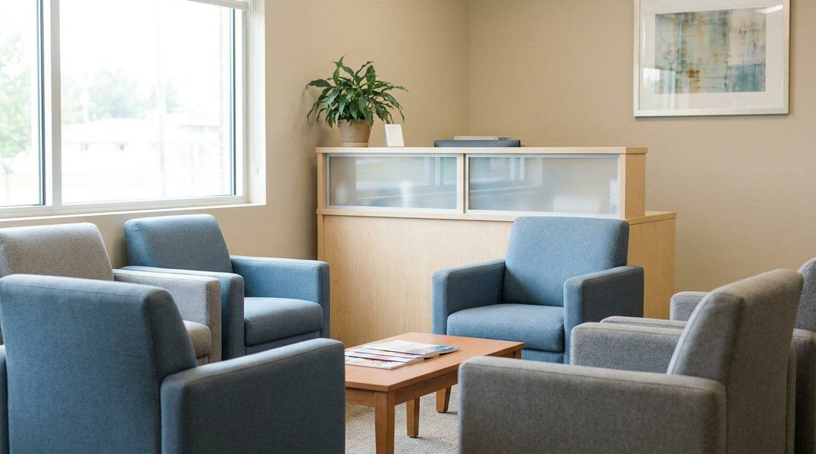
DAY 11
SCENE
Abel feels terrible. Maria is worried.
What will she tell him to do?
Notes:
Prediction in chat: what will Maria say? ▶ VIDEO SLOT: HeyGen two-avatar video goes here when ready.

Slide 4
DAY 11
SLOW 🐢
🩺 Going to the Clinic — part 1 — slow
Maria: You don’t look so good. Are you okay?
Abel: I feel awful!
Maria: Oh no. You have to see a doctor.
Abel: Yes… I think I am going to go this afternoon.
Notes:
SLOW version first — meaning before speed. Circle: who's talking? where? what do they want? Then the fast version.

Slide 5
DAY 11
FAST 🏃
🩺 Going to the Clinic — part 1 — fast!
Maria: You don’t look so good. You okay?
Abel: I feel awful!
Maria: Oh no. You gotta see a doctor.
Abel: Yeah… I think I’m gonna go this afternoon.
⚡ gotta · gonna
Notes:
FAST version: gold = melted words. Natural speed, echo line by line, then role-play. Reductions: gotta · gonna

Slide 6
DAY 11
SLOW 🐢
🩺 Going to the Clinic — part 2 — slow
Maria: What is wrong?
Abel: My head aches, and I feel super tired.
Maria: You have to rest. But let me know what the doctor says.
Abel: You are awesome. Thanks again.
Notes:
SLOW version first — meaning before speed. Circle: who's talking? where? what do they want? Then the fast version.

Slide 7
DAY 11
FAST 🏃
🩺 Going to the Clinic — part 2 — fast!
Maria: What’s wrong?
Abel: My head aches, and I feel super tired.
Maria: You gotta rest. But lemme know what the doctor says.
Abel: You’re awesome. Thanks again.
⚡ gotta · lemme · awesome
Notes:
FAST version: gold = melted words. Natural speed, echo line by line, then role-play. Reductions: gotta · lemme · awesome

Slide 8
DAY 11
PLAY
🎭 Your turn — check on a friend!
1 I'm Abel (so sick! 🤒) — everyone is Maria
2 Switch! You feel awful now.
3 Volunteers perform — drama encouraged! 👏
Notes:
Overacting encouraged — the sicker Abel sounds, the better the intonation practice. Real-life: clinic vocabulary check (appointment, fever, rest).

